Slide 1
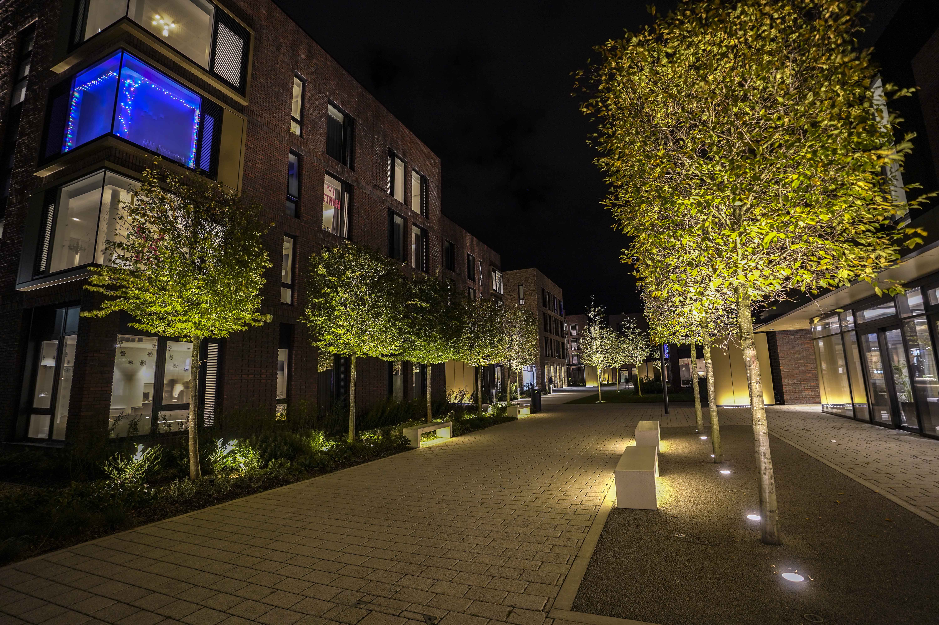
Arts University Bournemouth Staff and Student Sustainability Strategy
Collaborative efforts towards a sustainable university future
Notes:
---

Slide 2
Strategic Context and Vision
Notes:
Vision, Purpose and Policy Context

Slide 3


Vision, Purpose and Policy Context
Institutional Sustainability Commitment
  AUB commits to embedding sustainability into learning, teaching, creative practice, and campus life.
Strategic Framework and Policy
  The strategy sets a flexible, institution-wide framework aligning with environmental and carbon reduction goals.
Vision for Sustainable Creative Education
  AUB aims to lead in sustainable creative education, embedding eco-conscious practices across disciplines.
Inclusive Policy Scope and Review
  The policy covers all staff and students, complementing other institutional policies with regular reviews.
Notes:
This Staff and Student Sustainability Strategy sets out Arts University Bournemouth’s formal commitment to embedding environmental sustainability into learning, teaching, creative practice, and everyday campus life. As a specialist arts institution, AUB recognises both its responsibility and its opportunity to influence the future of the creative industries by equipping students and staff with the knowledge, skills, and behaviours required for a low-carbon, resource-efficient economy. The purpose of this strategy is to establish a clear, institution-wide framework that supports behaviour change, enables sustainable creative practice, and aligns staff and student activity with AUB’s wider environmental and carbon reduction ambitions.
The strategy functions as a policy-level document, providing strategic direction while allowing flexibility for departments, courses, and services to develop context-specific action plans. It supports AUB’s commitment to continuous environmental improvement and underpins compliance with recognised sector and international frameworks, including EAUC leadership and learning principles, AUDE estates and operations guidance, and the ISO 14001 Environmental Management System standard. Sustainability is positioned not as an add-on, but as a core institutional value that informs decision-making, resource use, and creative output.
AUB’s vision is to be a sector leader in sustainable creative education, where sustainability is embedded into studio culture, curriculum design, and professional practice. This includes recognising the environmental impacts associated with material-intensive disciplines such as fashion, film, fine art, and production design, and proactively supporting lower-impact alternatives. By engaging staff and students as active participants rather than passive recipients of policy, the strategy aims to create a shared sense of ownership and accountability.
The scope of this policy applies to all students, academic staff, professional services staff, technicians, and visiting practitioners. It complements existing institutional policies relating to estates, procurement, health and safety, and academic quality, and will be reviewed regularly to ensure alignment with evolving best practice, legislation, and sector expectations. Through this strategy, AUB commits to translating environmental responsibility into meaningful, measurable action that reflects its creative identity and civic responsibility.

Slide 4
Framework Alignment
Notes:
Alignment with EAUC, AUDE and ISO 14001

Slide 5
Alignment with EAUC, AUDE and ISO 14001
Framework | Key Focus Areas | Strategy Alignment
EAUC | Leadership, Learning, Engagement | Curriculum integration, staff and student leadership, sustainability culture
AUDE | Estates, Energy, Waste, Resources | Behaviour change, materials reuse, sustainable studio and production practices
ISO 14001 | Environmental Management Systems | Policy commitment, targets, monitoring, continuous improvement
Notes:
This strategy has been explicitly mapped against three key sustainability frameworks to ensure robustness, credibility, and sector alignment: EAUC (The Alliance for Sustainability Leadership in Education), AUDE (Association of University Directors of Estates), and ISO 14001 (Environmental Management Systems). Together, these frameworks provide a comprehensive structure covering leadership, learning, operational performance, and continuous improvement.
EAUC emphasises whole-institution approaches to sustainability, particularly the integration of sustainability into education, leadership, and engagement. This strategy responds directly by prioritising curriculum integration, staff and student leadership, and cultural change. By embedding sustainability learning outcomes across creative programmes and supporting student-led initiatives, AUB aligns with EAUC’s core principles of leadership, learning, and engagement.
AUDE focuses on the sustainability of university estates and operations, including energy, waste, water, and resource management. While this strategy is staff- and student-focused, it complements AUDE priorities by explicitly linking behaviour change to operational performance. Actions such as energy-conscious studio use, materials reuse schemes, and sustainable production guidelines directly support estates-led environmental objectives and encourage shared responsibility for campus performance.
ISO 14001 provides a formal management system framework based on policy commitment, planning, implementation, monitoring, and continuous improvement. This strategy operates as a supporting policy within AUB’s wider environmental management system, reinforcing the Plan–Do–Check–Act cycle. Clear objectives, defined responsibilities, measurable targets, and annual review mechanisms ensure that staff and student sustainability activity contributes to demonstrable environmental improvement and regulatory compliance.
By aligning with these frameworks, AUB ensures that its sustainability ambitions are not only aspirational but also auditable, measurable, and embedded within recognised best practice. This alignment strengthens institutional resilience, enhances external credibility, and provides a clear structure for governance, reporting, and continual enhancement.

Slide 6
Strategic Themes
Notes:
Embedding Sustainability in Creative Practice and Learning

Slide 7

Embedding Sustainability in Creative Practice and Learning
Sustainable Creative Practice
  Sustainability is integrated into studio culture and production, shared by students, staff, and technical teams.
Curriculum Integration
  All courses embed sustainability learning relevant to their discipline, supported by staff development.
Interdisciplinary Collaboration
  Encouraging cross-discipline projects to tackle complex sustainability challenges innovatively.
Creative Leadership and Influence
  Graduates lead in environmental responsibility, shaping industry norms and cultural change.
Notes:
A core strategic theme of this policy is the integration of sustainability into creative practice and learning. At AUB, sustainability must be relevant to studio culture, workshops, and production environments where the majority of environmental impacts occur. This strategy therefore prioritises sustainable creative practice as a shared responsibility between students, academic staff, and technical teams.
Curriculum integration is a key mechanism for achieving this objective. All courses are expected to embed sustainability learning outcomes that are appropriate to their discipline and level of study. This may include design for circularity in fashion, low-impact materials selection in fine art, sustainable set construction in performance, or carbon-aware production planning in film and media. Staff will be supported through professional development opportunities that build confidence in teaching sustainability within creative contexts.
The strategy also recognises the importance of interdisciplinary collaboration. Many sustainability challenges faced by the creative industries are complex and systemic, requiring collaboration across disciplines. By encouraging interdisciplinary projects and briefs, AUB can mirror real-world creative practice while fostering innovative, sustainability-led solutions.
Importantly, this theme acknowledges that sustainability in the arts is not solely about reducing harm, but also about creative leadership and influence. Graduates who understand environmental responsibility are better equipped to shape industry norms, challenge unsustainable practices, and contribute to cultural change. Through this policy, AUB commits to ensuring that sustainability is a defining graduate attribute, reinforcing the university’s reputation as a forward-thinking, responsible creative institution.

Slide 8
Behaviour Change and Engagement
Notes:
Staff and Student Behaviour Change on Campus

Slide 9
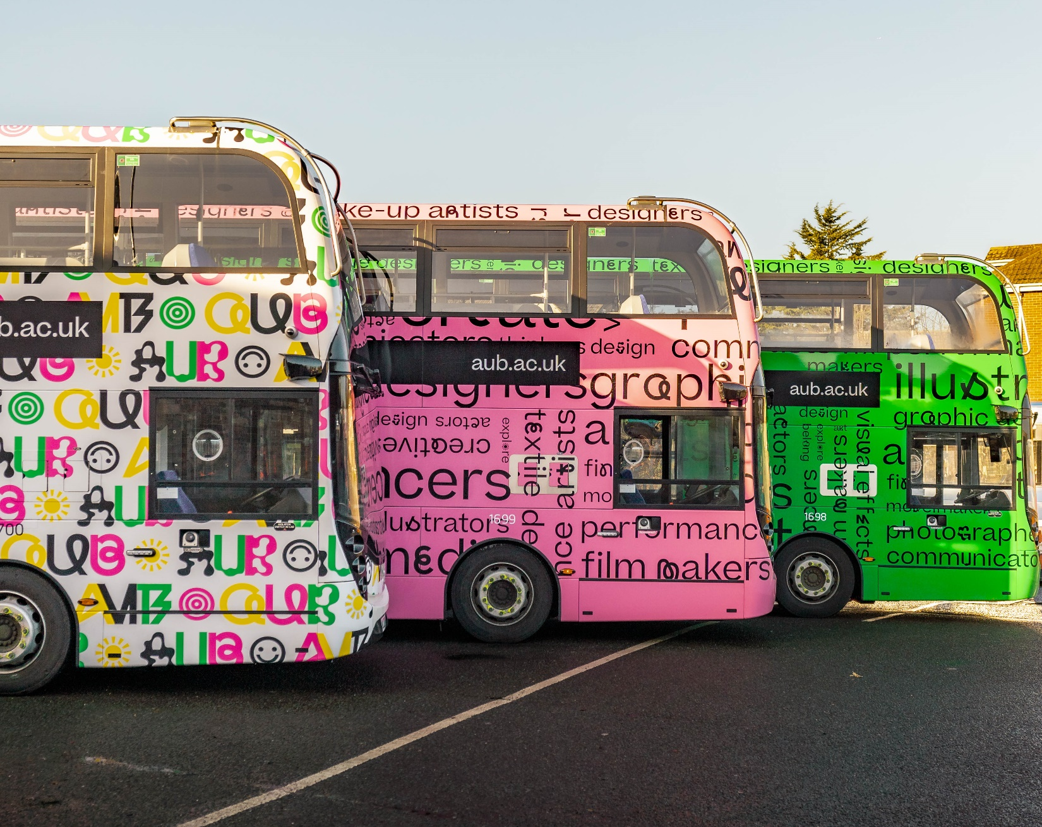
Staff and Student Behaviour Change on Campus
Shared Responsibility for Sustainability
  Behaviour change is essential and shared among staff and students to reduce energy use, waste, and resource consumption on campus.
Engagement and Behavioural Nudges
  Targeted campaigns use creative messaging and behavioural nudges like signage and feedback to encourage eco-friendly habits.
Leadership and Peer Influence
  Sustainability Champions and Green Ambassadors lead peer engagement to embed sustainable habits throughout the campus community.
Recognition and Cultural Shift
  Celebrating sustainable projects and practices helps normalize eco-friendly behaviour as part of campus culture.
Notes:
Behaviour change is central to delivering meaningful sustainability outcomes and is a primary focus of this staff and student strategy. While infrastructure and systems are critical, day-to-day decisions made by individuals significantly influence energy use, waste generation, and resource consumption. This policy therefore establishes behaviour change as a shared institutional responsibility.
Targeted engagement campaigns will address key impact areas such as energy use in studios and workshops, waste segregation, materials reuse, and responsible printing. Campaigns will be designed using clear, creative communication that resonates with AUB’s visual culture and avoids overly technical messaging. Behavioural nudges, such as signage, prompts, and feedback dashboards, will be used to reinforce positive actions and make sustainable choices the default option.
Student and staff leadership is essential to embedding long-term change. Sustainability Champions and Green Ambassadors will be supported to act as role models within courses, departments, and services. These roles will help translate policy into practice by encouraging peer-to-peer engagement and identifying opportunities for improvement at a local level.
Recognition and reward mechanisms will further support behaviour change. Celebrating sustainable creative work, responsible studio practice, and innovative student-led initiatives helps normalise sustainability as a valued part of AUB’s culture. Over time, the aim is to move from short-term campaigns to sustained cultural norms, where environmentally responsible behaviour is embedded into everyday creative practice and campus life.

Slide 10
Targets and Metrics
Notes:
Specific Sustainability Targets and Performance Indicators

Slide 11

Specific Sustainability Targets and Performance Indicators
Waste Reduction Targets
  Aim for a 60% reduction in non-hazardous creative waste per student by 2030 and achieve a 60% campus-wide recycling rate.
Energy Consumption Metrics
  Focus on reducing energy use per student and per studio square meter, supported by behavior change initiatives.
Engagement and Participation
  Target at least 75% student and staff engagement in sustainability activities by 2028 to foster community involvement.
Curriculum Integration
  Achieve 100% of courses embedding sustainability learning outcomes by 2027, plus sustainability-focused creative projects annually.
Notes:
To ensure accountability and alignment with ISO 14001 principles, this strategy establishes clear targets and metrics that link staff and student activity to measurable environmental outcomes. Targets are designed to be ambitious yet achievable, supporting AUB’s longer-term net zero pathway while recognising the specific context of creative education.
Key waste-related targets include a 50% reduction in non-hazardous creative waste per student by 2030, measured against a defined baseline, and a campus-wide recycling rate of at least 70%. Materials reuse schemes, such as a central Materials Exchange, will be monitored through participation rates and volume of materials diverted from disposal.
Energy-related metrics will focus on reducing energy consumption per student and per square metre of studio space, with a target of year-on-year reductions supported by behaviour change initiatives. Engagement metrics will include the proportion of students and staff participating in sustainability activities, with a target of at least 75% engagement by 2028.
Curriculum metrics will track the percentage of courses with embedded sustainability learning outcomes, with a target of 100% by 2027. Additional indicators will include the number of sustainability-focused creative projects, exhibitions, and productions delivered annually.
Performance against these targets will be reviewed annually and reported through institutional governance structures. Where targets are not being met, corrective actions will be identified in line with continuous improvement principles, ensuring that this strategy remains a living, responsive policy document rather than a static statement of intent.

Slide 12
Governance and Responsibilities
Notes:
Roles, Responsibilities and Policy Governance

Slide 13

Roles, Responsibilities and Policy Governance
Governance and Accountability
  University Executive holds overall accountability, ensuring the strategy aligns with institutional priorities and resources.
Operational Leadership
  A Sustainability Lead coordinates implementation with academic, estates, and professional services teams for effective delivery.
Steering Group Oversight
  Cross-university Sustainability Steering Group monitors progress and ensures compliance with environmental standards and frameworks.
Community Engagement and Roles
  Academic departments embed sustainability in curricula; students actively participate in projects and governance.
Notes:
Effective governance is essential to the successful implementation of this Staff and Student Sustainability Strategy. Overall accountability for the strategy sits with the University Executive, ensuring alignment with institutional priorities and resource allocation. Operational responsibility is delegated to a designated Sustainability Lead, working in collaboration with academic, estates, and professional services teams.
A cross-university Sustainability Steering Group will oversee delivery, monitor progress against targets, and ensure alignment with EAUC, AUDE, and ISO 14001 requirements. The group will include representation from academic staff, technicians, professional services, and students, reflecting the shared nature of sustainability responsibility at AUB.
Academic departments are responsible for embedding sustainability into curricula and creative practice, supported by staff development and guidance. Professional services and estates teams will provide data, technical expertise, and operational support, enabling staff and students to align behaviour with environmental performance objectives.
Students are recognised as active partners in delivery, not passive recipients of policy. Through representation, sustainability roles, and project-based learning, students will contribute directly to implementation and review. Clear reporting lines, documented responsibilities, and regular review cycles ensure that this strategy operates as a formal policy instrument within AUB’s governance framework.

Slide 14
Review and Continuous Improvement
Notes:
Monitoring, Review and Continuous Improvement

Slide 15

Monitoring, Review and Continuous Improvement
Annual Data Monitoring
  Performance data is collected yearly to track progress, identify risks, and enable corrective actions.
Sustainability Performance Summary
  An annual summary highlights achievements, challenges, and future priorities shared with staff and students.
Periodic Formal Review
  Strategy undergoes formal review every three years or as needed based on legislation or priorities.
Engagement and Continuous Improvement
  Feedback from stakeholders ensures the strategy remains relevant, inclusive, and drives long-term improvement.
Notes:
In line with ISO 14001 principles, this strategy is underpinned by a commitment to monitoring, review, and continuous improvement. Performance data relating to targets and metrics will be collected annually and reviewed by the Sustainability Steering Group to assess progress, identify risks, and agree corrective actions where required.
An annual sustainability performance summary will be produced, highlighting achievements, challenges, and priority actions for the following year. This summary will be communicated to staff and students using accessible, creative formats that reflect AUB’s identity and encourage ongoing engagement.
Formal review of the strategy will take place on a three-year cycle, or sooner where significant changes in legislation, institutional priorities, or sector guidance occur. Feedback from staff and students will be actively sought as part of the review process, ensuring that the strategy remains relevant, inclusive, and effective.
Through this structured approach to review and improvement, AUB ensures that sustainability remains embedded within institutional culture and decision-making. The strategy therefore operates not only as a policy commitment, but as a practical mechanism for driving long-term environmental performance and creative leadership in sustainability.

