Slide 1
Environment and Sustainability Annual Report 2024/25

Slide 2
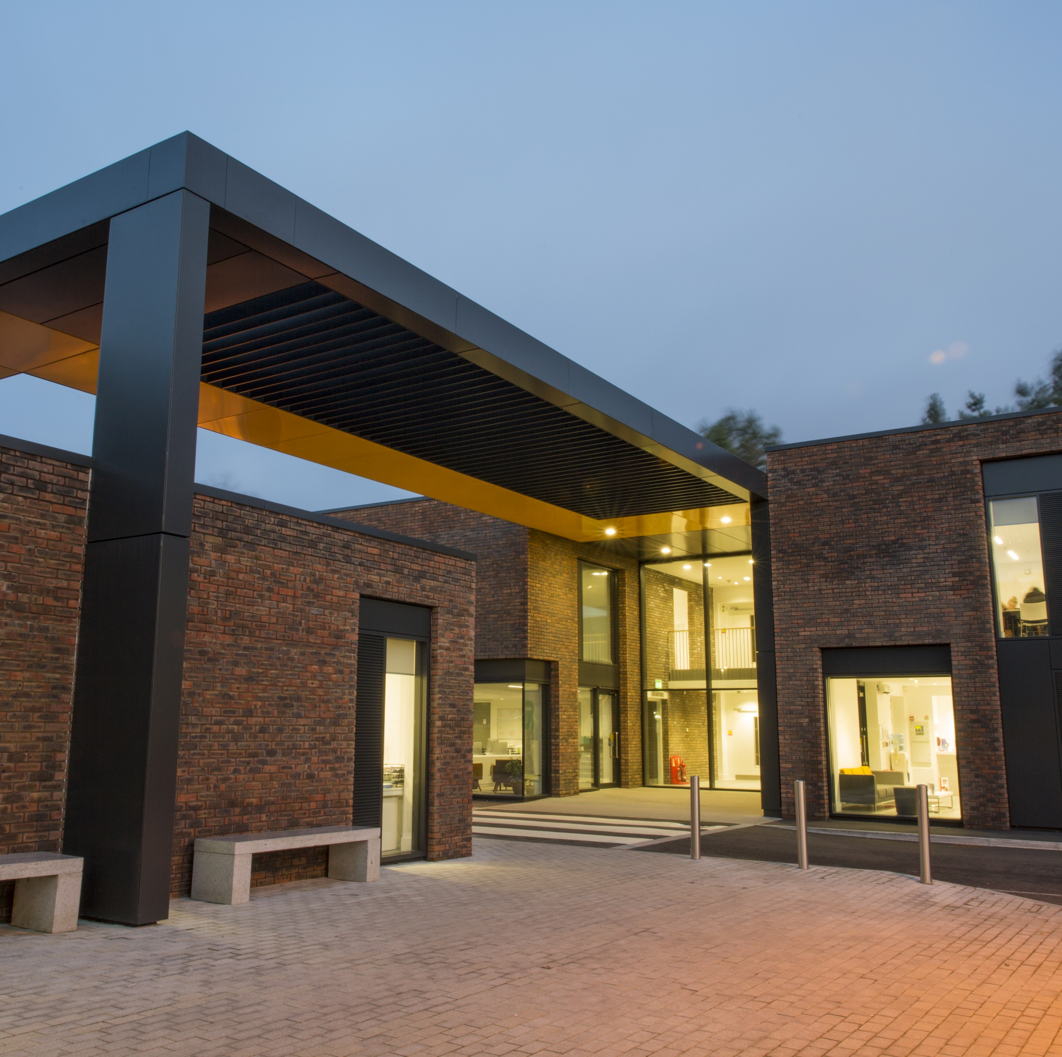
Contents
Message from the Vice-Chancellor and CEO
Introduction
Net Zero Summary
Net Zero in Numbers
Carbon Neutral and Offsetting
Water and Energy
Sustainable Resource Management
Travel
Sustainable Campus
Biodiversity
Social Justice
Supplementary Information
About This Report

Slide 3
Message from the Vice-Chancellor and CEO
At the heart of the AUB Strategy are four core values that guide our practices and behaviours. Of the four, our value of staying 'connected' speaks powerfully towards the AUB Sustainability Programme, and our ambitions towards neutrality:
"We are better for our diversity. We are enriched by the depth of respect we have for each other and the strength of our relationships with our people, our places and with the planet. Through our commitment to working with those who are different to us, or challenge us, we grow stronger together, creating new synergies, global connections and sustainable futures."
Our commitment to an environmentally sustainable future builds on significant achievements at AUB over the past five years. Having already achieved ISO14001:2015 and platinum status as an Eco-Campus, during the lifetime of this Strategy, we will embrace the spirit and practices of the United Nations Sustainable Development Goals across all aspects of AUB’s teaching, research and engagement. We are already seeing this in the new undergraduate curriculum, which staff have co-designed.
We have shown real commitment in becoming a signatory of the Global Climate Letter for Universities and Colleges, issued through EAUC (Environment Association for Universities and Colleges), and AUB has committed to reach net zero by 2030. We have gained certification as a registered Fairtrade university. During 2020/21 AUB was presented on the global Fairtrade website as one of three HEI case studies for Fairtrade. We create a great many environmentally sensitive and progressive projects across the University, through AUB Human and through live and simulated briefs These will continue to expand and deepen.
These are all significant achievements for which AUB ought to feel proud. But there is always more to do. The programmes of work set out in the document will be supported by the University and our Board of Governors as we move creatively - and credibly - towards a sustainable and net zero future.

Slide 4

Introduction
Insert Picture
Arts University Bournemouth (AUB) acknowledges global climate change and the ecological crisis and wishes to play its part in mitigating against unwanted outcomes of these issue’s. Furthermore, AUB is aware of its own environmental impacts, through operational practices and capital projects, and is committed to eliminating, reducing or compensating where this is not possible, these impacts in an innovative, efficient, and transparent way.
Our Sustainability and Net Zero (SNZ) Programme of works is AUBs response to mitigate and adapt to these impacts. Furthermore, it promotes our aim for an inclusive, innovative, creative, and connected campus.

Slide 5
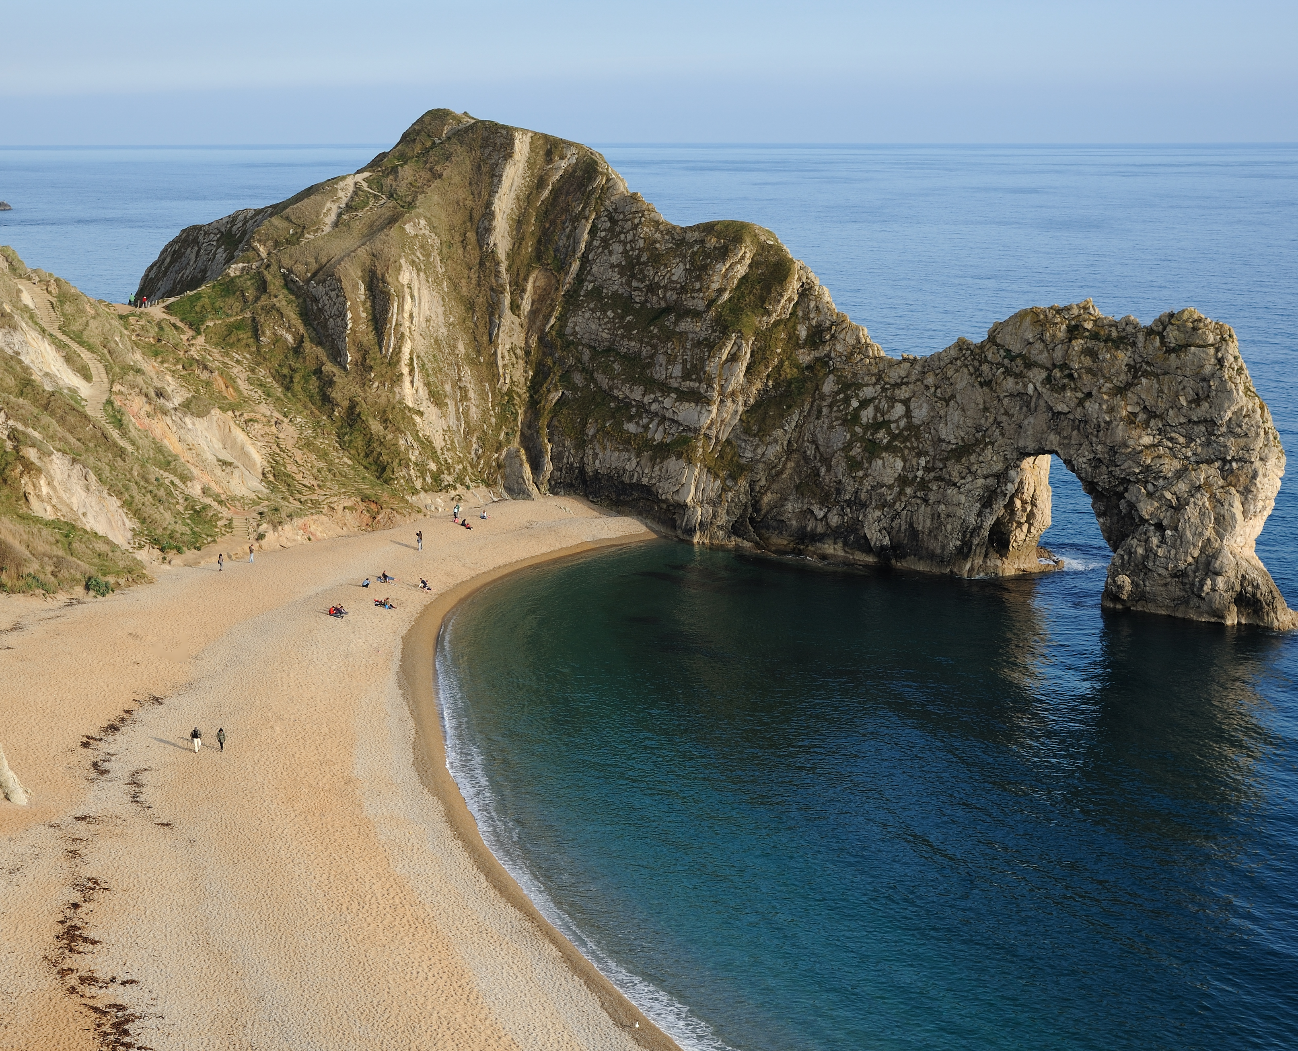
Introduction
Here we report on our actual greenhouse gas (GHG) equivalents emissions and evaluate against the targets that we have set. We use the Higher Education sector Standardised Carbon Emissions (Reporting) Framework for our emissions inventory, which covers all the emission scopes.
This is our annual report for the 2024-2025 academic year. This report will inform students, staff, and community how we are progressing against climate change impacts, the biodiversity crisis, and social justice targets and is structured around a net zero summary and our six main areas of focus.

Slide 6
Water and Energy
Sustainable Resource Management
Travel
WATER
and
ENERGY
WASTE
ENERGY AND
WATER
T
R
A
V
E
L
TRAVEL
Sustainable Campus
Biodiversity
Social Justice
BIODIVERSITY
SOCIAL JUSTICE
SUSTAINABLE CAMPUS

Slide 7

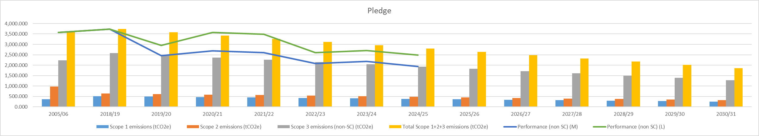
Net Zero Summary
The SNZ is now into its sixth year, and emissions have decreased from our baseline year of 2018/19.
Our emissions have decreased in 2024/25 compared with 2023/24. Electricity use has increased with the installation of an ASHP, but this is more than offset by a significant decrease in gas usage. Home student travel has also slightly increased but only by natural student number fluctuations.
Gas, fleet vehicles, water, wastewater, waste, staff commute, and student commuting emissions have all decreased ensuring AUB now reports a 48% emissions reduction from 2018/19 baseline.
Our 2030/31 aim:
50% Emissions reduction from 2018/19 baseline
Performance:
48% Market-Based reduction from our 2018/19 baseline
Performance:
34% Location-Based reduction from our 2018/19 baseline

Slide 8

Net Zero Summary
We have seen an overall decrease in emissions for 2024/25 compared to the previous reported year (decrease of 224.194tCO2e Location-Based (L) and 234.885tCO2e Market-Based (M)).
AUB is still performing well against the Science-Based-Target (SBT). AUB is 310.636tCO2e (L) and 854.797tCO2e (M) below the SBT.
AUB in 2024/25 is1,252.406tCO2e (L) and1,796.567tCO2e (M) below SBT 2018/19 baseline.
Student emissions when travelling to university from home address has increased in 2024/25 from last year by 19.687tCO2e. This will naturally fluctuate each year and in line with AUBs international recruitment strategy should not be relied upon to achieve net zero.
Business travel has decreased from last year by 26.032tCO2e although this likely fluctuate year on year.
2024/25 business travel emissions are still 231.069tCO2e lower than the 2018/19 baseline.
Staff commuting emissions decreased significantly by 82.458tCO2e reflecting on campus/working from home policy and EV car use.
Water and wastewater emissions have decreased in 2024/25 also, but
AUB fleet vehicle emissions have decreased in 2024/25 compared to previous year by 2.186tCO2e reflecting the transition to electric vehicles.

Slide 9
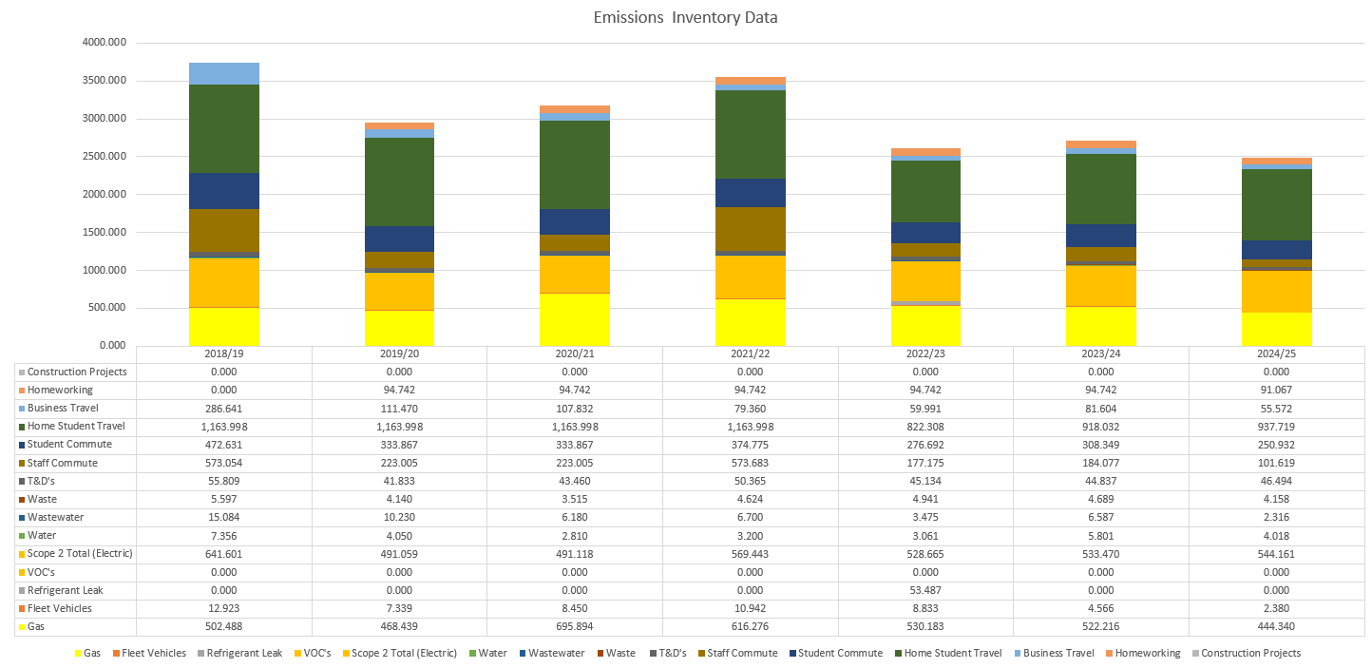
Net Zero in Numbers (Location-Based Data)

Slide 10




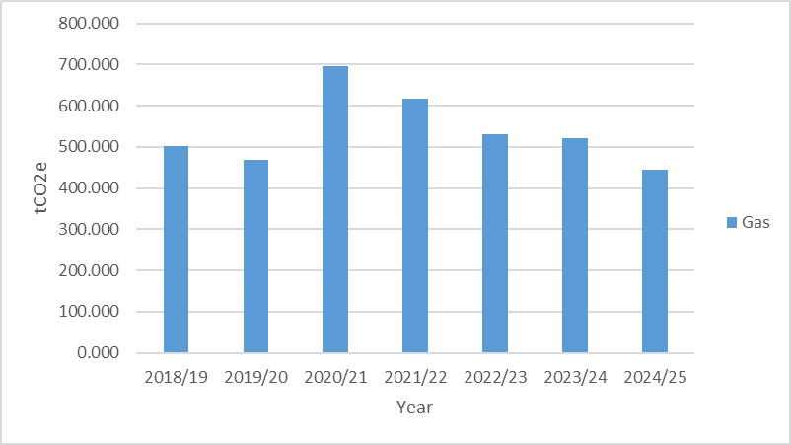
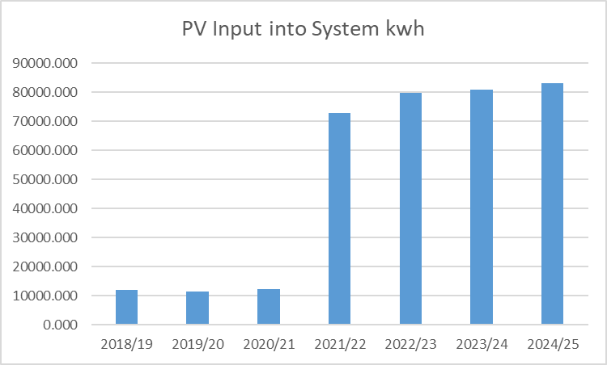
Energy and Water
PV infrastructure has not changed so produces similar energy.
AUB purchases REGO electricity, which is (Market-Based) zero emissions. Electricity use has increased raising emissions by 10.691tCO2e. This reflects the part use in the year of the ASHP technology.
Gas emissions have significantly decreased by 77.876tCO2e. This is likely due to the ASHP although multi-year data will be needed to confirm this.
Water use has decreased reducing emissions by 1.783tCO2e although caution is still needed due to estimations in use.

Slide 11


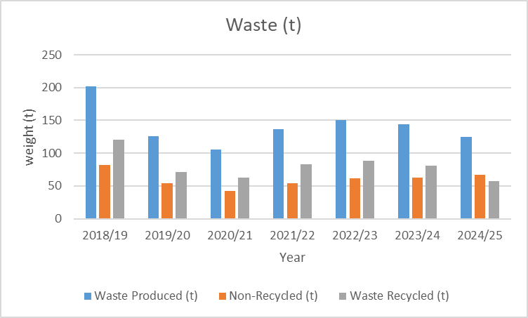
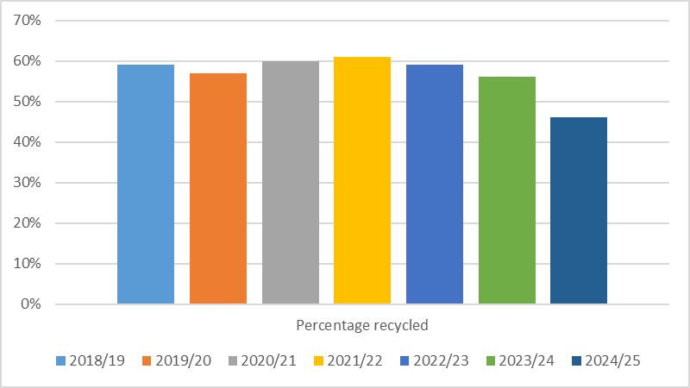
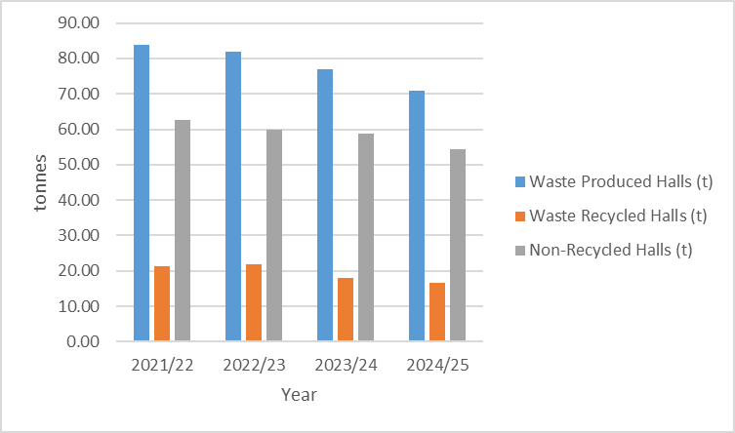
Sustainable Resource Management
Our overall waste (t) has decreased in 2024/25 compared with previous year by 18.962 tonnes.
Our recycling rate has dropped to 46%. This is the lowest it has been since and including the baseline year and demonstrates a year on year drop since 2021/22. This does not include halls accommodation. AUB would like to see recycling rate increase but likely correlates to the overall reduction in waste – suggesting reuse.
Accommodation recycling rate is 23%, which is regular figure for accommodation.

Slide 12

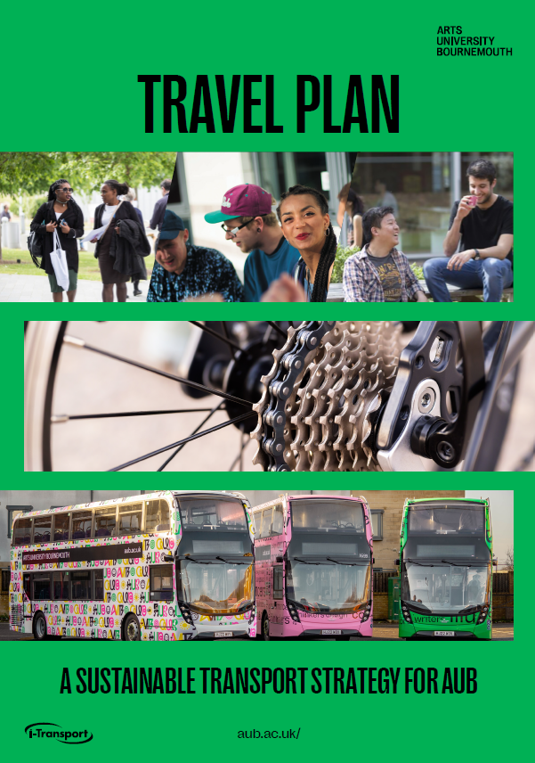
Travel
New Travel Plan was created in 2023/24
Cyclescheme is part of the constitution of Travel to AUB and is a staff employee benefit saving 26-40% savings on bicycles and accessories with payments being tax efficient from salary. The cap on the amount that can be claimed overall increased by 20% to allow for good quality electric bikes to be purchased through the scheme.
Once a month we have a Cycle Surgery where students and staff can visit for free to get maintenance and repairs on bicycles. We have two Beryl Bike stands/hubs for bicycles and scooters. One is by Campus Services and the other located by Campus Halls car park. We give away free minute bundles throughout the year with the codes advertised through social media and physical adverts.

Slide 13
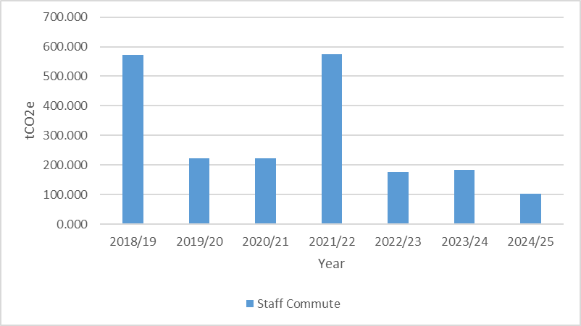
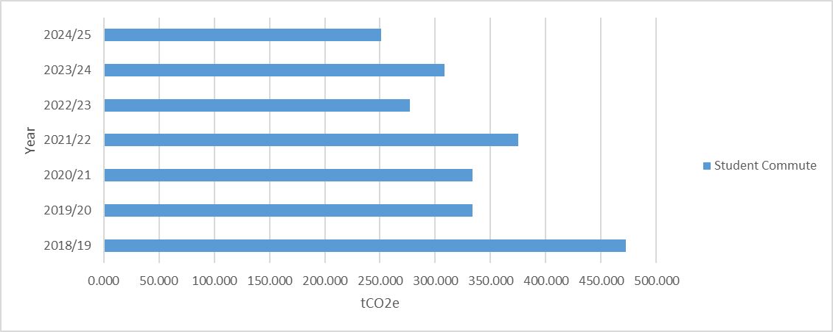
Travel
A new online Travel to AUB system is now fully functional for staff. It involves a process of logging on and then being informed and directed about all the sustainable travel methods and incentives available to staff. These include shower, locker, and changing facilities, Cyclescheme, Beryl Bike, bus permit, and finally car permit.
The car permit cost involves an offset cost for the commuting emissions for the year. The portal data accuracy has significantly lowered emissions from staff travel.

Slide 14
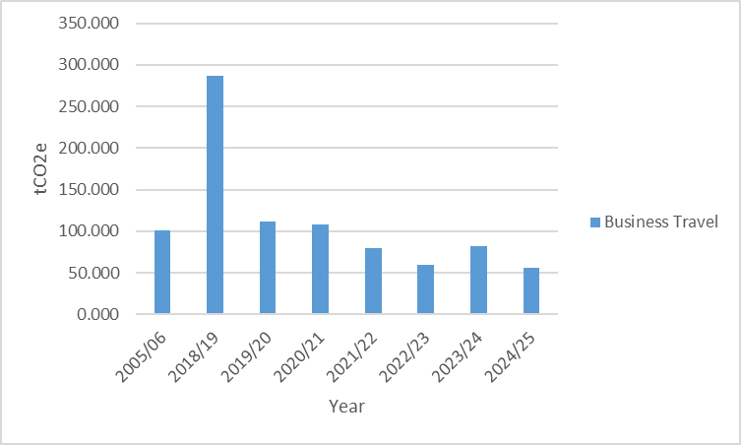
Travel
AUB collaborates with BU for the Unibus service with fantastic savings for students and a discount permit for staff.
AUB is represented on the Transforming Travel - Transforming Cities Fund.
Business Travel has decreased in 2024/25 but is within the parameters of natural annual fluctuation.
Fleet cars are all electric with one hybrid and the reduction in fleet vehicle emissions reflects this.

Slide 15











Sustainable Campus
AUB was awarded a First university ranking in the People & Planet University League and joint first for Carbon Reduction in the UK.
The university ranked highly in several categories including Auditing and EMS, Environmental Policy, and Sustainability Staff.
AUB maintained its ISO14001:2015 certification and EcoCampus Platinum award in 2023/24.

Slide 16
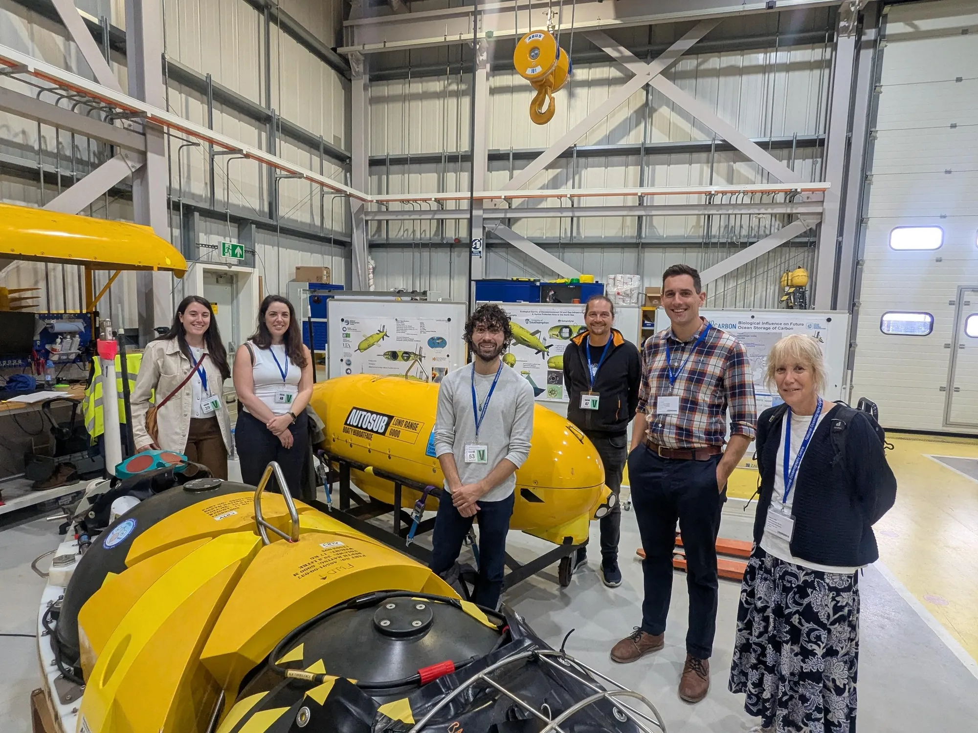
Sustainable Campus
The NOC, funded by UK Research and Innovation, delivers National Capability programmes and operates the National Marine Equipment Pool—Europe’s largest fleet of autonomous marine vehicles—as well as the research ships RRS Discovery and RRS James Cook.
A new partnership between the NOC Innovation Hub and AUB Innovation Studio will combine NOC’s marine technology expertise with AUB’s design-led innovation to support sustainable ocean solutions and the growing blue economy. In June, the AUB team visited the NOC to begin creating a full‑scale display replica of one of its underwater Gliders.
These robotic vehicles measure ocean conditions such as chlorophyll, temperature, and salinity, sending data back to shore for effective long-term monitoring.

Slide 17

Sustainable Campus
Writing the Earth is an annual celebration of creativity that explores environmental issues.
Every year, on and around Earth Day, a programme of events are created comprising author talks, readings, workshops, book launches, and open mics.
These take place online and on campus at Arts University Bournemouth, and are convened by Dr Kevan Manwaring, Course Leader, MA Creative Writing.

Slide 18

Sustainable Campus
Industry experts, academics, and community members gathered at AUB to launch PlastIC, a new research centre focused on plastics innovation, sustainability, and curation. Supported by a £1.6 million Research England grant, PlastIC brings together AUB’s Museum of Design in Plastics and the Innovation Studio to explore how plastics behave, degrade, and can be reused.
Its work aims to support sustainable manufacturing, improve plastics conservation, and advance circular‑economy practices. At the launch, Circular11 founder Connor Winter highlighted how the centre will help accelerate their recycling technology, which transforms waste‑bound plastics into low‑carbon products.
With its new materials lab now active, PlastIC is beginning projects that will shape the future of plastic sustainability, recycling, and lifecycle design.

Slide 19
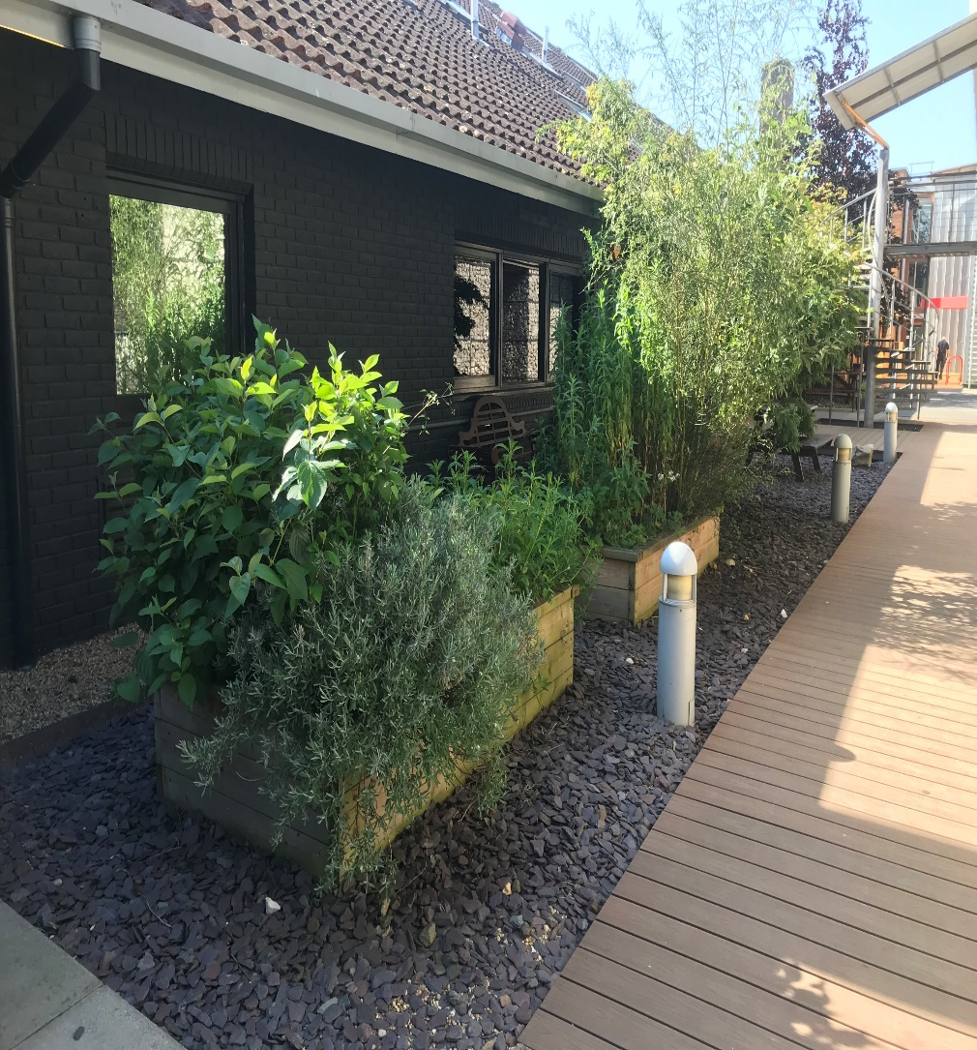
Biodiversity
There are insect hotels throughout the campus and solitary bee tubes in the side of Campus Services and AUBSU. We have also registered our hedgerows through national survey with all hedgerows being species/habitat friendly. AUB has introduced an Herb Garden that is being used by our Catering contractor to use in the daily menu’s.
There are bird, bat, and hedgehog houses featured throughout the main campus and at Elliott Road studios. Two compost bins are on campus for ‘garden’ waste.

Slide 20

Social Justice
AUB is a Champion of the Dorset Sustainable Palm Oil initiative.
Food bank available in Library (access for all the community to use).
University Retreat: for student mental health.
Fairtrade events and campaigns held during the two-year timeframe. Two information campaigns were held to take Fairtrade to people rather than host events for people to attend. One of the campaigns include an ‘information blast’ where for a few days it was included throughout the campus. Survey demonstrates that students are committed to AUB remaining a Fairtrade university alongside ethical procurement. There is still scope to improve awareness through future events and campaigns.

Slide 21
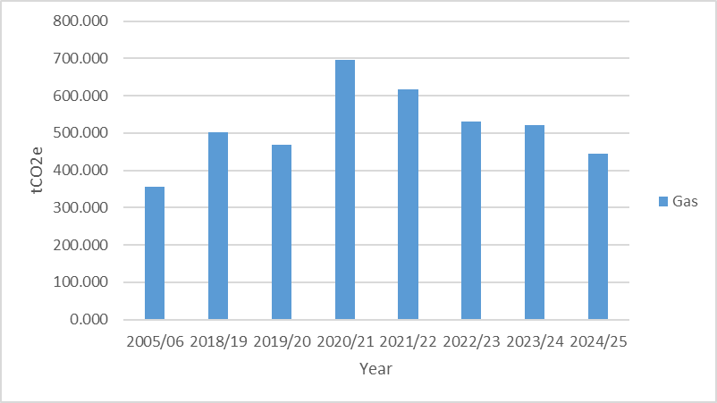
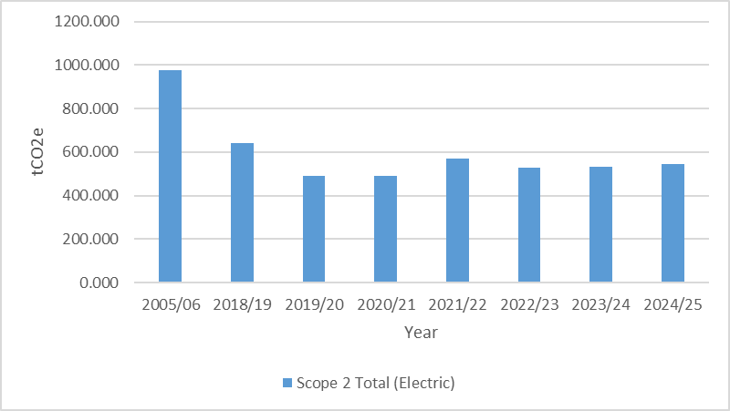
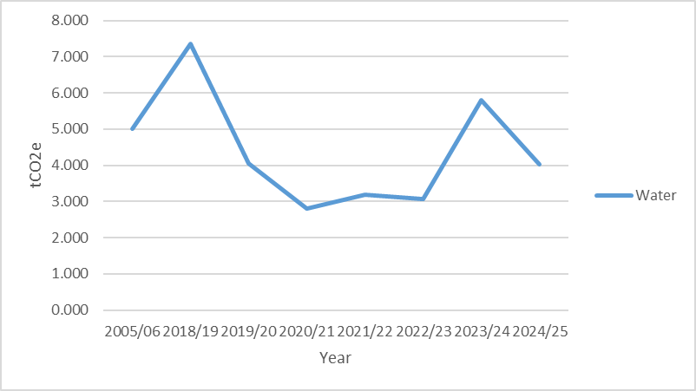
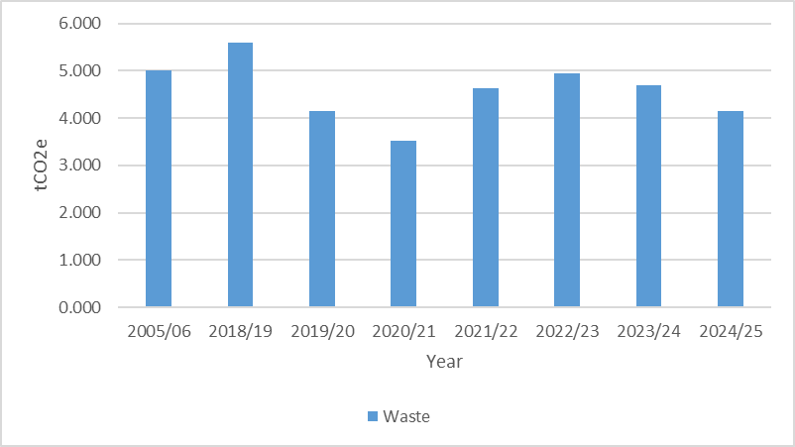
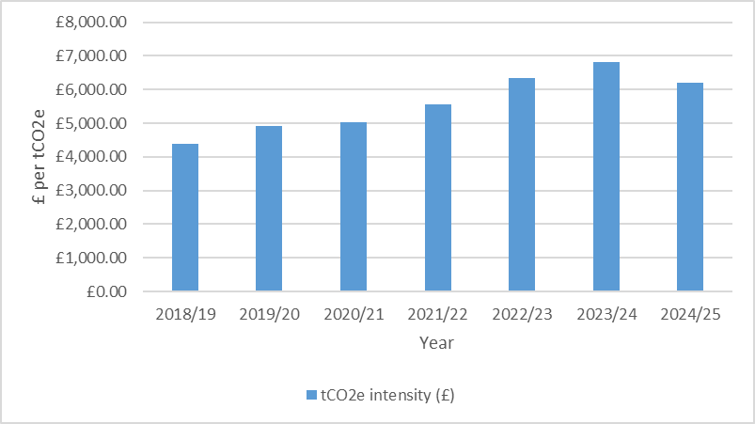
Supplementary Information
WATER
and
ENERGY
WASTE
ENERGY AND
WATER
T
R
A
V
E
L
TRAVEL
BIODIVERSITY
SOCIAL JUSTICE
SUSTAINABLE CAMPUS

Slide 22
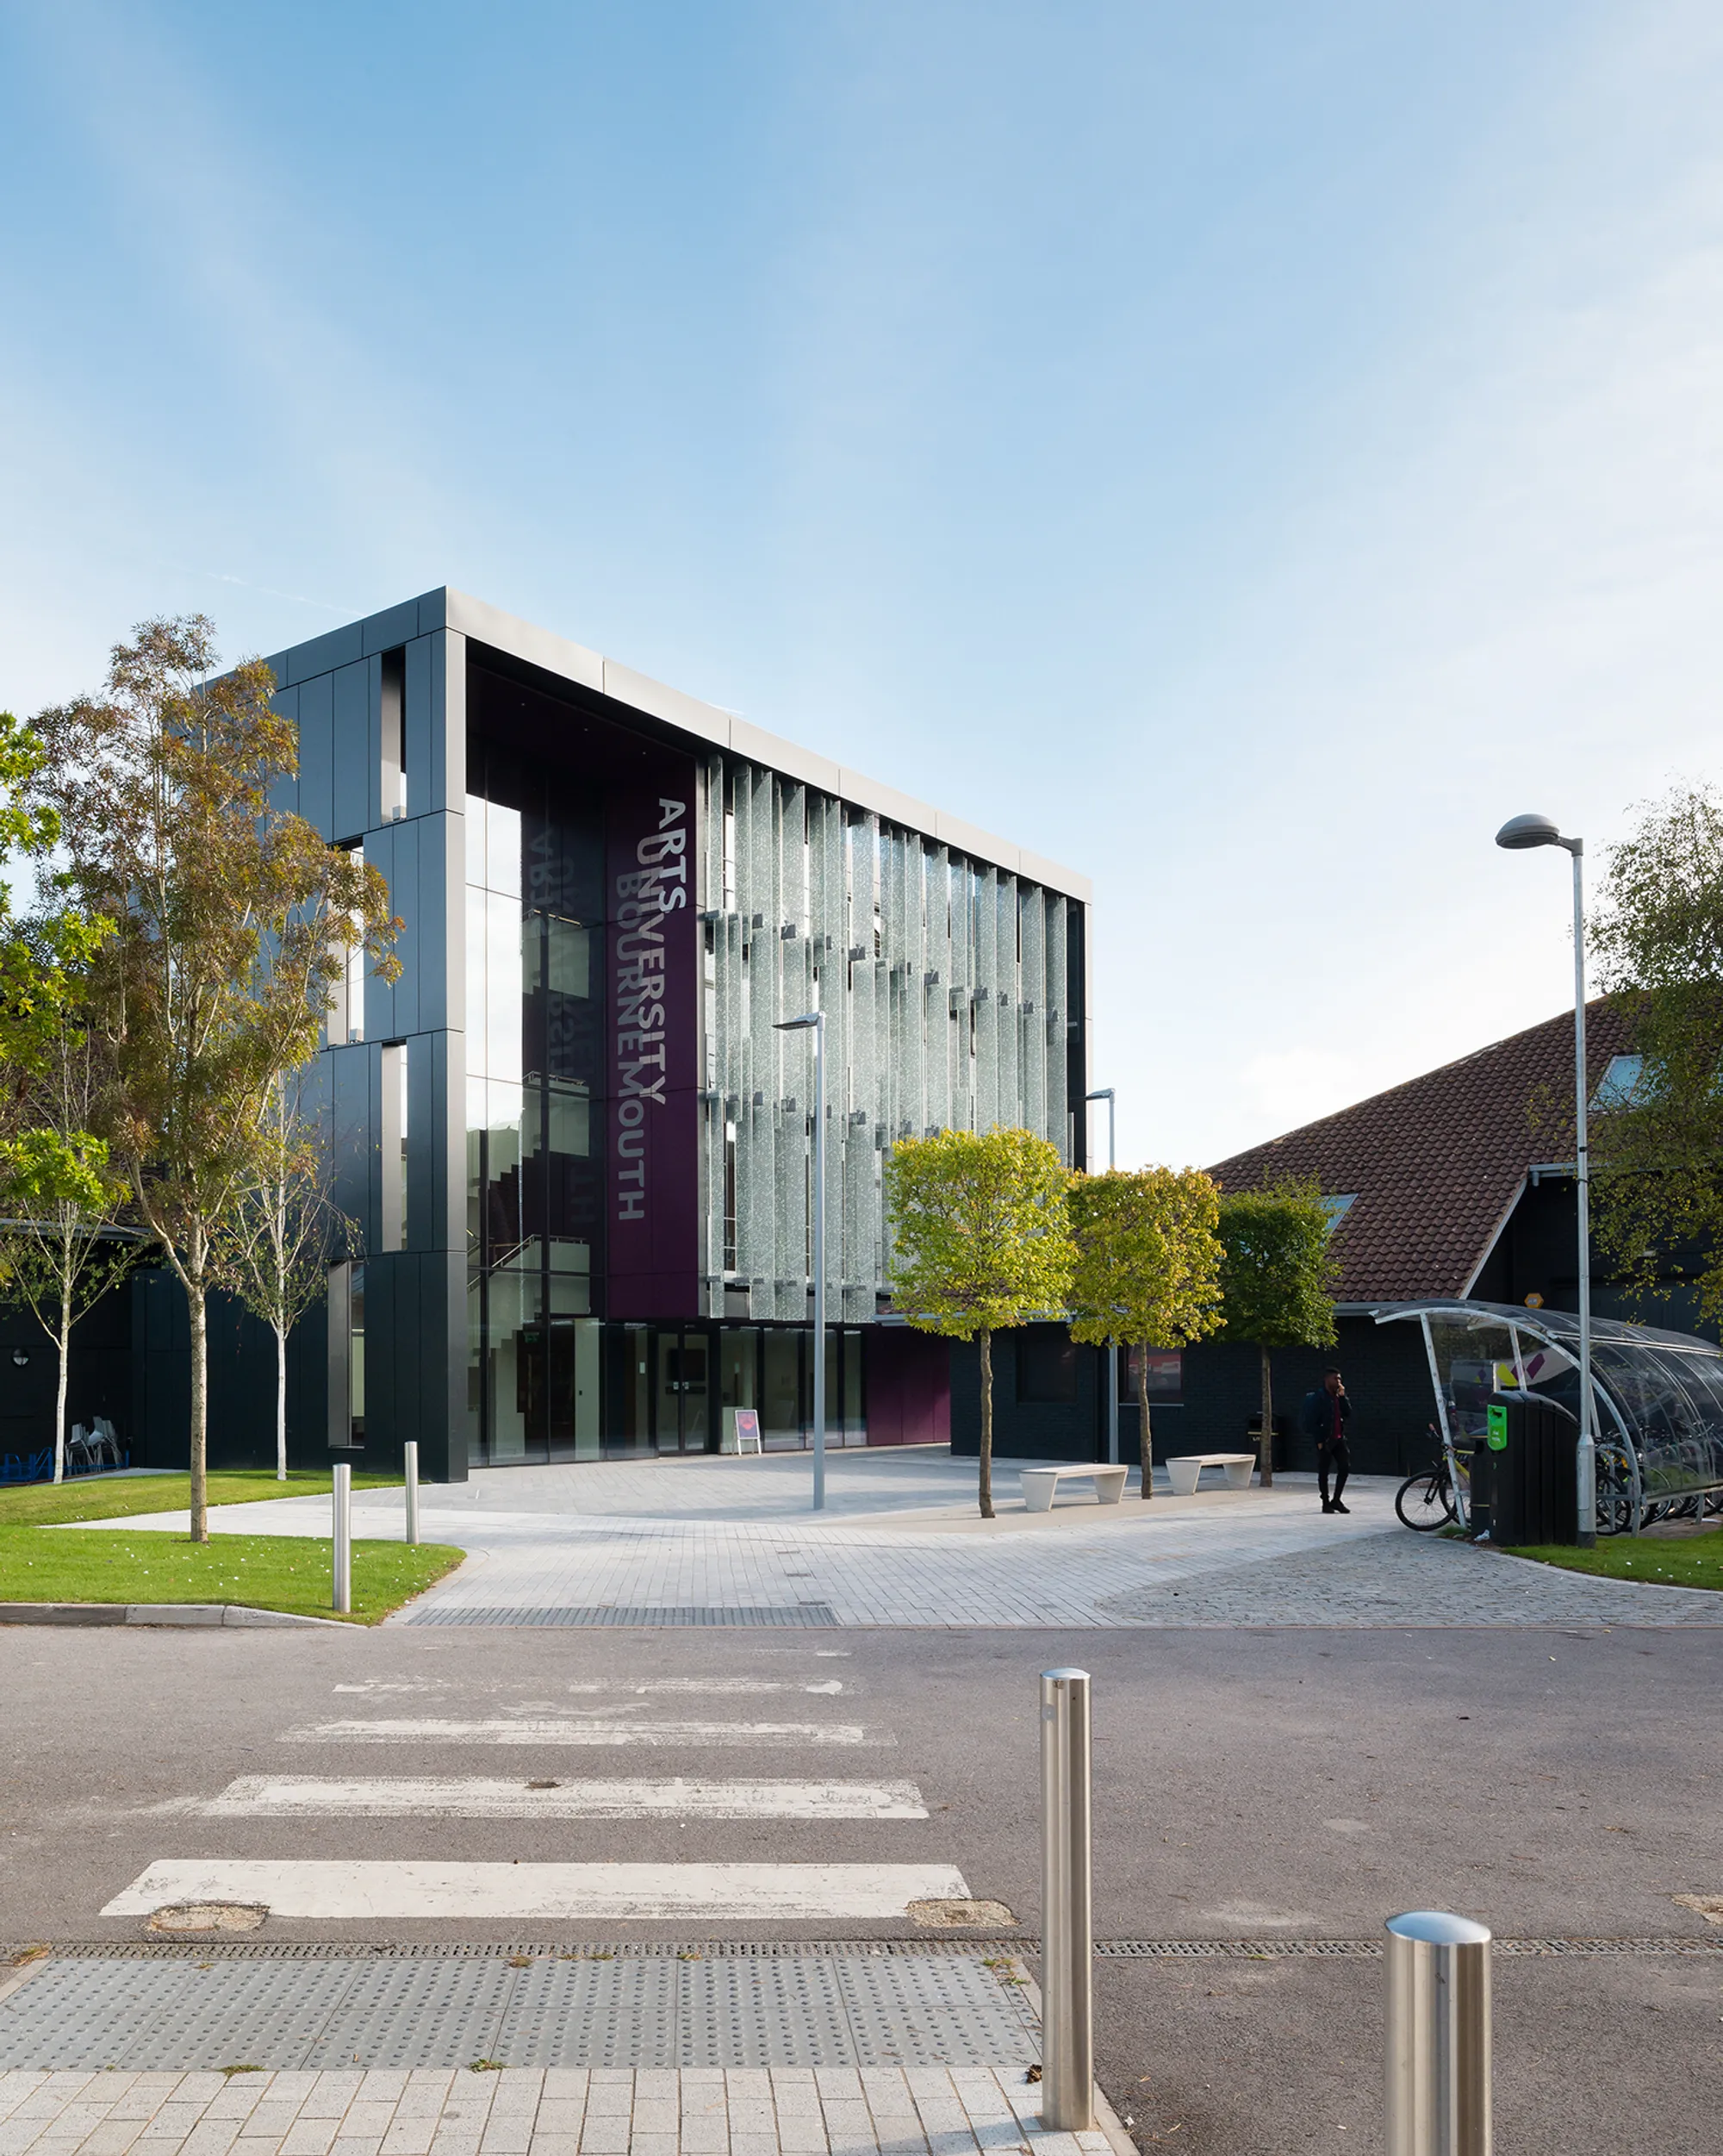
About This Report
The Environment and Sustainability Annual report 2024/25 relates to AUB Sustainability and Net Zero (SNZ) programme and is created for the activities and practices of:
Arts University Bournemouth
Fernbarrow Road
Wallisdown
Poole
Dorset
BH12 5HH
Enquiries: James Jackson – Environment and Sustainability Manager – jajackson@aub.ac.uk
WASTE
This report is published in February 2026 and is accurate at time of publication.
The report is approved by AUB Environment and Sustainability Committee prior to publication. Convenor and Chair – Jon Renyard – University Secretary.
The report emissions data is aligned in accordance with the Greenhouse Gas (GHG) Protocol unless indicated otherwise.
The emissions inventory aligns with the Standardised Carbon Emissions Framework (SCEF) for Higher Education.
The buildings covered in the report include:
University House
South House
West Building
North Building
Student Services
Block A
Block B
Passiv Haus
Library
Northlight Studio’s
Crab Studio
Workshop
Campus Halls
Innovation Studio
Elliott Road Studios
Madeira Road Halls
ENERGY AND
WATER
T
R
A
V
E
L
TRAVEL
Arts University Bournemouth is ISO14001: 2015 and EcoCampus Platinum certified.
Arts University Bournemouth is Fairtrade certified.
Arts University Bournemouth is a Champion of the Dorset Sustainable Palm Oil initiative.
AUBs Annual Financial Statement.
AUB is represented on several environment and sustainability groups including:
EAUC South Group – AUB Environment and Sustainability Manager is Chair.
Bournemouth, Christchurch, and Poole Council Transforming Travel - Transforming Cities Fund.
Dorset Public Sector Decarbonisation and Ecology Group.
BIODIVERSITY
SOCIAL JUSTICE
SUSTAINABLE CAMPUS

