Slide 1
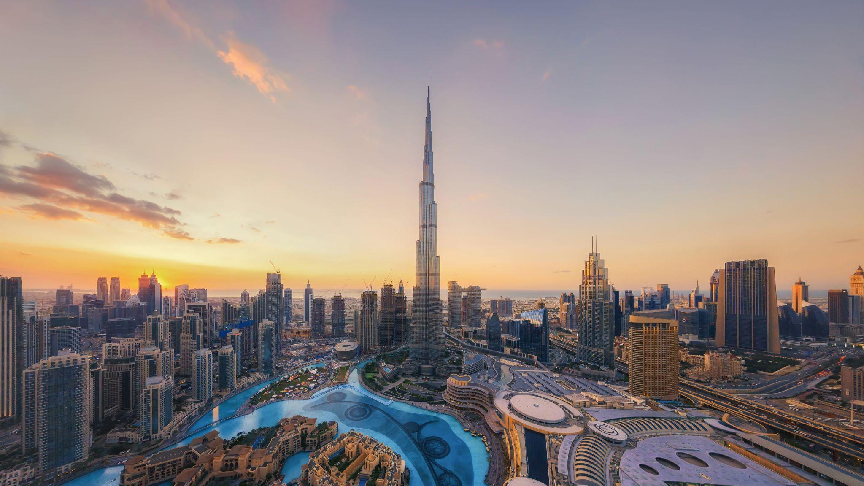
DESIGN YOUR WAY TO A 3 MONTH INTERNSHIP & TWO WEEKS IN DUBAI
Amsterdam • Berlin • Bournemouth • Chengdu • Dubai • London • Madrid • New York • San Francisco • Shenzhen • Sydney

Slide 2
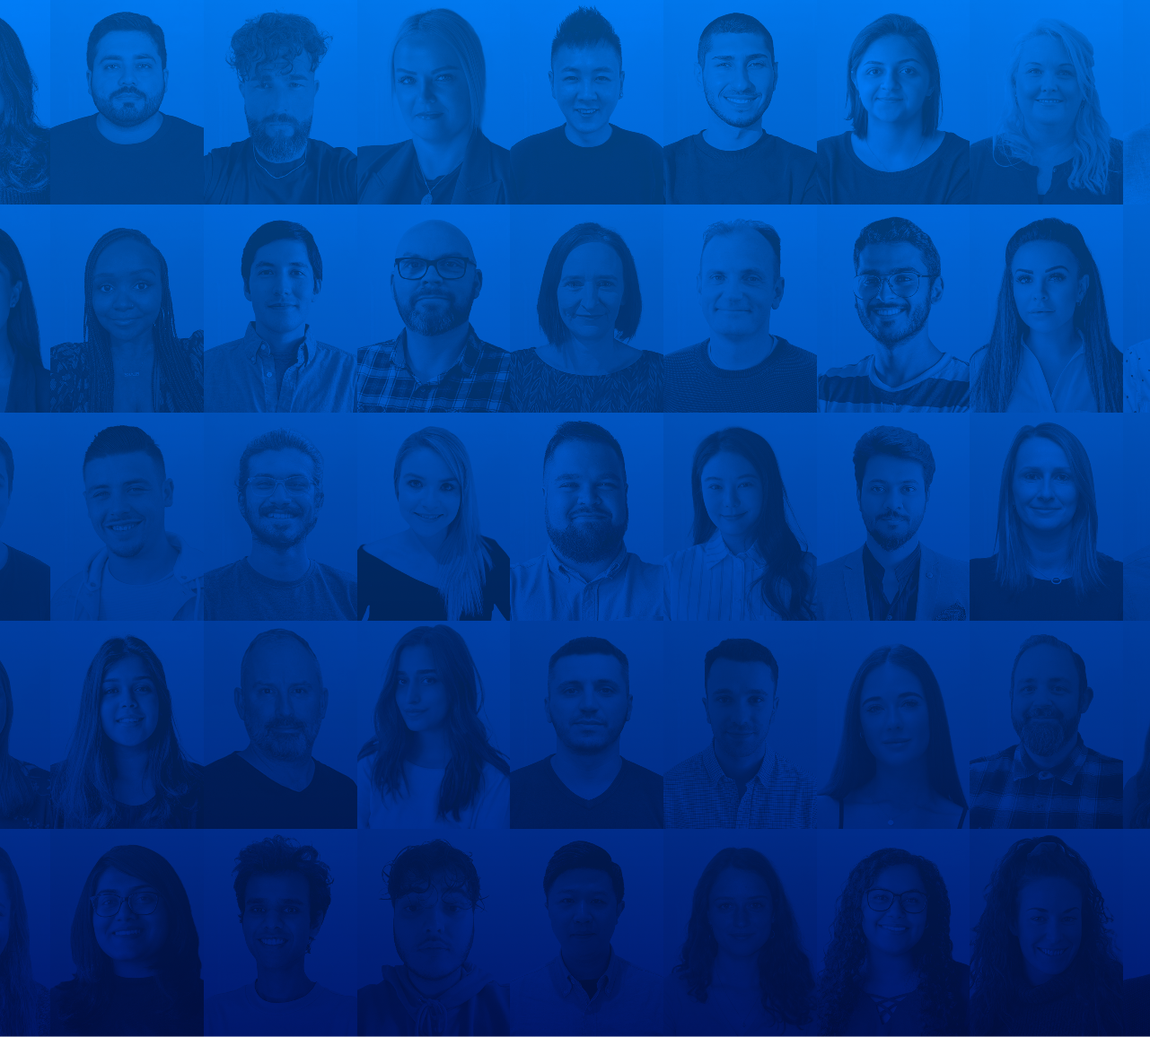
Hello.
We’re Crowd
Crowd is an award-winning global marketing agency with 11 offices worldwide.

Slide 3
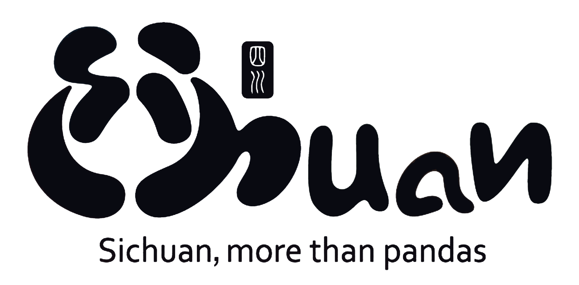
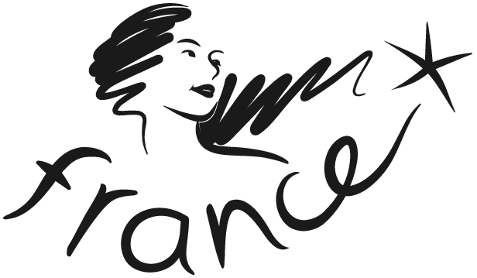
We work with clients like these…
And champion British creativity across the world.

Slide 4
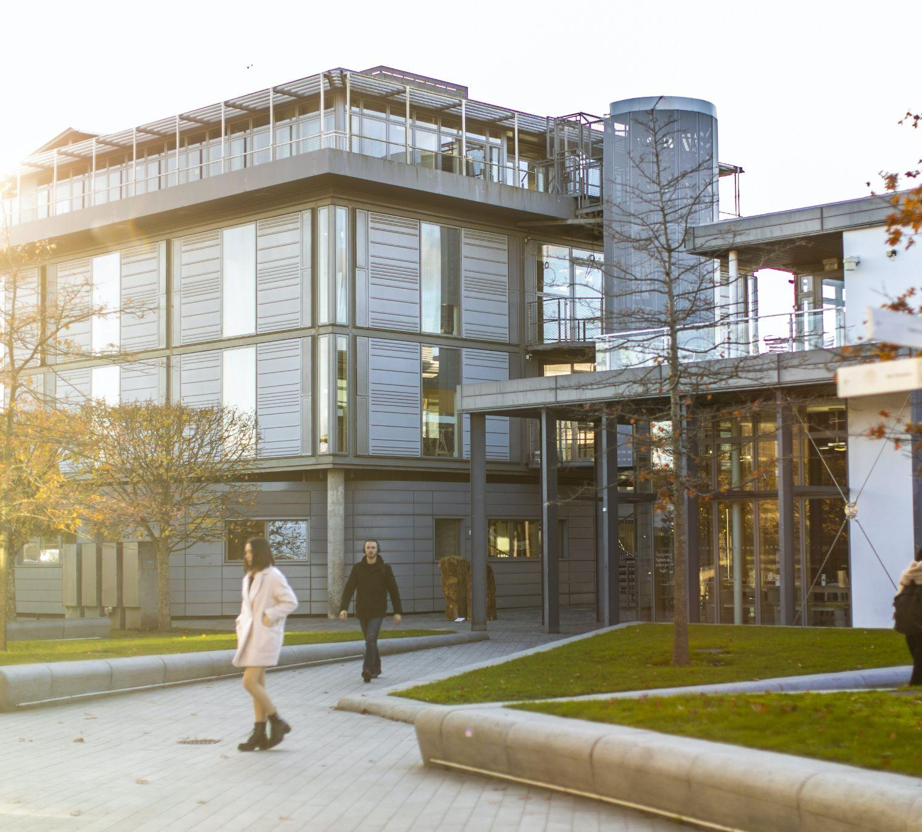
It all started, 11 years ago.
Right here in AUB
And we want to give todays AUB students a great opportunity…

Slide 5
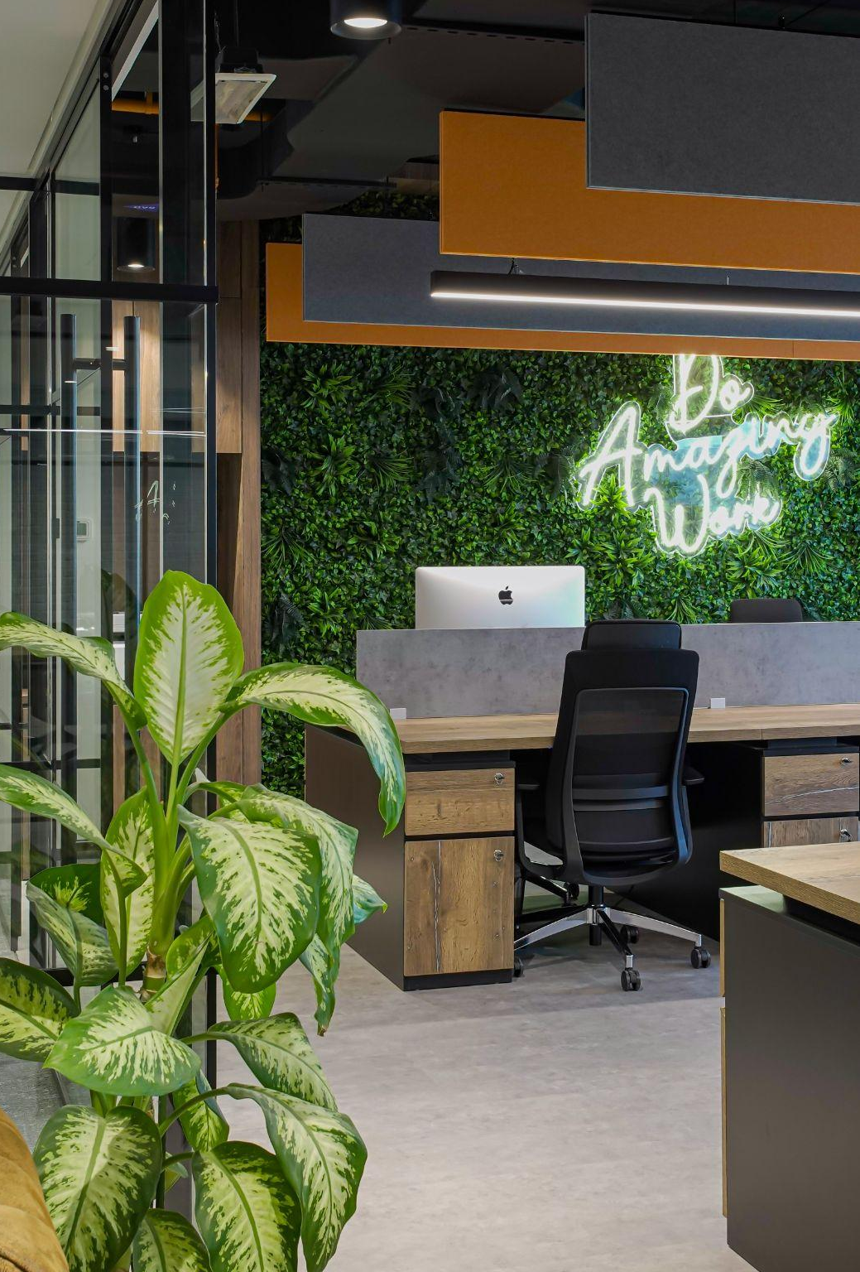
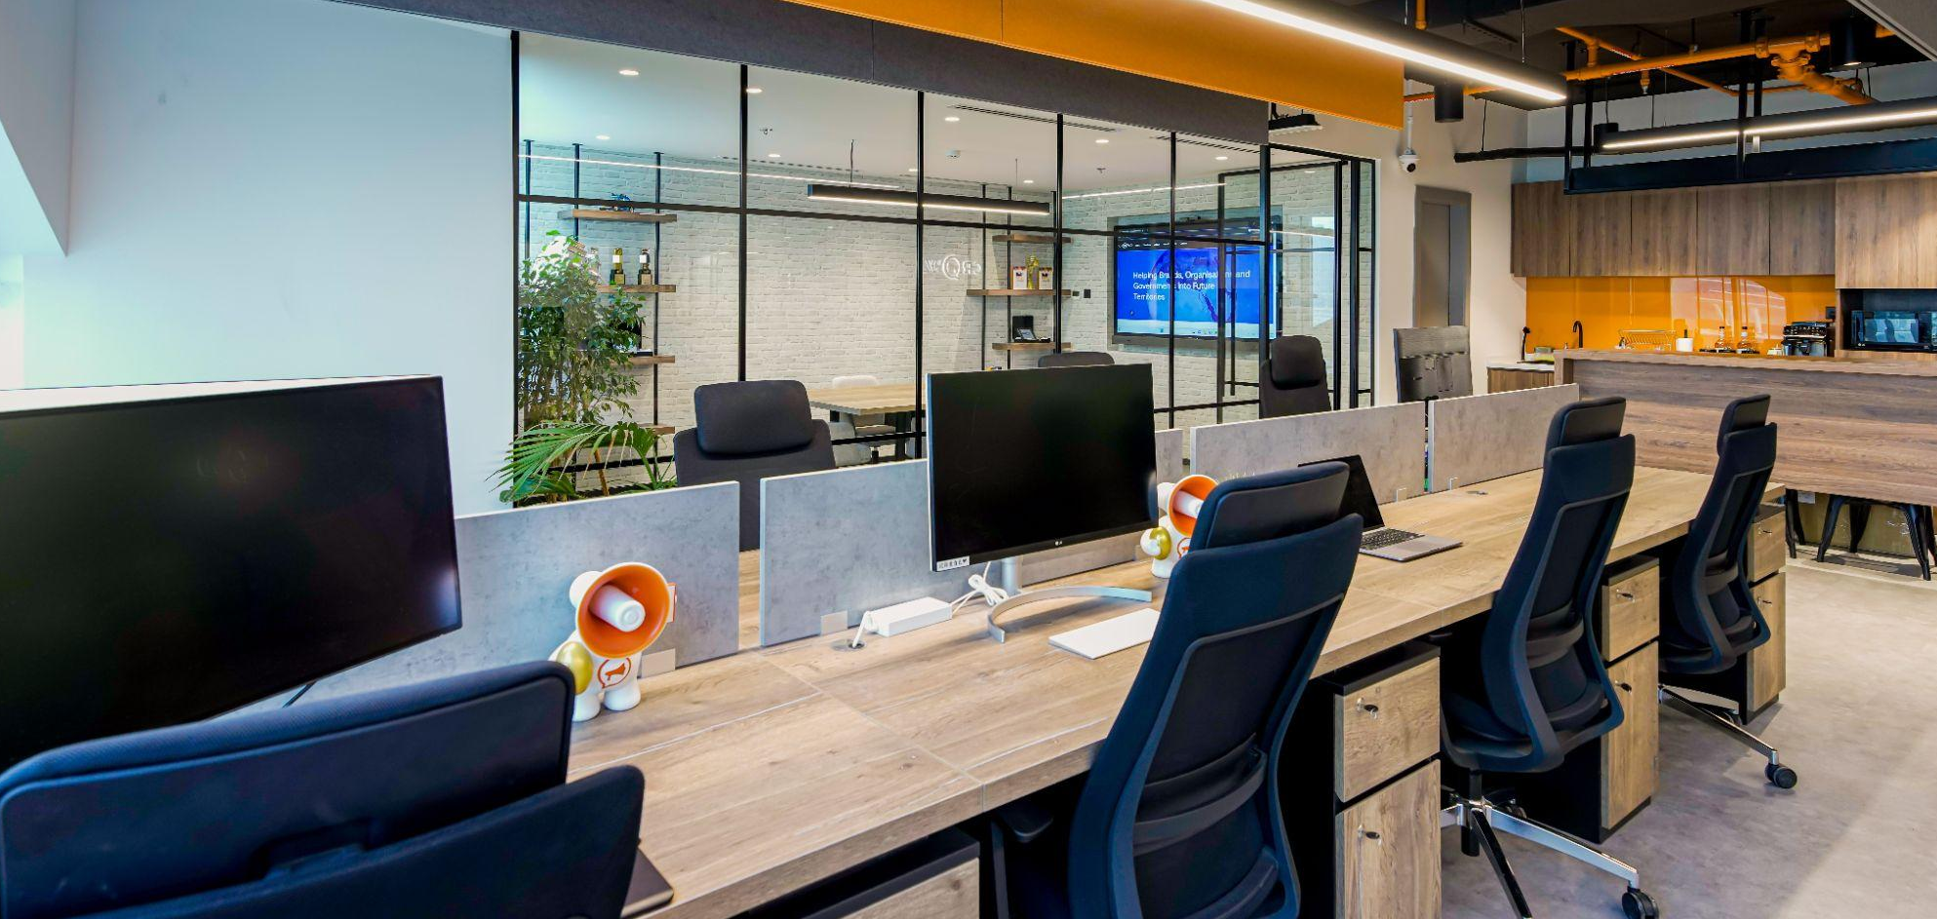
WHAT’S THE OPPORTUNITY?
WIN A 3 MONTH INTERNSHIP WITH CROWD
Remote working in our UK and EU offices
2 weeks located in our Dubai office
Work on live, real-world briefs

Slide 6
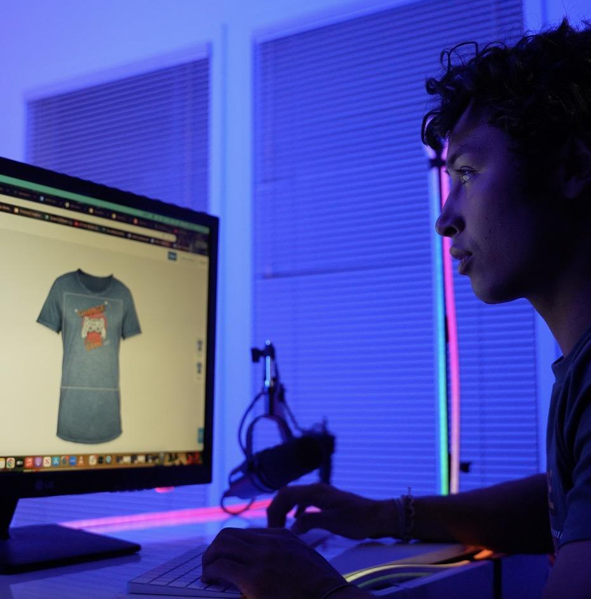
HOW DO YOU WIN?
2 SIMPLE STEPS
So how can you win this golden opportunity in one of the world’s most innovative cities?
By flexing your side hu$tle muscle.
Create merch designs for Dorset Mind
The top 3 students who sell the most merch will get the chance to demonstrate their commitment to doing the internship and their understanding of the Crowd Mission to be in for a chance to win

Slide 7
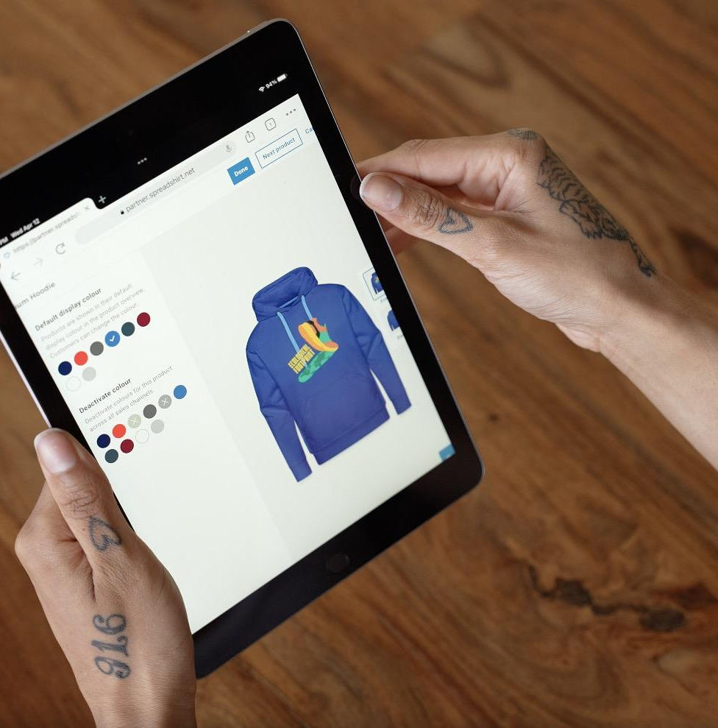
WHY IS MERCH GREAT FOR CREATIVES?
Merch is one of the cornerstones of the multi billion dollar creator economy.
It helps people grow their brands, increase their influence, and create a passive revenue stream.
Our client, Spreadshop, is a global leader in print-on-demand drop-shipping, and is the inspiration behind our competition brief…
Design merch for another client of ours, Dorset Mind.

Slide 8
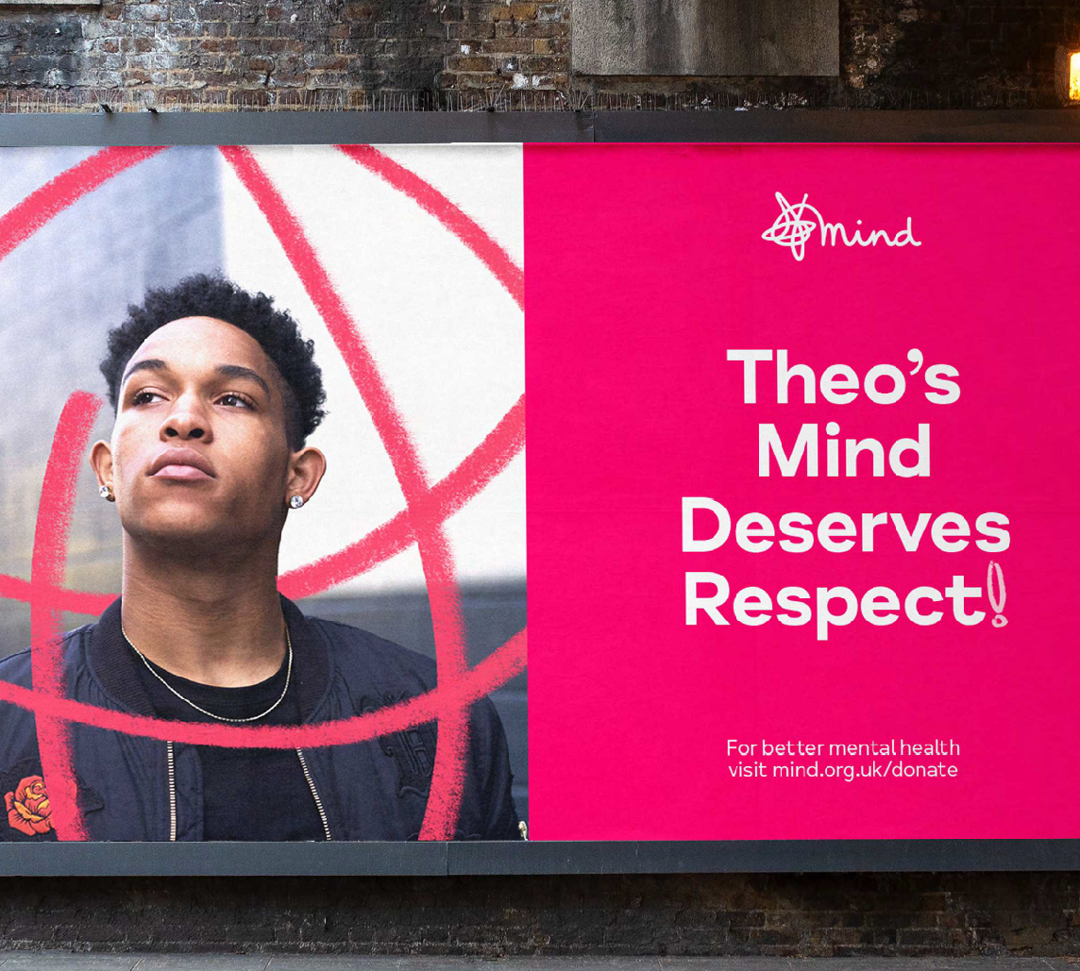
DORSET MIND
Dorset Mind is the local branch of a national charity and provides help and guidance for people of all ages dealing with mental health.
SO WHAT DO WE WANT YOU TO DO?
Create merch for Dorset Mind inspired by the theme ‘positive vibes’
It can be whatever you want, created in any style so long as it has the Dorset Mind logo at the bottom
AND HOW DO YOU WIN?
By selling the most merch and demonstrating your commitment to completing the internship and alignment with Crowd’s values

Slide 9
NEXT STEPS
We will share live merch briefs from clients both locally and across the world
Flex your skills and build your portfolio
So if you’ve think you’ve got some side hu$tle muscles…
It’s time to flex them!

