Slide 1
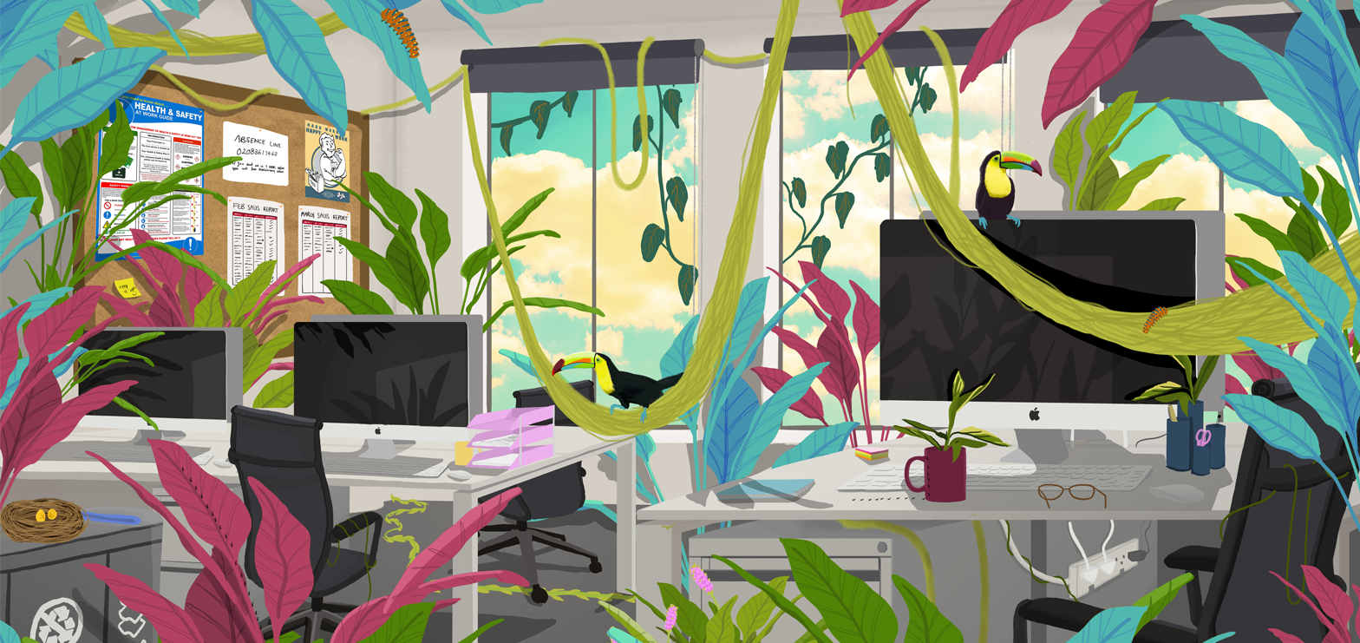
Our People Induction
AUB

Slide 2

Introductions

Slide 3
Introductions
Name, role, where do you live & an interesting fact about yourself.

Slide 4
Agenda
10.00 - 10.10 Welcome and refreshments
10.10 - 10.20 Agenda & Introductions
10.20 - 10.35 Human Resources (Kelli McCrudden)
10.35 - 10.45 Finance (Gemma Barton)
10.45 - 11.00 Marketing (Helen Duckworth & Charlotte MacKay)
11.00 – 11.15 Equalities, Inclusion & Diversity (Sarah Addis)
11.15 - 11.30 BREAK
11.30 - 11.50 Health and Safety (James Pritlove)
11.50 – 12.05 Environment and Facilities (James Jackson)
12.05 - 12.20 Student Services (Carrie Packer)
12.20 - 12.30 Library (Charlotte Wilmot)
12.30 - 12.45 Trade Unions (Emma Lay/Ian Dolan/Preeti Sood)

Slide 5
Our Vision
A world-class arts, design, performance and media university working with professional partners to create excellence, relevance and impact.

Slide 6

Our Values
Passionate
Connected
Innovation
Collaboration

Slide 7
Passionate
Education transforms lives; a creative education transforms society. Through our sense of purpose and determination for the best education, research and partnering with industry, we empower our people to learn, grow and connect. We are about the work we do, the respect we have for each other, and the powerful sense of inclusivity and belonging that characterises everything we do.

Slide 8
Connected
We are better for our diversity. We are enriched by the depth of respect we have for each other and the strength of our relationships with our people, our places and with the planet. Through our commitment to working with those who are different to us, or challenge us, we grow stronger together, creating new synergies, global connections and sustainable futures.

Slide 9
Collaborative
We strive to make a difference in all that we do. Through our collaborative and inclusive approach, we are to be the agents of positive change for our students, staff and the communities we serve. Through the applied excellence of our learning, teaching and research we strive for relevance to make a positive impact.

Slide 10
Innovative
With an open mind we try new things, nurture ideas, trigger creativity and develop solutions. Through our innate curiosity, practice-based enquiry and industry partnered projects we work with our students, staff and stakeholders to tackle problems and encourage authentic innovation.

Slide 11
Our Goals
Goal 1
To enhance our standing as a global leading independent arts, design, performance and media university
Goal 2
To create opportunity for our students, alumni and staff through a passionate belief in collaboration, creativity and innovative practices
Goal 3
To impact positively on society, industry and our stakeholders through the excellence and relevance of our practice and research

Slide 12
New Starter Induction
Our AUB People

Slide 13
Our HR Team

Slide 14
Your Benefits
Enhanced Holiday Entitlement
Enhanced Sickness Entitlement
Pension Scheme ( Teachers & Local Government Scheme)
Discounted rate on short courses
Discounted rate on bus passes
Excellent Training & Development
Free AXA Healthcare Assessments
Enhanced Maternity, Paternity & Adoption Pay
Motorbike Loan Scheme
Cycle to Work Scheme
Annuals Savings Account

Slide 15
Sickness Entitlement
Service | Sick Pay
During first year of service | After 13 weeks' continuous service, 4 weeks' full pay and 8 weeks' half pay
During 2nd year of service | 8 weeks' full pay and 8 week's half pay
During 3rd year of service | 16 weeks' full pay and 16 weeks' half pay
During 4th year of service | 20 weeks' full pay and 20 weeks' half pay
During 5th and subsequent years | 26 weeks' full pay and 26 weeks' half pay

Slide 16
Your Wellbeing
Assess to AXA Healthcare app (register with AUB code A810801)
AXA Healthcare onsite assessments
EDI webinars and workshops
Headspace app & free staff counsellor
EAP – Employee Assistance Programme
Discounted gym membership at BU
Annual Flu jabs / eye test vouchers (for frames as well)
LinkedIn Learning Collections on wellbeing and EDI issues

Slide 17
Your Performance
Annual performance review linked to incremental pay increase (after successful completing of probation)
Performance measured on achieving objectives aligned to AUB Strategy / Plans, as well as related to demonstrating AUB Values
Regular 1:2:1’s with your line manager
Training & Development linked to your objectives and professional goals

Slide 18

Your Learning & Development
Continued Professional Development – conferences, networking, short courses & qualifications
Formal qualifications / memberships
LinkedIn Learning – curated pathways & collections and bite sized learning
Buddying & mentorship opportunities

Slide 19
Committees & Working Groups
H&S Committee | UKVI Group | Environmental Committee | EDI Committee
Research Degrees Committee | Learning, Teaching and Quality Committee | Research and Knowledge Transfer Committee | Social Committee
Research Ethics Committee | Prevent Implementation / Safeguarding Team | Data Governance and Management Group
Resource Planning Group | Operating Working Group | Curriculum Innovation Group

Slide 20



Our Events
AUB Open Days and Graduations
Shows & productions
Innovation workshops
Christmas Party / Summer BBQ
Gallery Exhibitions
Walking Club

Slide 21
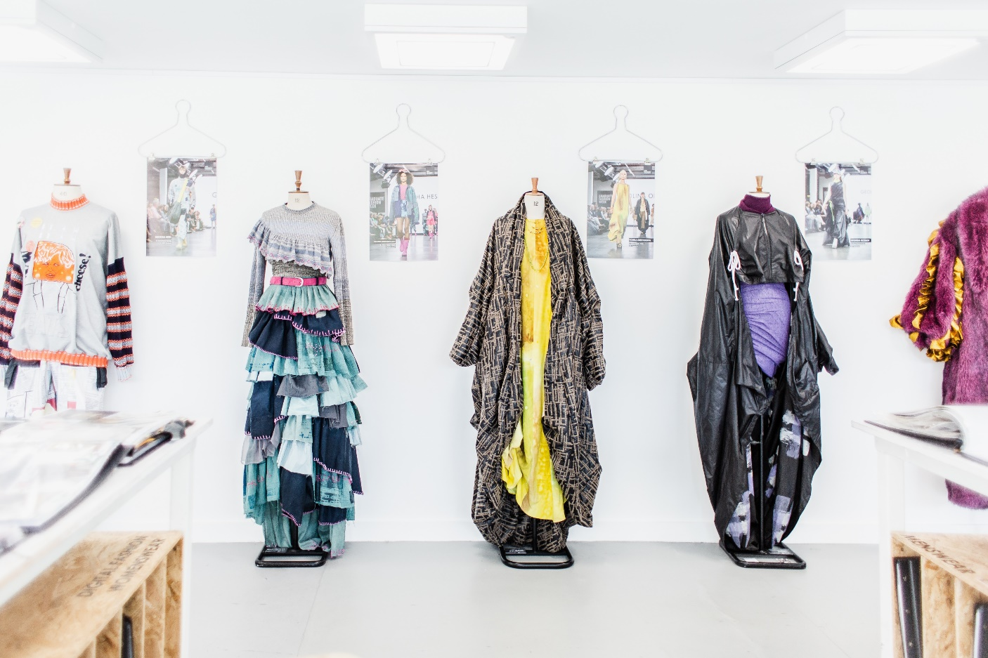
Our Events
Summer Show Reel 2022

Slide 22
Useful links and documents
Working at AUB document
Virtual campus map / travel guide
LinkedIn Learning – Activate your learning account and start curating pathways
MyView – Booking leave
Paul’s Place
All Policies
Student work
Staff Profiles

Slide 23

FINANCE

Slide 24

How to contact us
In person: At University House
Or via email:
finance@aub.ac.uk
payroll@aub.ac.uk
income@aub.ac.uk
Or via Teams

Slide 25


Forms on Intranet
Finance and Payroll forms can be found on the Intranet. These include:
Change of Bank Details Form
Overtime and Casual Hours Claim Forms
Form for an Advance
Forms for Expenses, including CPD

Slide 26

Pay
Payroll is run by DC (Dorset Council)
All queries to AUB Payroll
Paid on last working day of the month
Payslips are emailed from DC

Slide 27

Overtime
Overtime/Additional hours are
paid a month in arrears
Overtime - only for grades I,II and III for any hours above 37 hours per week
Overtime paid at time and a half or double time for Sundays
Additional hours - for part time staff for hours worked up to 37 per week, available to all grades
Additional hours paid at single time
Claim forms MUST be authorised and submitted to Finance by 2nd working day of the month

Slide 28


Pensions
All staff are automatically enrolled into the relevant pension scheme
Information is available on pension scheme sites
Register for Member Portals - ‘My Pension’ or ‘MPO’
Professional Services - LGPS
(Local Government Pension Scheme)
www.dorsetpensionfund.org/
  Academics - TPS
  (Teachers’ Pension Scheme)
  www.teacherspensions.co.uk
It is your right to opt out
Or opt to join the 50/50 scheme - LGPS

Slide 29

Annual Savings Scheme
Runs for one year from December to November
Invite in November to join new scheme
You choose how much to contribute. You are committed to the whole year
Deducted monthly directly from salary
Total balance plus interest (currently 2%) is paid at the end of November

Slide 30

Other Finance Services
Staff and Student Advances and Expenses
Continual Professional Development Expenses
Ordering
Procurement Advice
Facilitating Travel Bookings
Payment of Supplier Invoices
AUB Online Store Set Ups / Transactions
Sales Invoices Requests
Project Accounts
Cost Transfers

Slide 31

New starter induction – Marketing

Slide 32
Our aim

Slide 33
Our aim
Show the outside world who we are… through development of our brand, and innovative campaigns and activities to reach our target audiences.

Slide 34
Our aim
Show the outside world who we are… through development of our brand, and innovative campaigns and activities to reach our target audiences.
Help prospective students make better educational choices and find out more about AUB, so that ultimately more students choose us.

Slide 35
The Team

Slide 36
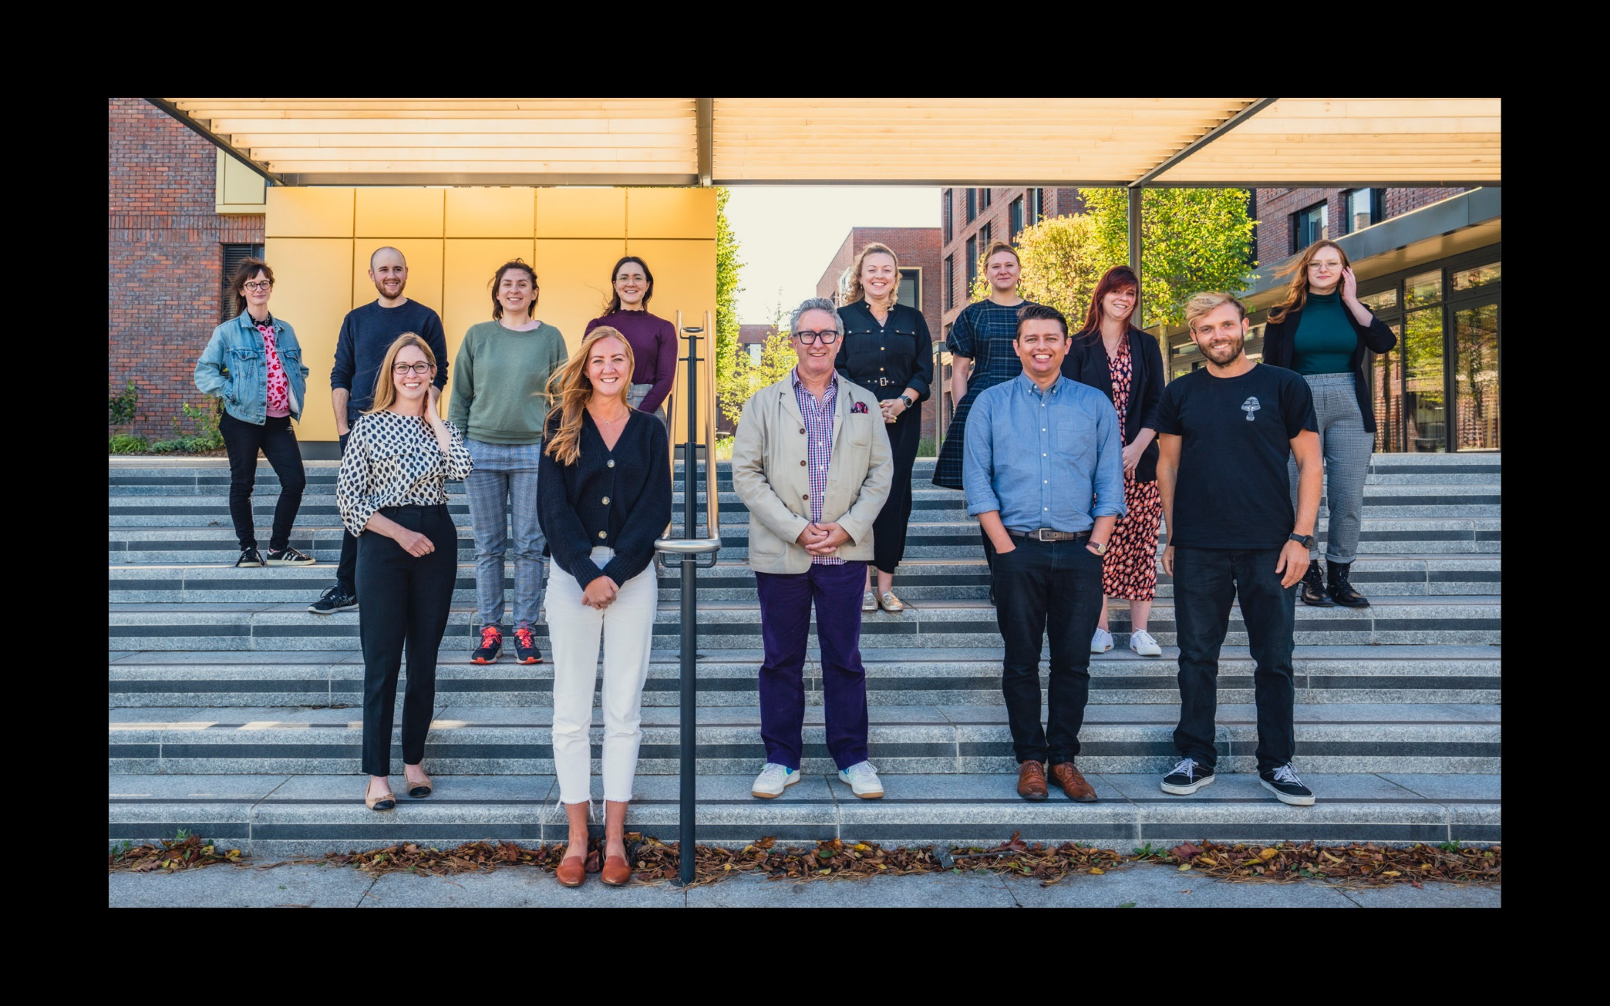
What do we do?

Slide 37
Who are we?
Simon Pride
Head of Student Recruitment and Marketing
Kim Ensten
Student Recruitment Manager
Helen Duckworth
Marketing and Communications Manager
Sarah Kusztelan
Senior Events Officer
Charlotte MacKay
Senior Digital Communications Officer
Ashleigh Barker
Senior Marketing Officer
(AUB Open Campus)
Jon Beal
Senior Press Officer
Zoe Larrad
Alumni Officer
Naomi Ryan
Events Officer
Anna Garrett
Outreach Officer
Harry Davenport
Digital Communications Officer
Justine Morris
CRM Officer
Lauren Bowling
In-House Graphic Designer
Richard Tarr
Photographer and Videographer
Eva Sekeresova
Schools Administrator
Hannah Baker
Outreach
Co-ordinator
Samantha Linda
Communications Administrator
Dale Hurst
Digital Content Administrator

Slide 38
What do we do?

Slide 39
What do we do?
Marketing and Communications:
Design
Website
AUB:360
Social media
Digital media
Instagram Prospectus
Outdoor media
Print media
Keep warm materials
Contact strategy – CRM
Press and PR
Photography and Videography
Student Recruitment:
Events
UCAS
Open Days
Offer Holder days
Graduation
Alumni
Schools contact strategy and engagement
Outreach – combined Access and Participation
Cross-team outputs
I Can’t Draw
WonderWhat
Schools’ Hub
AUB&

Slide 40
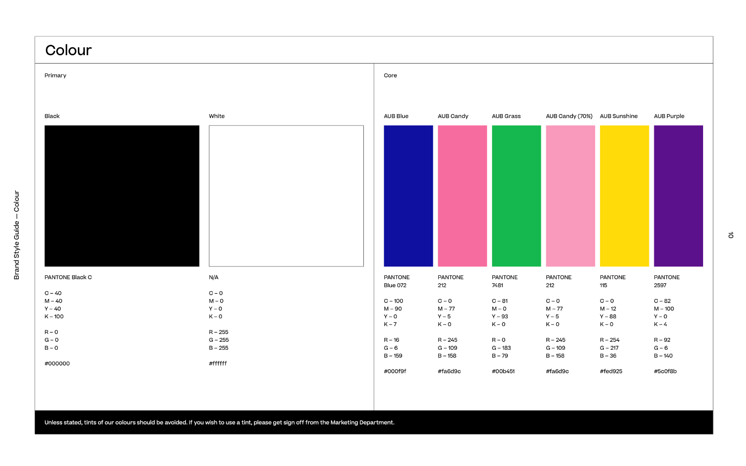
Our brand
We’re proud of our brand and have worked hard evolving it over the years.
We have a distinctive Tone Of Voice, we’re friendly and chatty especially when talking to future students.
We have style guidelines and templates for PPTs, word docs and more, on our intranet page.
We welcome design briefs so send them to marketing@aub.ac.uk, or if you’re creating something yourself, please send it over for review.

Slide 41
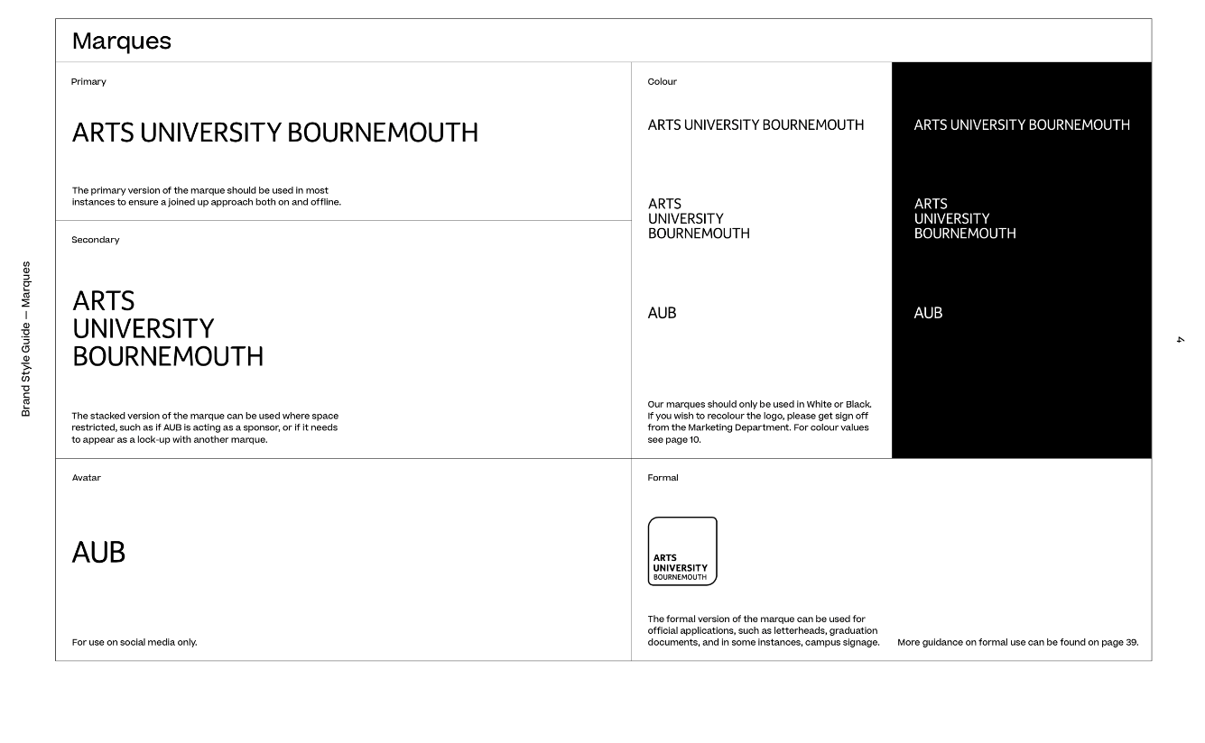

Our logo
We have four logos:
  – Primary (full marque)
  – Secondary (stacked marque)
  – Avatar (initial)
  – Formal logo (in the squirkle)
  We have co-branded logos if needed
  – BFS
  – AUB Productions
  – The Graduate School
  Visit intranet or email marketing@aub.ac.uk for guidance on use.

Slide 42
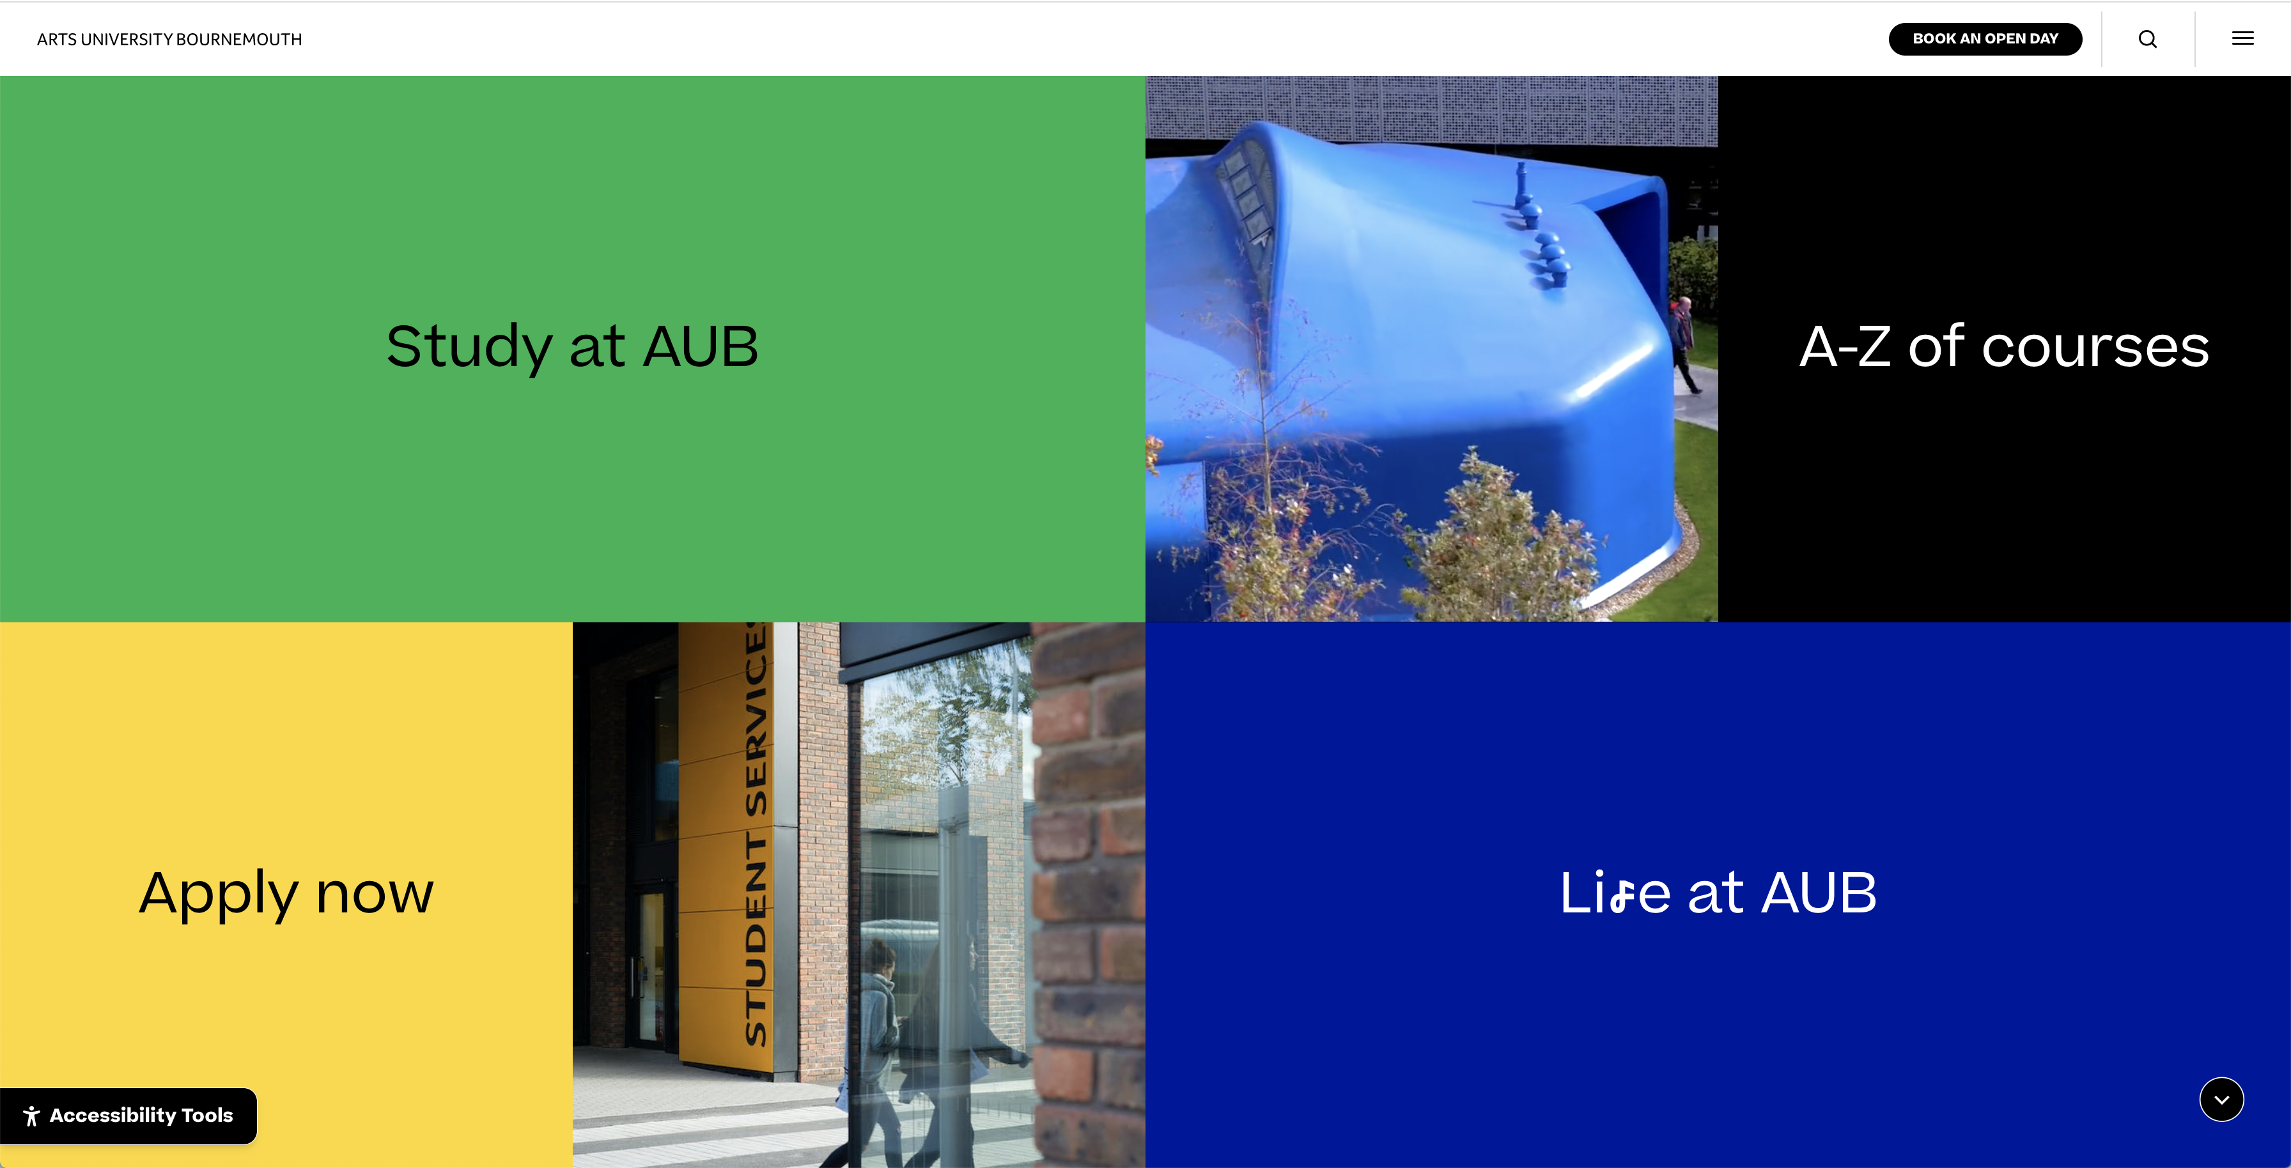
AUB.AC.UK

Slide 43
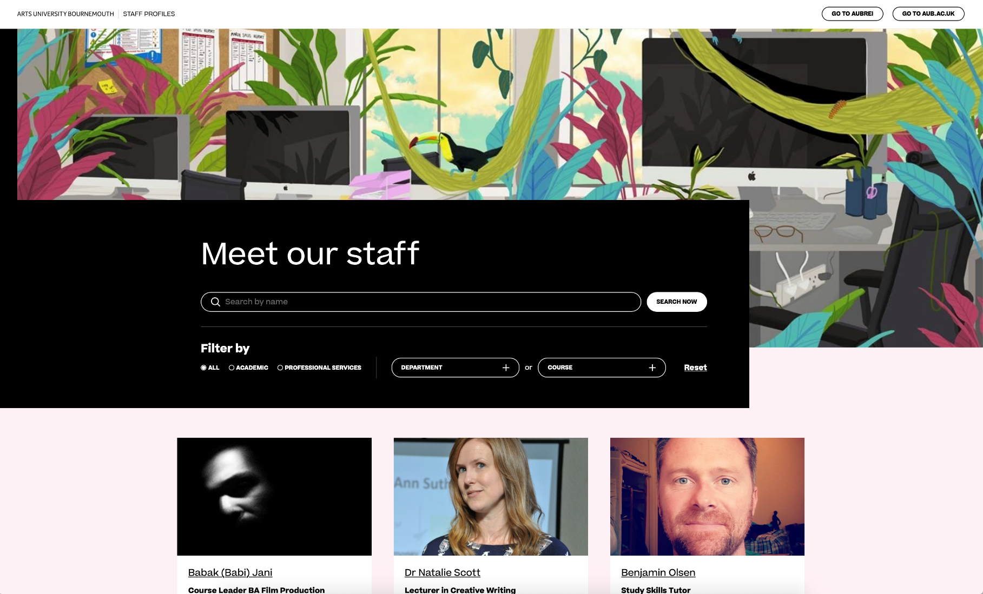
Staff profiles

Slide 44
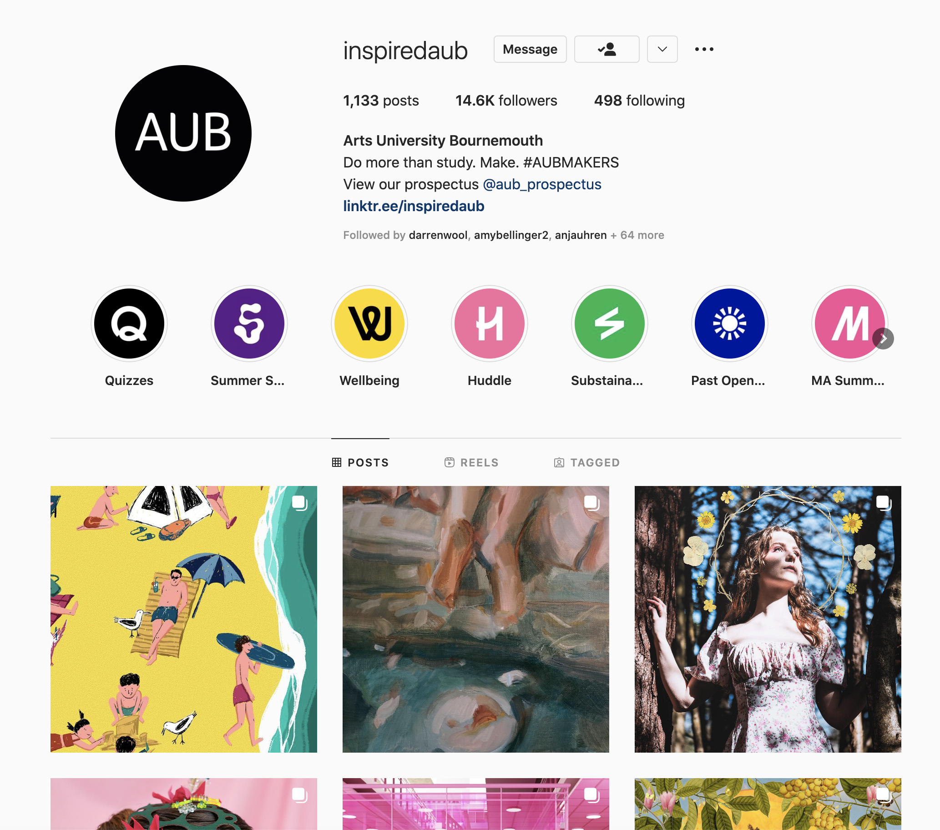
@inspiredaub #AUBMAKERS

Slide 45

@aub_prospectus

Slide 46

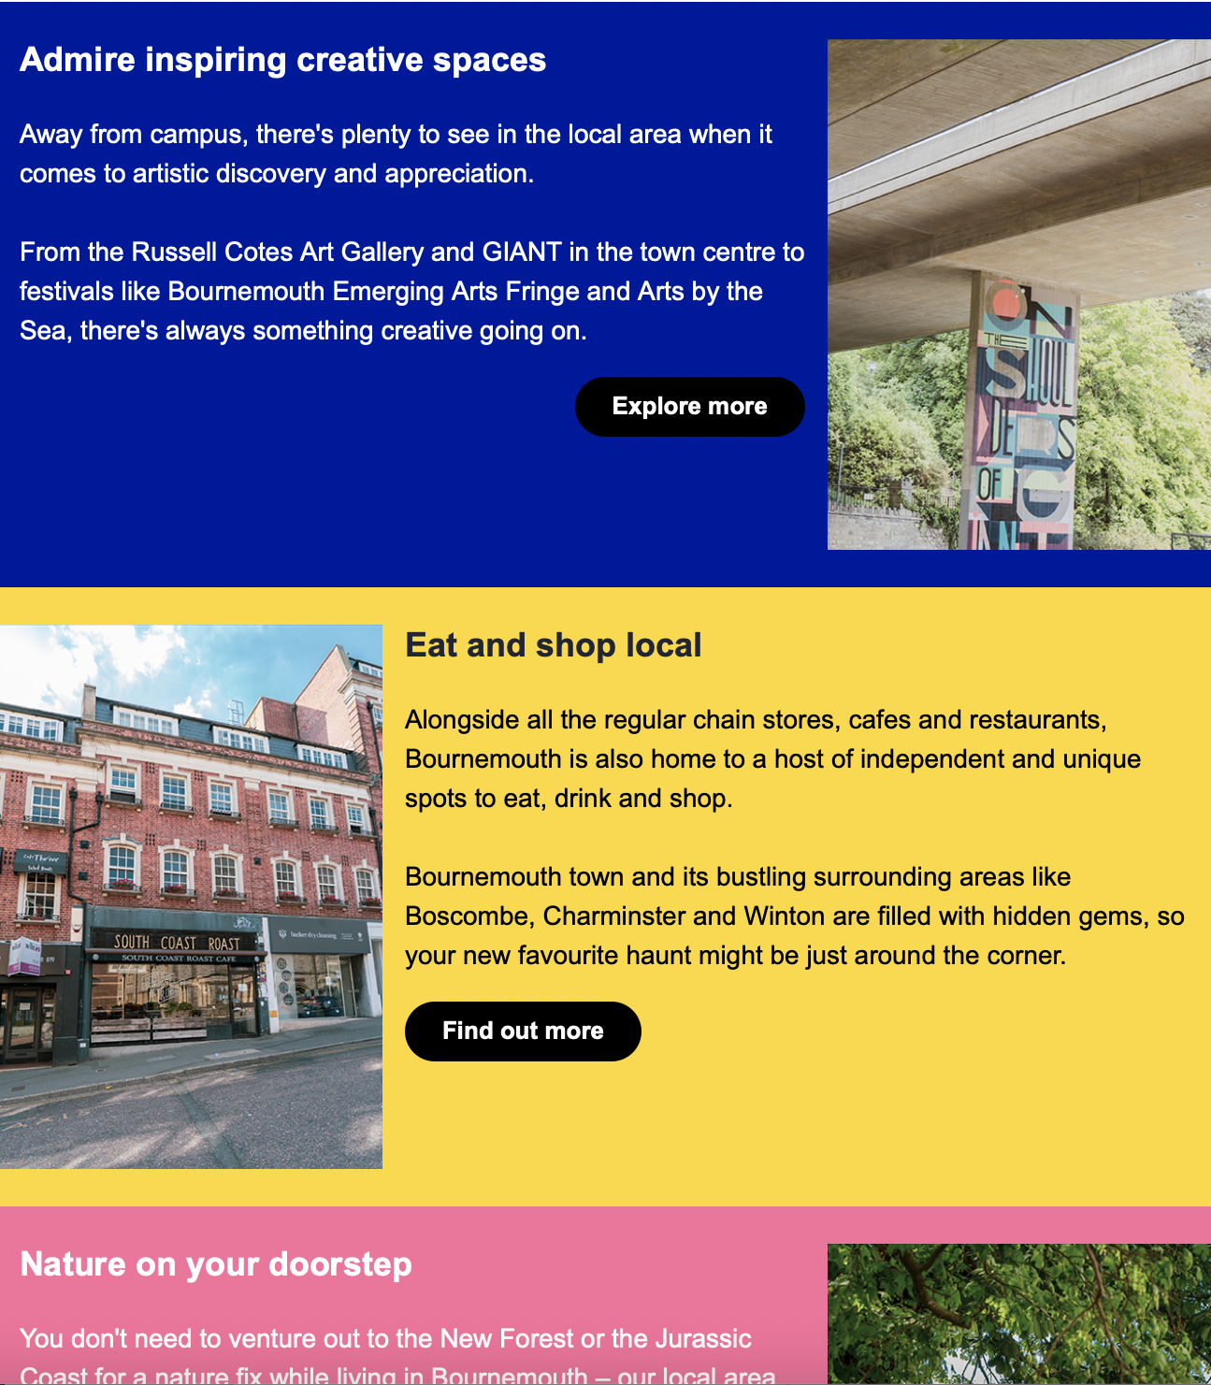
CRM (Customer Relationship Management)
We launched a brand new CRM system (called Azorus) in summer 2022
We plan, design and send series of emails to prospective students
The system provides functionality for booking events, like our open days
…and enables us to track performance of activities we run

Slide 47
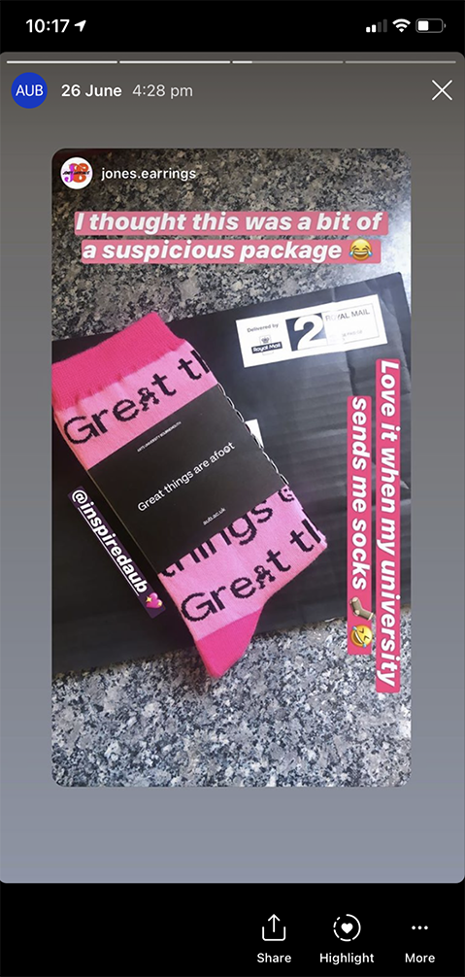


Physical keep warm items
The Anthology - posted out to applicants when they receive an offer.
Personalised print (A-Z of life at AUB)
…Socks!

Slide 48
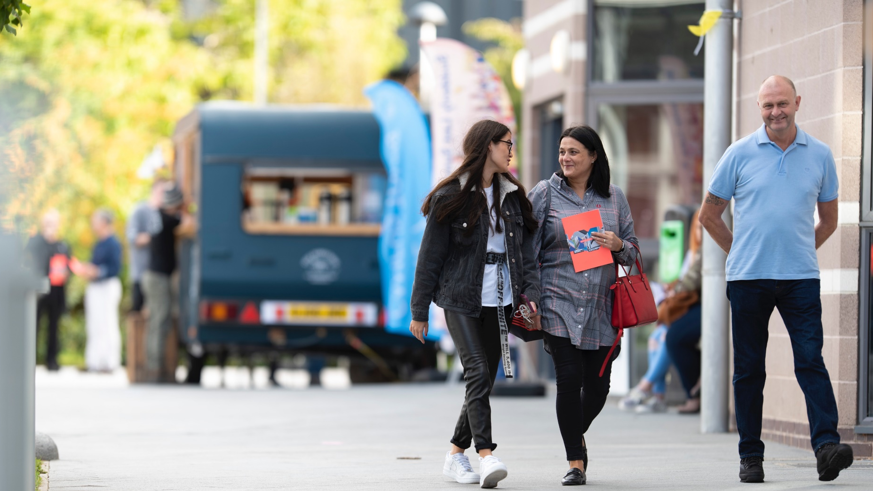
Open days
Five events on campus per year
We welcome hundreds of prospective students and their families to campus
Each course runs three talks per day

Slide 49
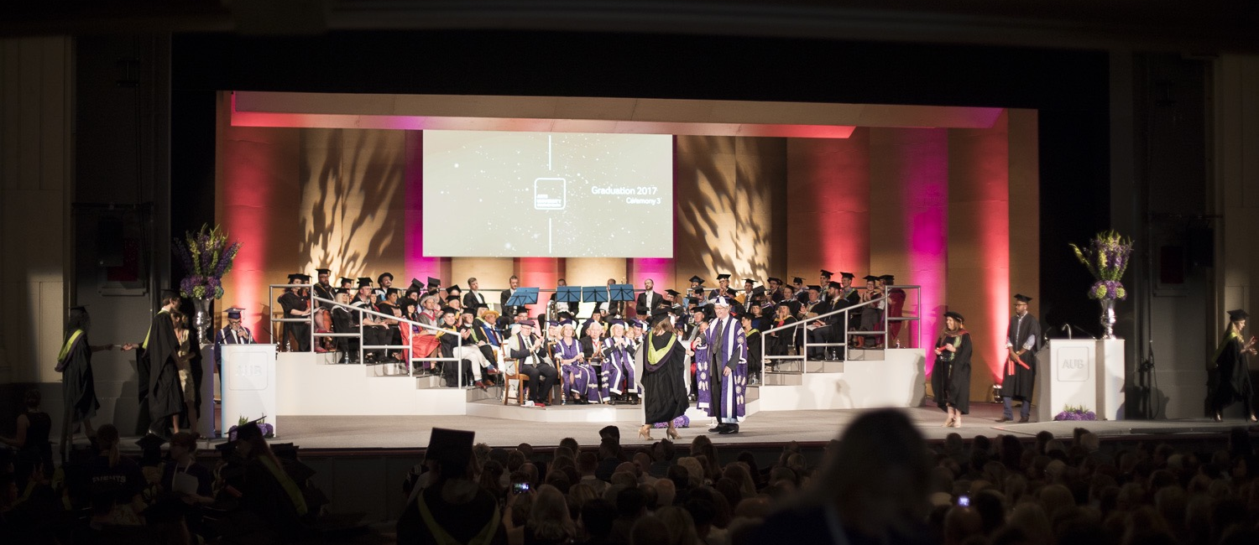
Graduation

Slide 50
Thank you ☺
marketing@aub.ac.uk
web@aub.ac.uk

Slide 51


BREAK

Slide 52
Health & Safety
Notes:
Health and safety induction training for new employees.

Slide 53
Content
- Fire Safety
- Fire Evacuation Duties
- Accident Reporting
- First Aid
- Risk Assessment
- AUB Health and Safety Management
- Health and Safety Online Platforms
Notes:
This short presentation will cover your daily occupational health and safety support here at AUB plus some useful information for you to know when you are on or off campus.

Slide 54
AUB Health and Safety Manager
- AUB’s health and safety ‘Competent Person’
- Expert advisor on all health and safety policy and strategy
- Oversee systems development and implementation
- Assess the risks
- Provide information about risks
- Consult employees and support them
- Provide health and safety information (HSE 2022).
Notes:
My name is Jim Pritlove and I’m the University’s competent health and safety person. My role here is to ensure we at AUB are proactive in safety management and feel empowered to look after each other in the workplace. Safety is an ethical responsibility. We advocate a culture in which we continually try to harness a communal social responsibility without using enforcement or rigid regulatory behaviours. Ultimately, our goal is to encourage creativity within a safe learning environment.

Slide 55
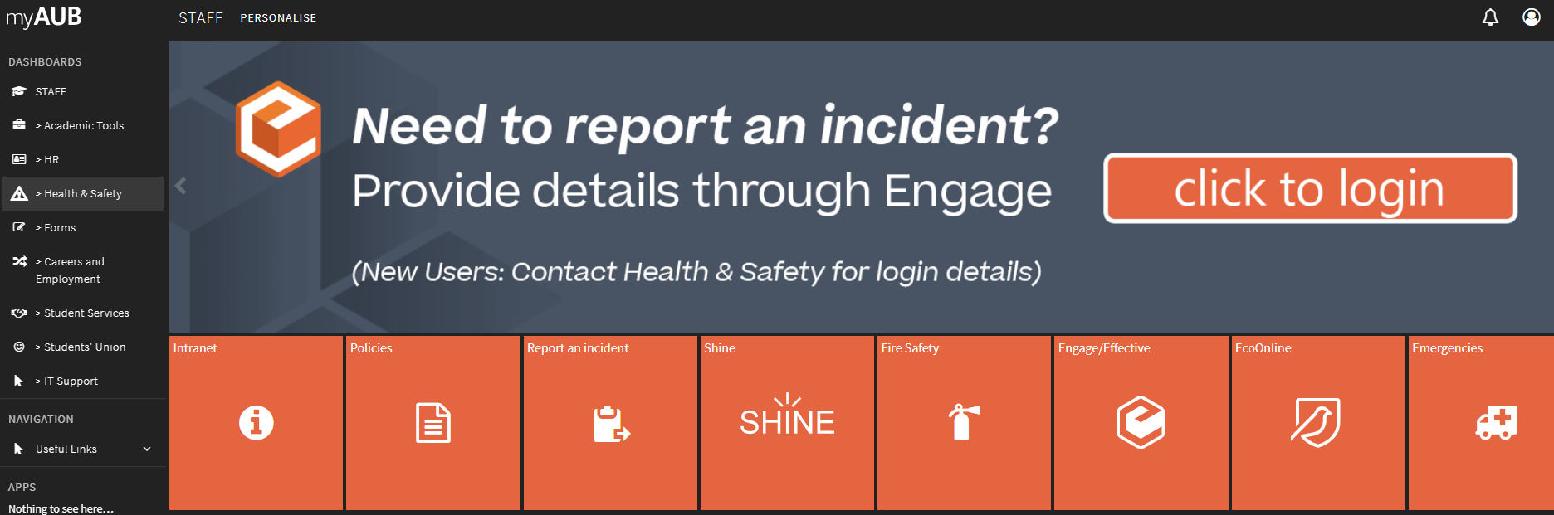
AUB Health and Safety Intranet Page
Notes:
The AUB Health and Safety intranet page will hold all the health and safety information you’ll need to know during your daily activities.
The webpage contains a number of quick access options in case you have to report an accident or an incident, or in need of a first aider. You can also sign in to your EcoOnline account health and safety management platform.

Slide 56
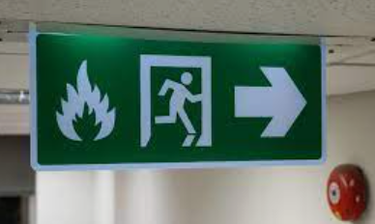
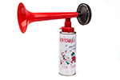
Fire Safety
  Action on the event of a fire
    Close doors and windows
    Follow exit signage
    Safest and shortest route out
    Do not use lifts
    Assembly Point – evacuation map
    All clear – who decides?
Notes:
In the event of a fire or on hearing the fire alarm then it is the responsibility of members of staff to escort students from the building to one of the assembly points. Do not put yourselves at risk but try to reduce the effects of the fire by closing doors and windows.

Slide 57
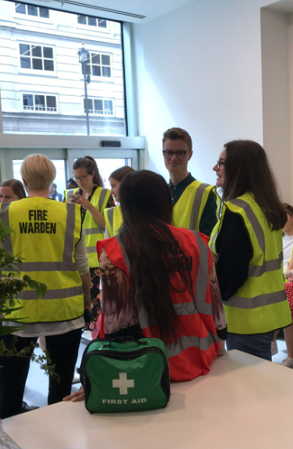
Fire Evacuation Duties
  All staff – responsibility for others
  Fire Wardens- check corridors, storerooms etc, assist disabled persons to safe refuges – PEEPs will be in place where needed.
  Fire Marshals – escort persons to Assembly Points, report any issues to fire brigade or responsible person.
  Assembly points map on following slide.
  Debrief your staff and students post event.
Notes:
Fire Wardens are located in each building on campus and at our external sites. It is important to follow their instructions.
If the Fire Warden in your building isn’t available Campus Service and Facilities staff members will act as Fire Wardens in support during operational hours.
Fire Wardens will normally be identified by their high viz vests but this may not always be the case.
A Fire Warden list for each building on campus will be available on the AUB Health and Safety intranet site under ‘Campus Fire Safety Arrangements’.

Slide 58
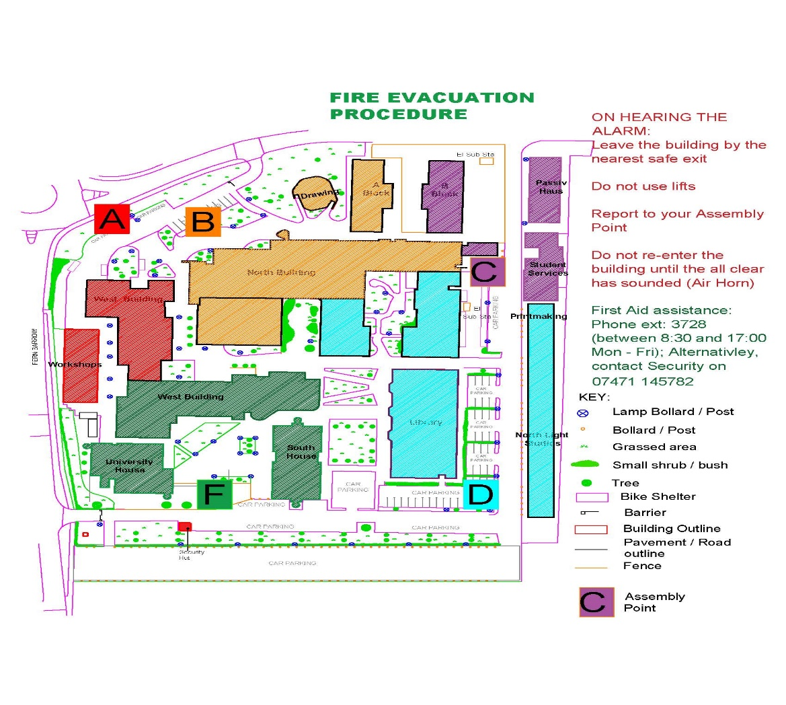
Muster Points
Notes:
Colour coded Campus map’s showing assembly point locations marked in alphabetical letters A to F are located at each access and egress point on Campus.
For example: Assembly point A (coloured in red) will serve the Innovation and Workshop building and West Building zones (also coloured in red).

Slide 59

Accident / Incident & Injury Reporting
  Please Report:
  EcoOnline online health and safety platform.
  Intranet - Report Forms- Health & Safety - Intranet
  Email: jpritlove@aub.ac.uk
  Notify a Technician or another member of staff if you are unsure.
  Intranet>Campus Services>Health&Safety>Forms and Reports
Notes:
AUB has myriad of activities in which safe working conditions are key. The continual collection of safety data including incident reporting is fundamental to allow a more pragmatic approach to safety management.
A report will be treated with confidence, there is a ‘Just Culture’ at AUB, and the concept is to learn from the incident in order to improve our safety systems or the ‘way we do things’. A proactive reporting approach will create greater resilience to risk within our university, this will enable us to conduct more exciting variability of work and creative activities for our staff and students.

Slide 60
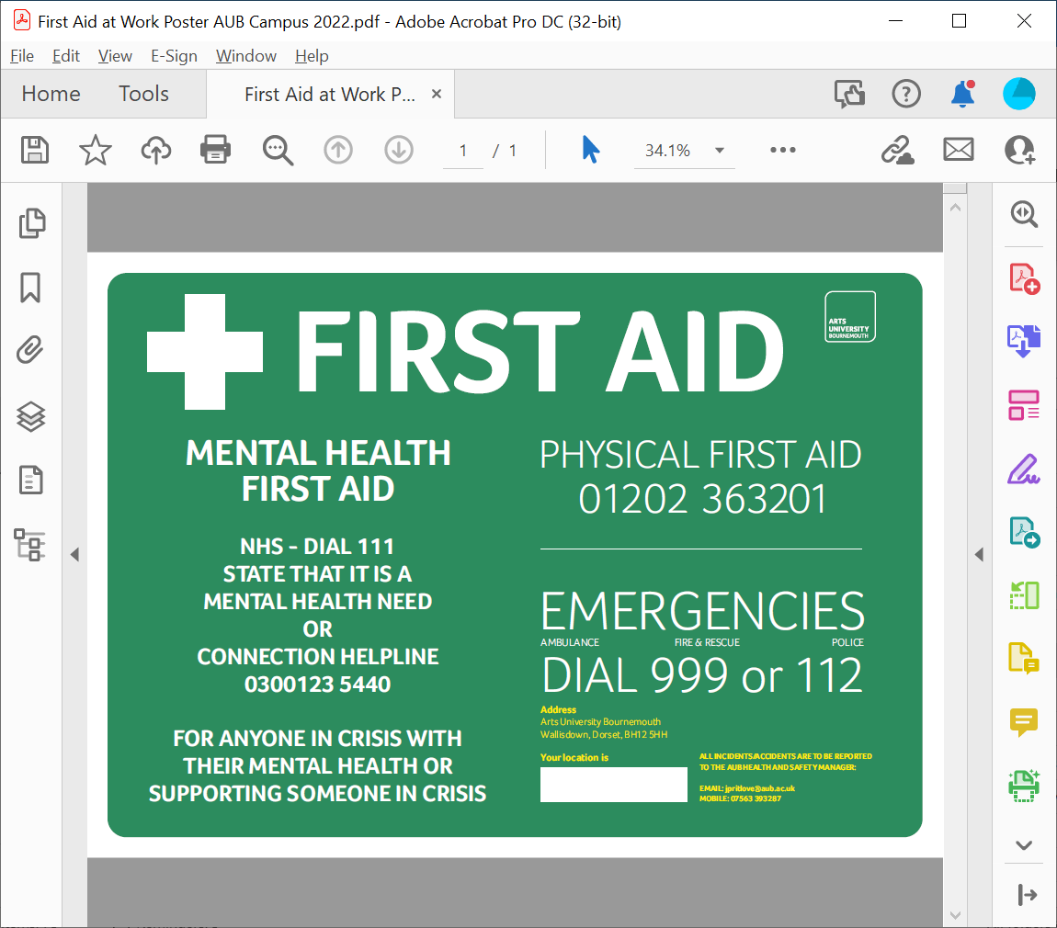
First Aid
Ways of obtaining first aid assistance:
  Call: Reception 01202 36(3201)
  Seek help from local First Aider
  Tel: Facilities technicians ext: 01202 36(3278)
  Report to Jim Pritlove.
  Signs in the workplace.
Notes:
If you require a First Aider on campus or at an AUB external site then dial the number on the poster.
The Physical First Aid number is manned 24 hours by a security team member.
The security team are all qualified First Aiders. There is also a list of campus trained First Aiders at the Security office. This list will be used if the security team are unavailable.
All First aid incidents must be reported to me the Health and Safety manager.
You can report the incident by using the intranet, just go to the AUB health and safety web page and click on ‘Report an incident’.

Slide 61
Conflict Management – Personnel Security Code Word.
Call security desk for support and include the sentence into the call:
“my keyboard is broken”
The security team will come to your office and provide support for you during difficult situations.

Slide 62
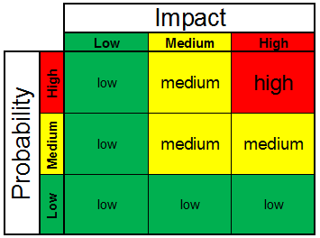
Risk Assessments
  Who's responsible?
  Management of Health and Safety Regulation 1999
  When to use one?
  Planning events and activities.
  Chemicals (COSHH)
  Who can help me?
Notes:
When we are planning activities on campus, at our external sites, or further afield we as the collective or as the individual have a duty to make a suitable and sufficient assessment of the risks to the health and safety of staff, students and others who may be affected by the University's activities. It does not expect us to eliminate all risk, but requires us to protect people as far as is reasonably practicable.
Risk assessments are a legal requirement under the Health and Safety at Work Act 1974 and the Management of Health and Safety Work regulations 1999.
For guidance to create risk assessments please contact your line manager. Or alternatively, contact me and I shall provide advice and guidance or training.

Slide 63

Health and Safety Law
Notes:
The Health and Safety at Work etc Act 1974 is the primary piece of legislation covering occupational health and safety in Great Britain.
It sets out the general duties which:
employers have towards employees and members of the public
employees have to themselves and to each other
certain self-employed have towards themselves and others
Under the Health and Safety legislation are statutory instruments or regulations.
One such regulation - The Workplace (Health, Safety and Welfare) Regulations 1992 requires the workplace and workstation to be of a suitable and safe standard, maintained and cleaned correctly, with adequate ventilation and lighting. We advise you report any issues with your workplace or workstation to your line manager. If you observe or experience an unsafe act please report it to me or your line manager.

Slide 64
Responsible Persons
Who are they?
All staff members
Technicians
AUB Health and Safety Manager.
Notes:
We are responsible for each’s health and safety at AUB.
Within departments and schools there are senior technicians and technicians that will be the designated responsible person. They will have received more specialised training and are here to support staff and students.
The Health and Safety manager is always available to help AUB employees and students.
Please don’t hesitate to contact me at the Estates and Campus Services office.

Slide 65

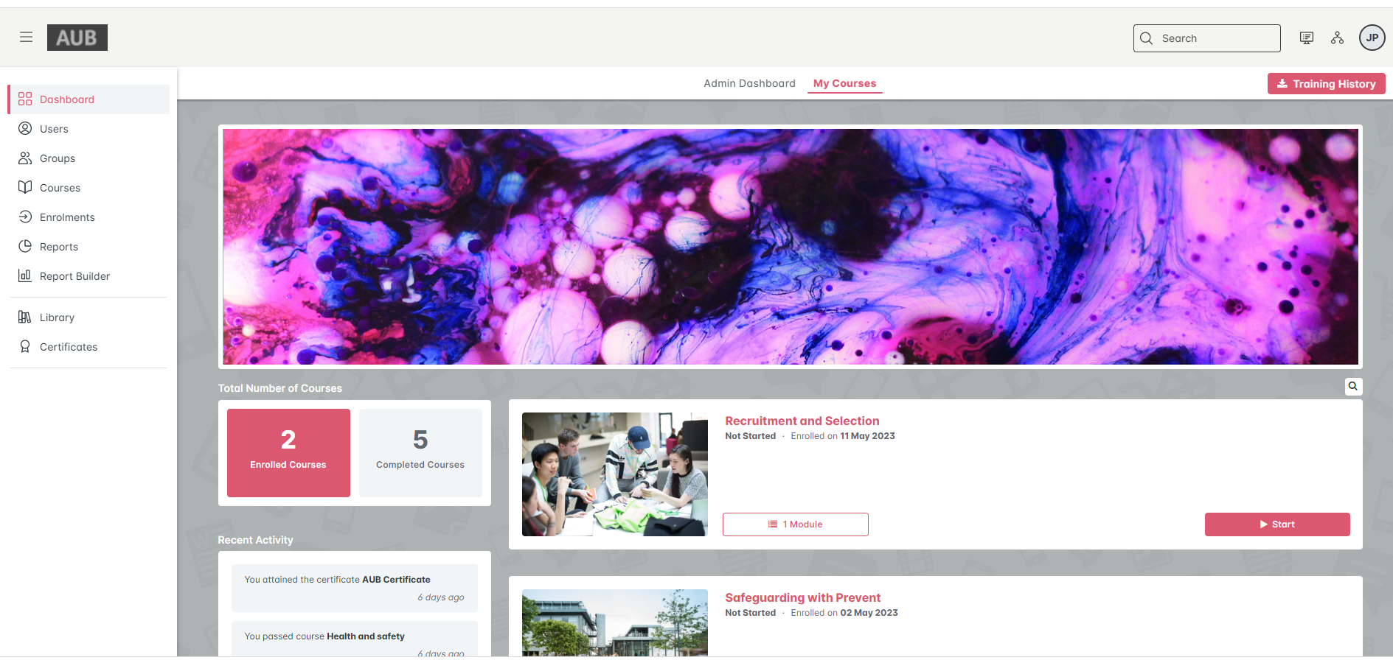
Health & Safety Online Staff Training
Notes:
The Health and Safety online training is mandatory and is available on the MyAUB intranet, click on the HR section and then the Training and Development section to see your courses to be completed.

Slide 66
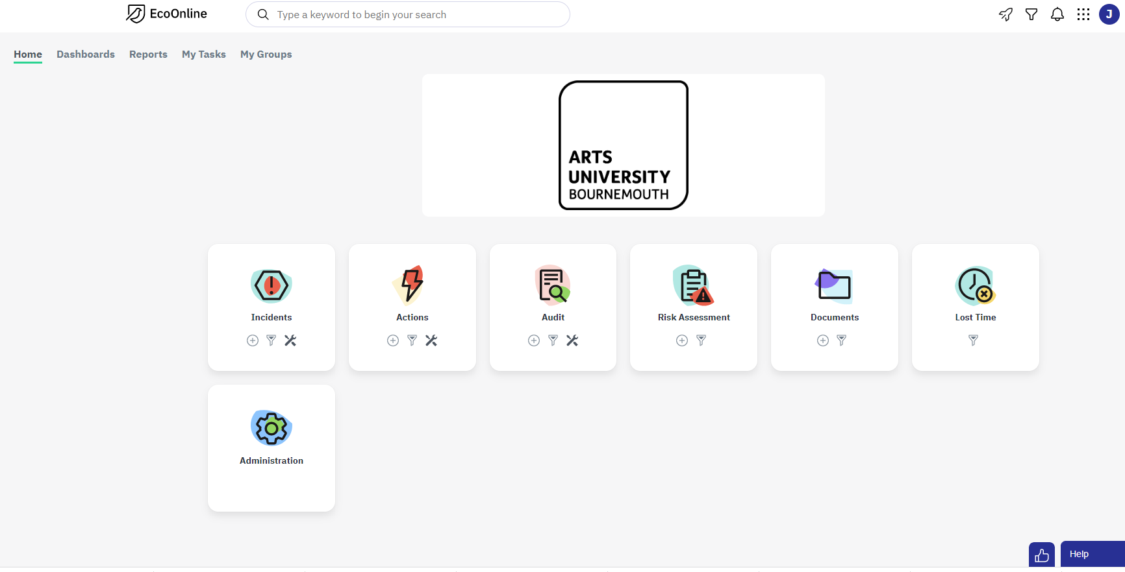
Health & Safety Online Platform
Notes:
EcoOnline is the AUB’s health and safety management software. The system will help the user report health and safety incidents or concerns and create AUB risk assessments. The system is accessible on the AUB intranet, click on the Health and Safety web page, then click on the EcoOnline section and it will automatically take you to your personal account.
To open an account please contact the Health and Safety manager email: jpritlove@aub.ac.uk.

Slide 67
Questions?
End of Presentation

Slide 68
Content
- Fire Safety
- Fire Evacuation Duties
- Accident Reporting
- First Aid
- Risk Assessment
- AUB Health and Safety Management
- COVID–19
- Health and Safety Online Platforms

Slide 69
AUB Health and Safety Manager
- AUB’s health and safety ‘Competent Person’
- Expert advisor on all health and safety policy and strategy
- Oversee systems development and implementation
- Assess the risks
- Provide information about risks
- Consult employees and support them
- Provide health and safety information (HSE 2022).

Slide 70
Fire Safety
  Action on the event of a fire
    Close doors and windows
    Follow exit signage
    Safest and shortest route out
    Do not use lifts
    Assembly Point – evacuation map
    All clear – who decides?
Notes:
In the event of a fire or on hearing the fire alarm then it is the responsibility of members of staff to escort students from the building to one of the assembly points. Do not put yourselves at risk but try to reduce the effects of the fire by closing doors and windows.

Slide 71
Fire Evacuation Duties
  All staff – responsibility for others
  Fire Wardens- check corridors, storerooms etc, assist disabled persons to safe refuges – PEEPs will be in place where needed.
  Fire Marshals – escort persons to Assembly Points, report any issues to fire brigade or responsible person.
  Assembly points map on following slide.
  Debrief your staff and students post event.

Slide 72
Notes:
Colour coded Campus map showing assembly point locations

Slide 73
Accident / Incident & Injury Reporting
  Please Report:
  Engage online health and safety platform.
  Intranet - Report Forms- Health & Safety - Intranet
  Email: jpritlove@aub.ac.uk
  Intranet>Campus Services>Health&Safety>Forms and Reports

Slide 74
First Aid
Ways of obtaining first aid assistance:
  Call: Reception 01202 36(3201)
  Seek help from local First Aider
  Tel: Facilities technicians ext: 01202 36(3278)
  Report to Jim Pritlove.
  Signs in the workplace.
Notes:
If you require a first aider either telephone Reception or contact the nearest trained first aider in your studio or location. Alternatively you can contact Security or Campus Services personnel

Slide 75
Risk Assessments
  Who's responsible?
  Management of Health and Safety Regulation 1999
  When to use one?
  Planning events and activities.
  Chemicals (COSHH)
  Who can help me?
Notes:
Risk Assessments are the cornerstone to good management of health and safety. The process is firstly to identify the hazard from electricity to using a bandsaw and asbestos to water hygiene. The risk is the chance that the hazard can cause harm. Control measures determine how the risk can b reduced and the hazard made safe

Slide 76
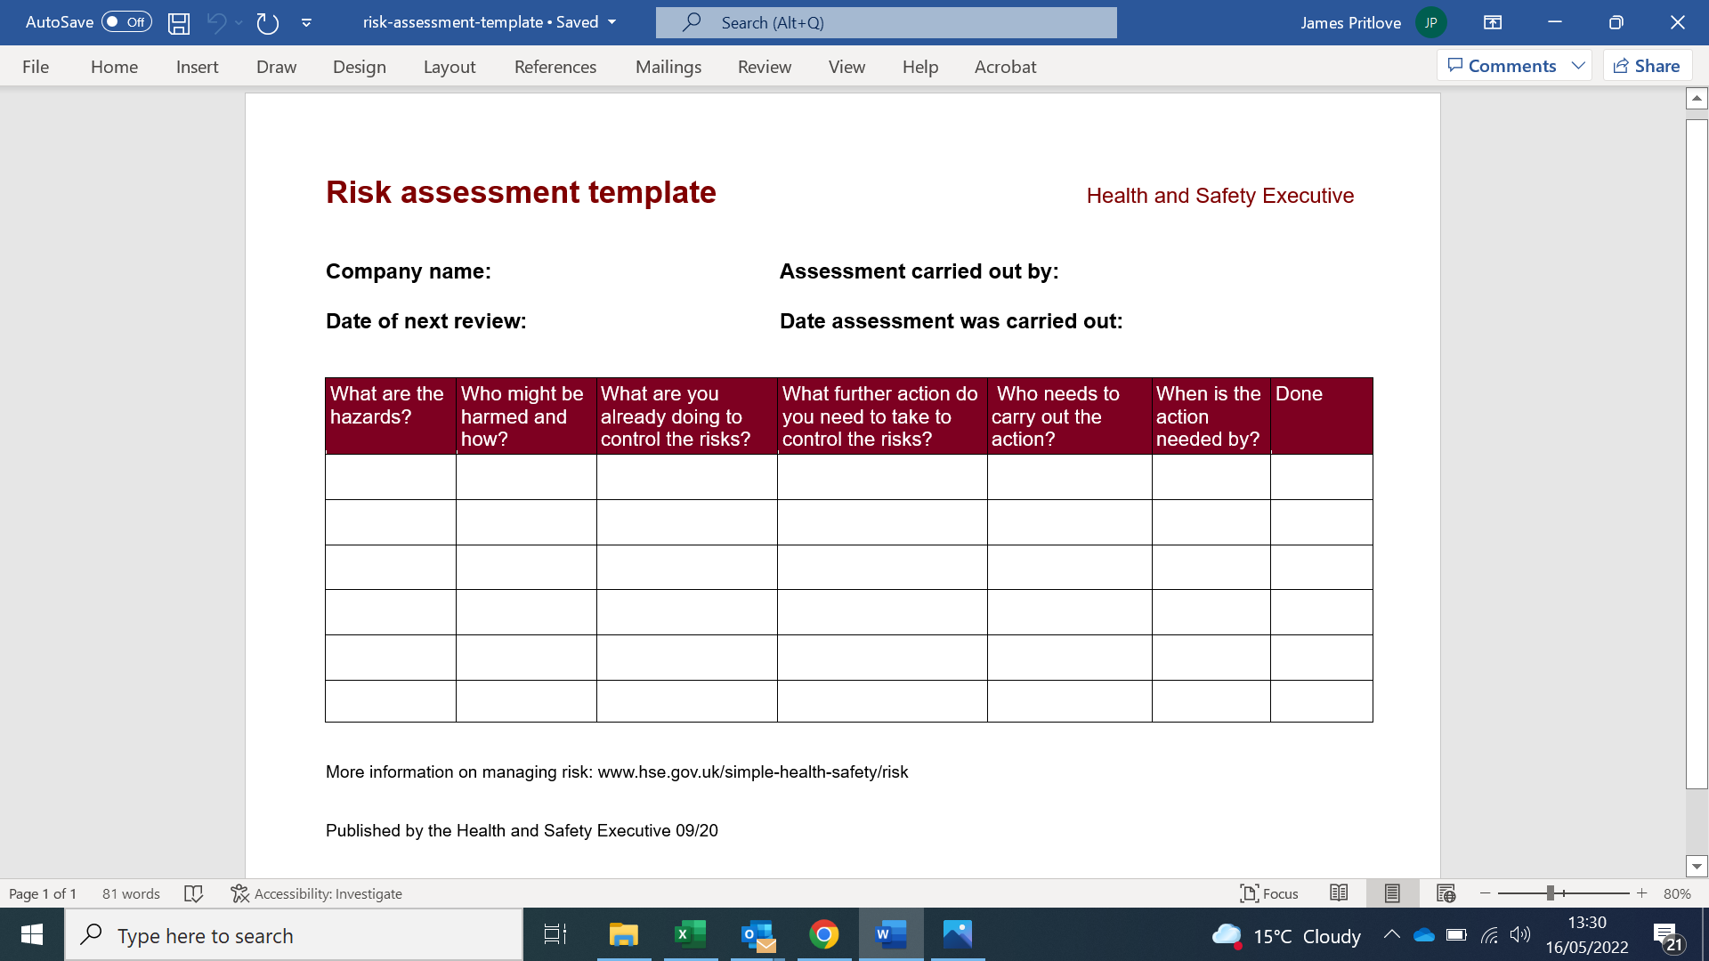
Assessing the Risks
Notes:
Eliminate – remove the hazard completely
Reduce – or substitute, use other methods, limit the time using the process/exposure, alternative means eg scaffold tower not ladder
Isolate – erect barriers, insulate
Control – training, supervision, safe systems of work, qualifications, skills
Personal protection – PPE, gloves, goggles, hi-vis
Discipline – inform others of hazards, follow instructions, close fire doors, do not use wedges

Slide 77




COSHH - Control of Substances Hazardous to Health
  Substances – toxic, corrosive, irritant, harmful,
  Mists, vapours, gases, powders
  Inhalation, ingestion, absorption, contact
  SDS – Safety Data Sheet
  Disposal

Slide 78
Health and Safety Law

Slide 79
Health & Safety Management
Duties and Responsibilities
  Employer – "Under health and safety law employers are responsible for managing health and safety risks in their businesses" (HSE 2022).
Notes:
SFARP – So Far As is Reasonably Possible – 3 duties – absolute,

Slide 80
Responsible Persons
Who are they?
All staff members
Technicians
AUB Health and Safety Manager.

Slide 81



Health & Safety Signage
Notes:
Signage – green sign in all rooms; fire doors, fire extinguishers

Slide 82
Covid-19
Information at https://aub.ac.uk/covid-19 including AUB Covid-19 risk assessment
Wearing of face coverings is optional
Good hygiene in the workplace
Natural ventilation in studios and rooms
- What do I do if I'm experiencing flu like symptoms? - https://www.nhs.uk/conditions/coronavirus-covid-19/symptoms/main-symptoms/

Slide 83
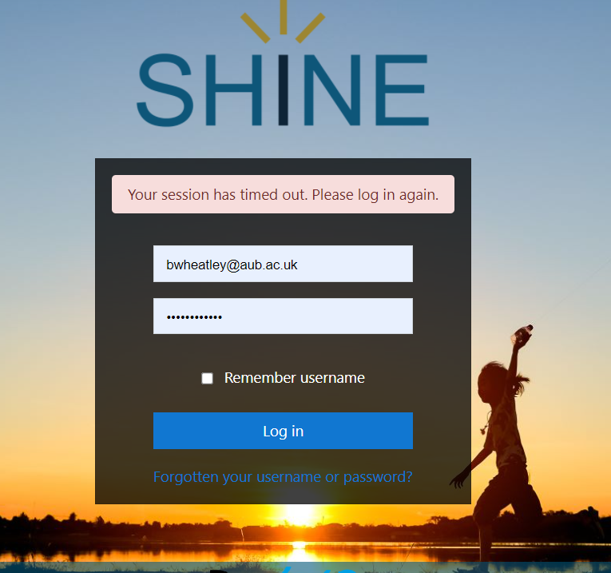
Health & Safety Online Staff Training

Slide 84
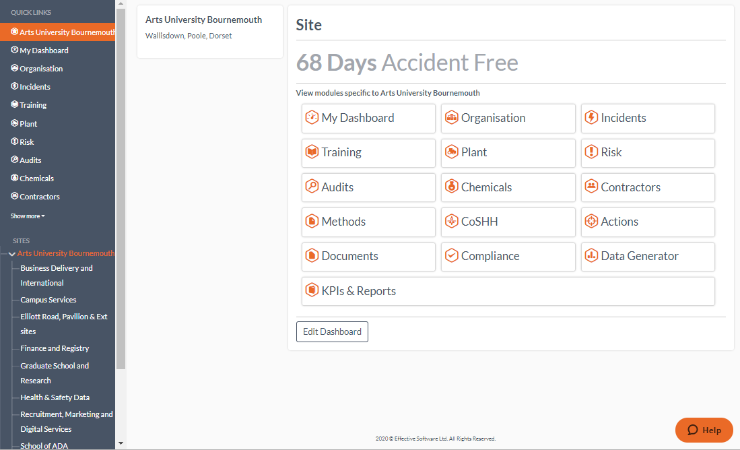
Health & Safety Online Platform

Slide 85
End of Presentation
Any Questions?
My Health and Safety contact details are on the intranet

Slide 86
New Starter Induction
Environment

Slide 87
Context
The context rests on the fact that human activities are having a major effect on the environment at a global scale
Environmental sustainability attempts to address these impacts and identify measures that ensure human needs are met without compromising the ecosystems on which we all depend
The following (Figure 1) gives a striking impression of the scale and rate that global environmental change is happening:

Slide 88


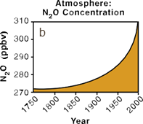








THE INCREASING RATES OF CHANGE IN HUMAN ACTIVITY SINCE THE BEGINNING OF THE INDUSTRIAL REVOLUTION
Figure 1. The increasing rate of change in human activity since the beginning of the Industrial Revolution. From: Steffan et al. (2004)

Slide 89
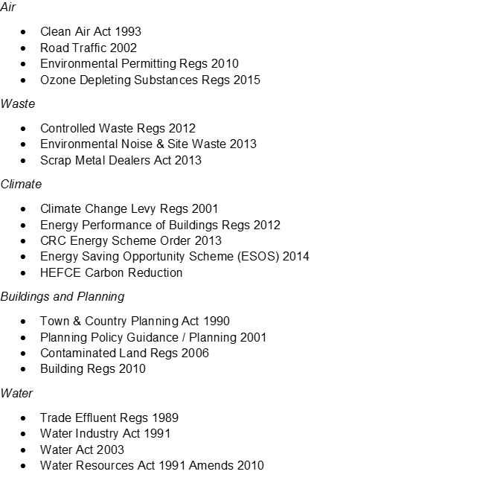
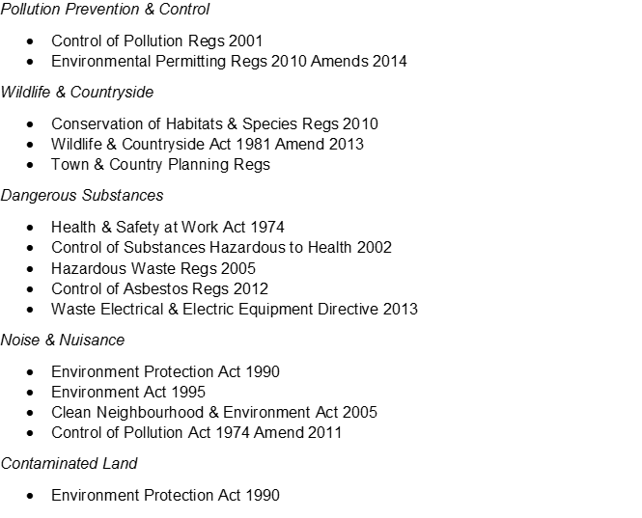

Legislation

Slide 90


Slide 91
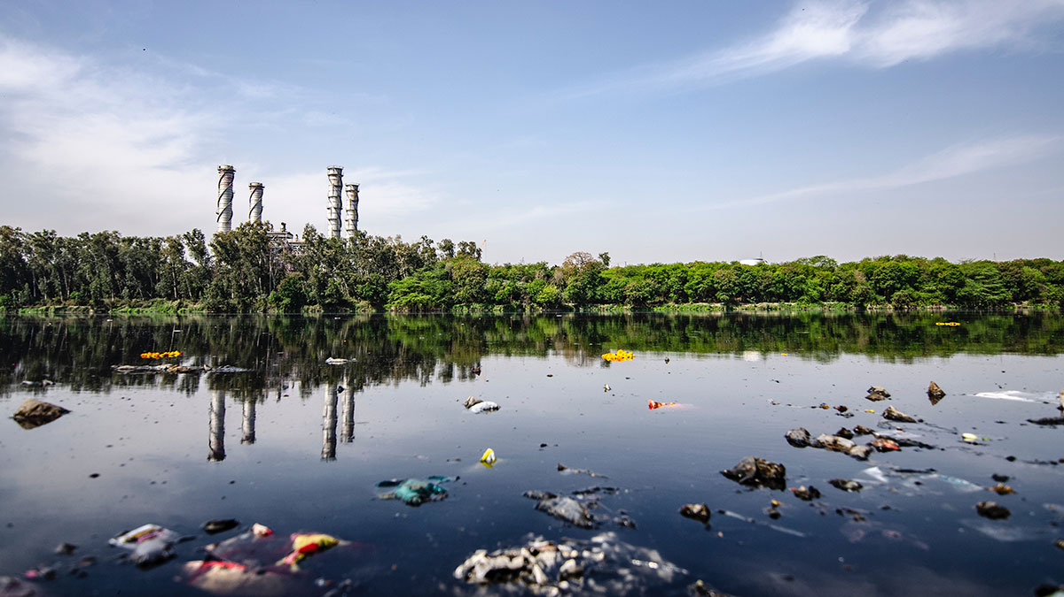
Introduction
AUB acknowledges
Global climate change
Ecological crisis
AUB aims to
Eliminate
Reduce
Compensate emissions
Increase biodiversity
AUB programme of works
Sustainability and Net Zero

Slide 92
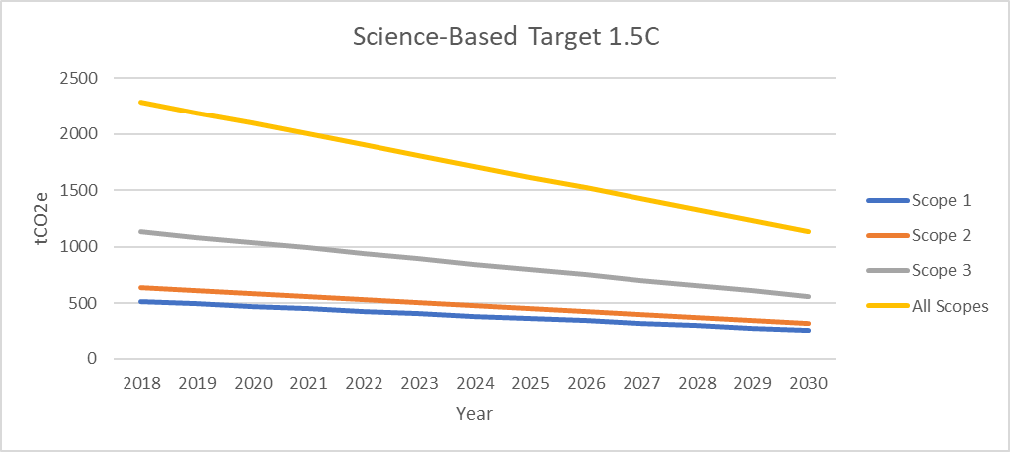
Science-Based Target

Slide 93
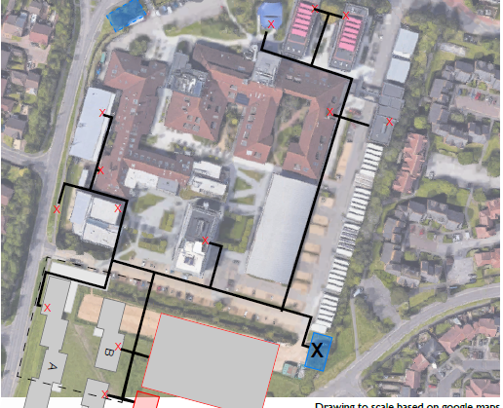
What are we doing now and next?
Salix funding projects 3a and 3b
Heating and electric campus system
Heat Decarbonisation Plan
Carbon Trust
New Energy Management Software

Slide 94

What are we doing now and next?
PPA electric contract to compliment REGO
Digital services moving 15% of server capacity to cloud
New ‘Travel to AUB’ online system
Electrify the AUB vehicle fleet

Slide 95


What are we doing now and next?
Looking to lower waste production and increase recycling
Fairtrade campus certification 3-star achieved 2022
Looking to become a Hedgehog Friendly Campus

Slide 96

What are we doing now and next?
Rewilding project
Expanded our Dye Garden
Created a herb garden
Dorset Sustainable Palm Oil champion

Slide 97
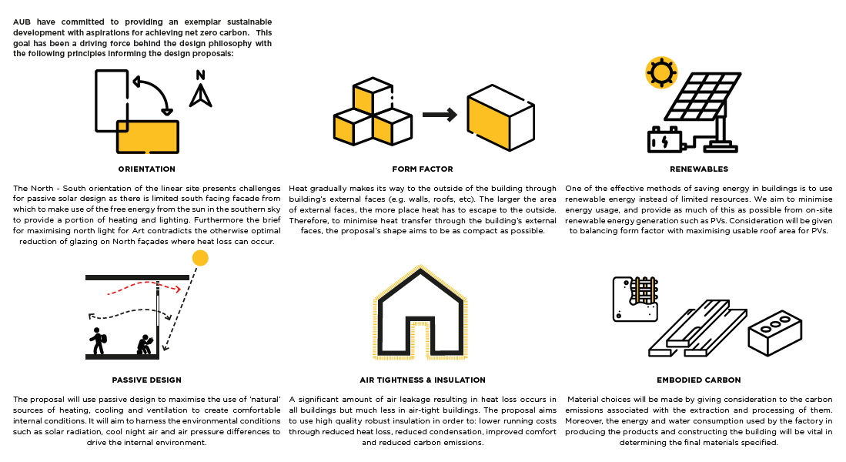
Further influence
New builds and refurbishments – net zero projects
Air source heat pumps and PV on the new Northlight Studio builds
PV on campus halls
ASHP in Innovation studio
Sustainable Development Goals in Level 4 curriculum

Slide 98
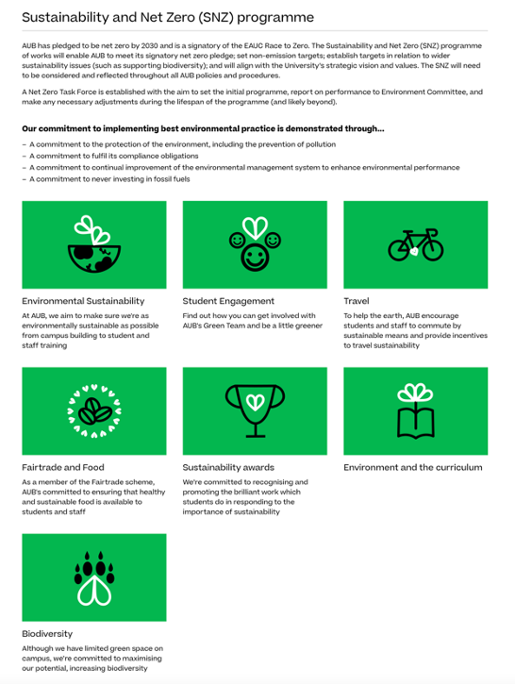
Environment webpages
Updated webpages: aub.ac.uk/environment
New sections and icons
New video content
Ongoing updates to reflect ongoing progress

Slide 99
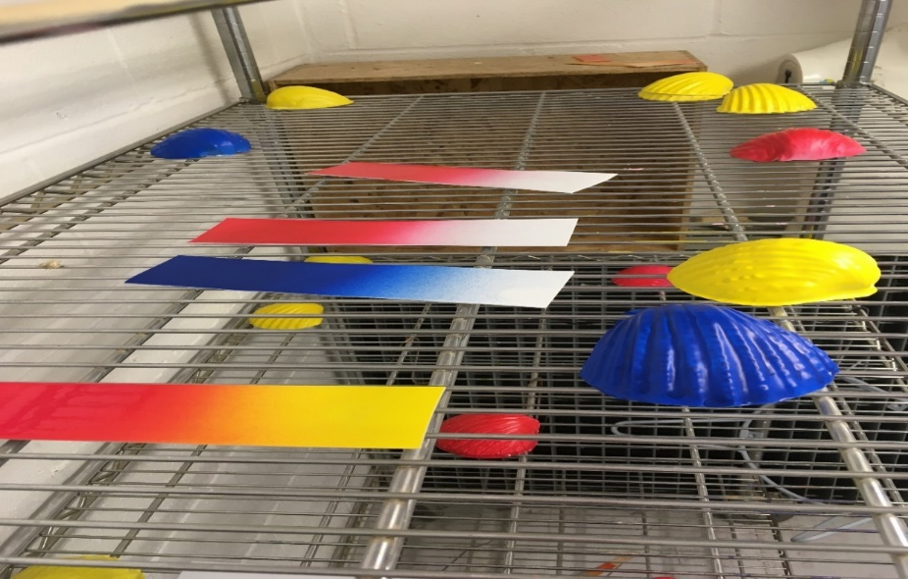
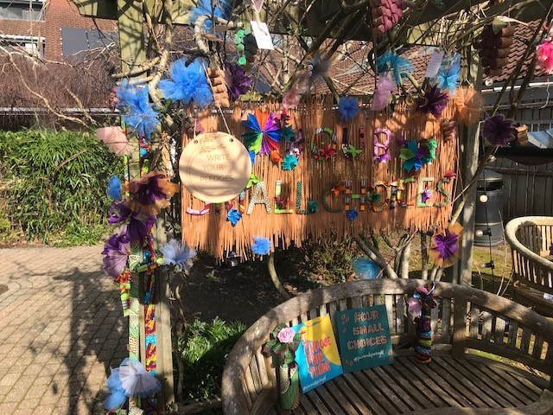
AUB Academic and Technician Demonstrator Projects
BA (Hons) Performance Design and BA (Hons) Costume and BA (Hons) Event Management
BA (Hons) Modelmaking

Slide 100
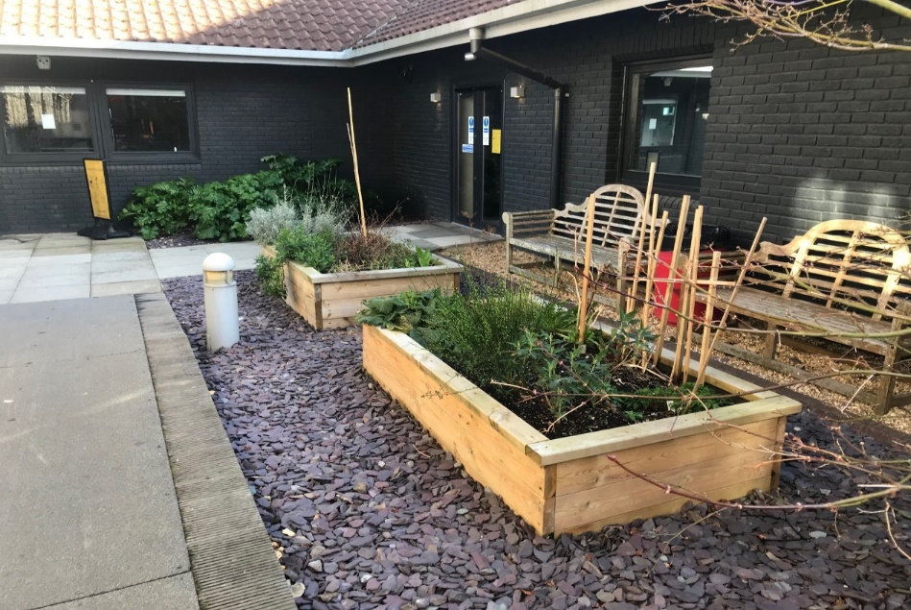

AUB Academic and Technician Demonstrator Projects
BA (Hons) Creative Writing
Dye Room – School of Art, Design and Architecture

Slide 101
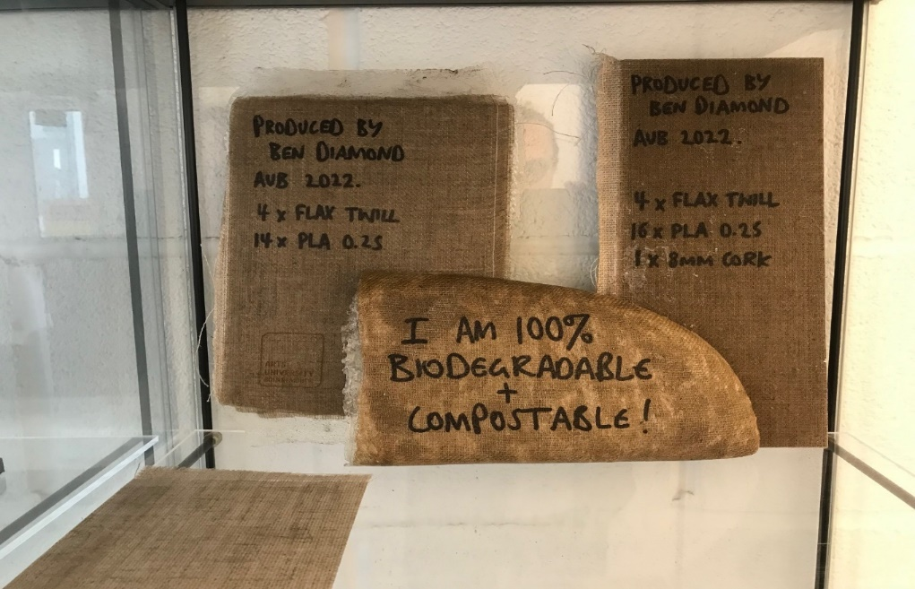

AUB Academic and Technician Demonstrator Projects
Workshop
Film and Television

Slide 102

AUB Human
Travel Consultation
Green week
Staff Induction
Travel Survey
Greenzine
Ethics Day
New Ideas Welcome
Staff Sustainability Ambassadors
AWARENESS AND ENGAGEMENT

Slide 103

Sustainability and Net Zero Project Team

Slide 104
Thank You
Any Questions?
http://aub.ac.uk/campus/environment/

Slide 105
MINI BREAK

Slide 106
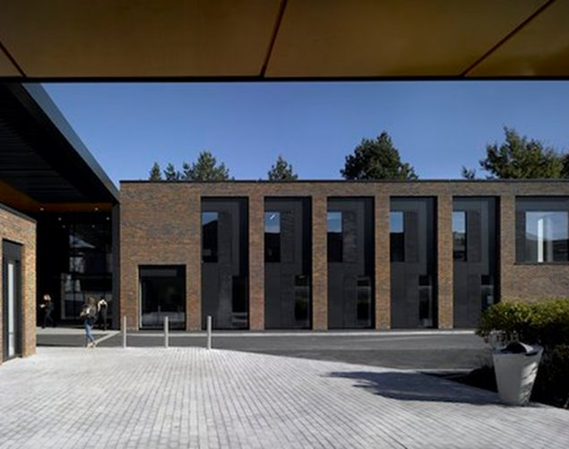
AUB Student Services
Contact:
studentadvice@aub.ac.uk
+44 1202 363780
Director of Student Experience and Employability:
Heidi Cooper-Hind
Introduction

Slide 107
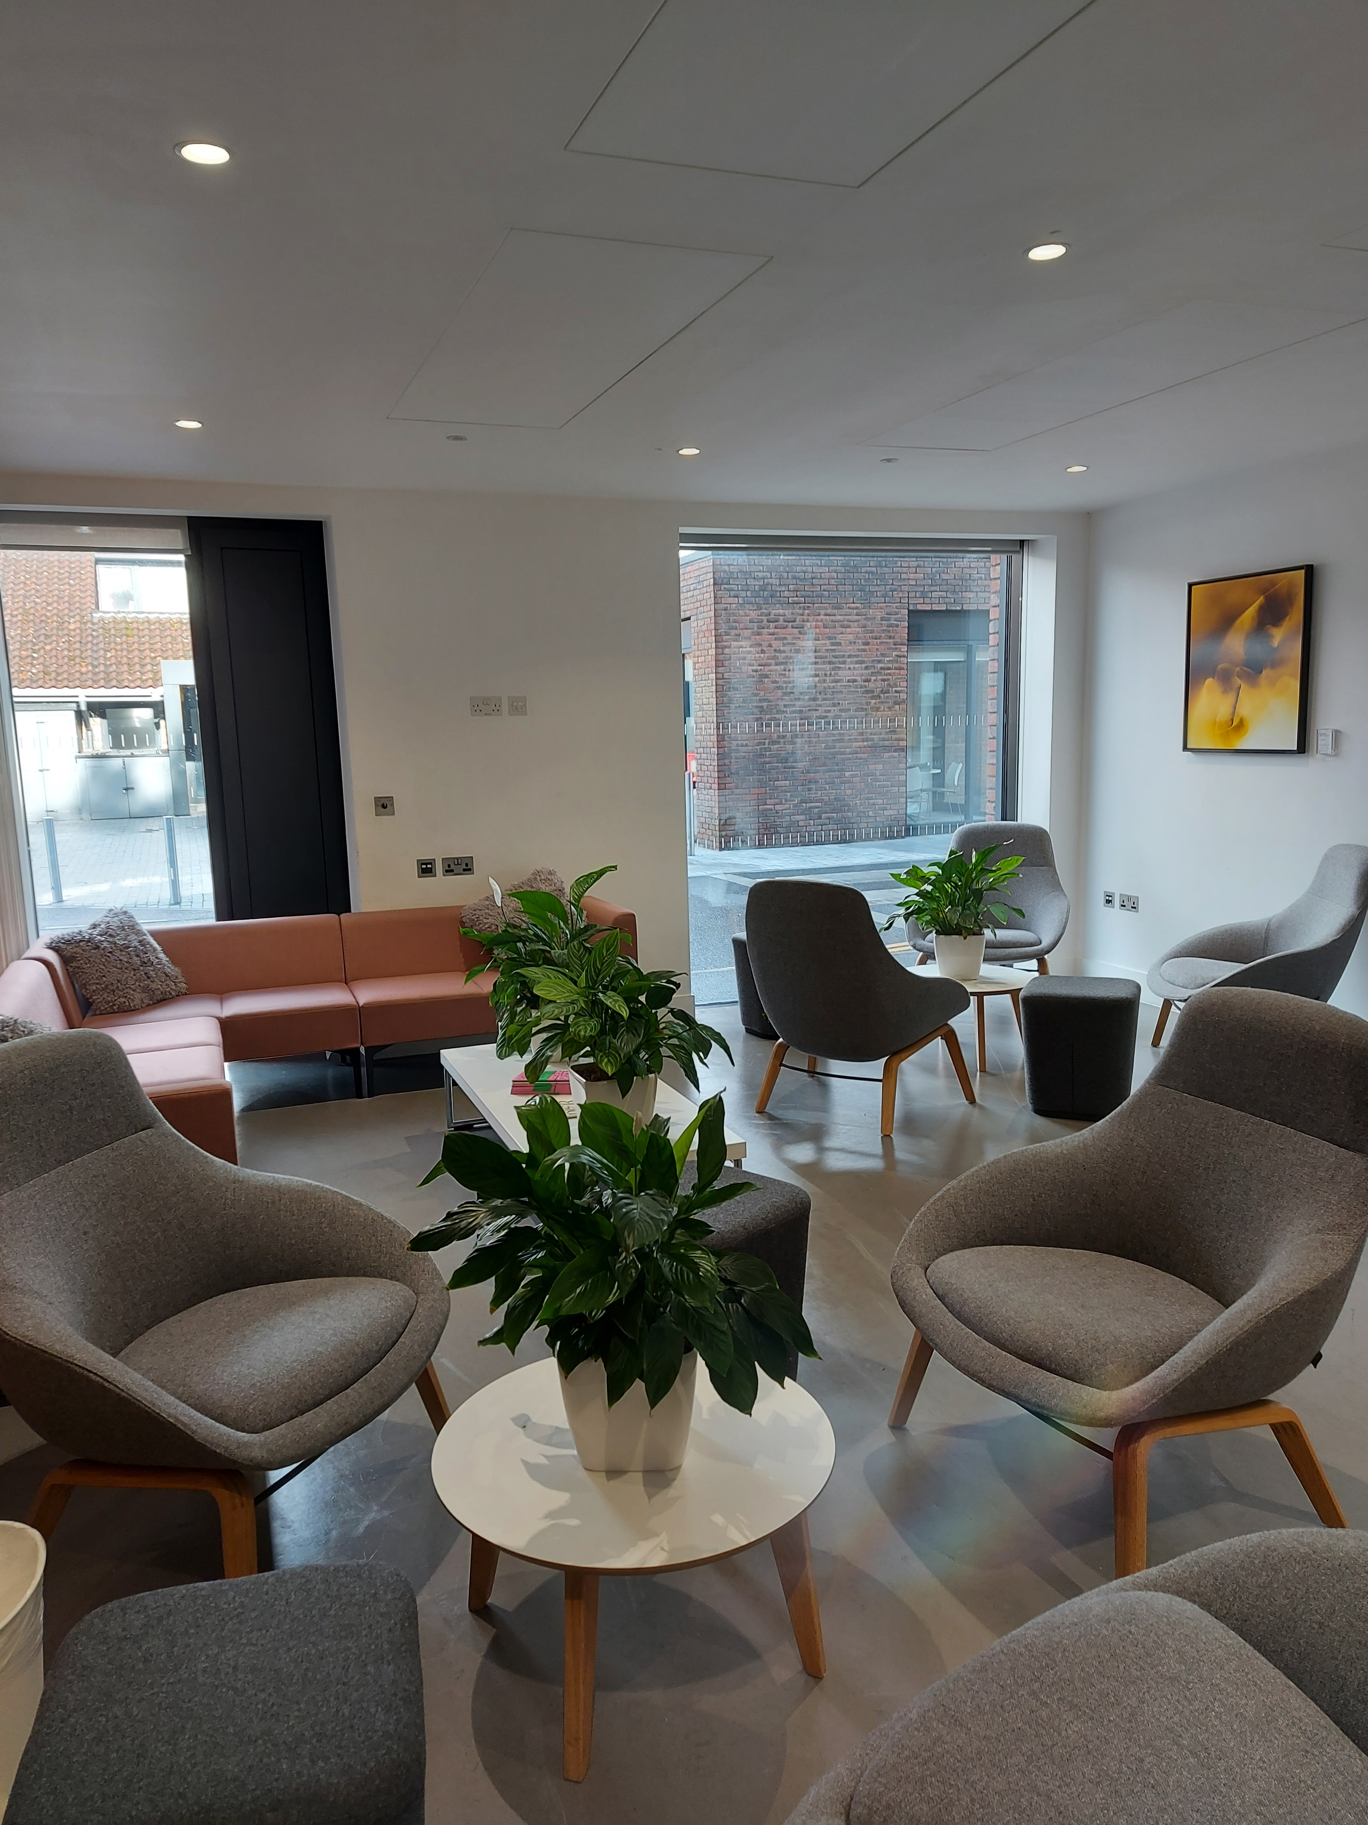

Student Advice
General Student Services communications.
In person and online support with all practical issues.
Financial Support administration
Support with all services appointments.
@aubsupport
All appointments via AUB Bookings
Accommodation & Advice Manager: Carrie Packer
studentadvice@aub.ac.uk

Slide 108
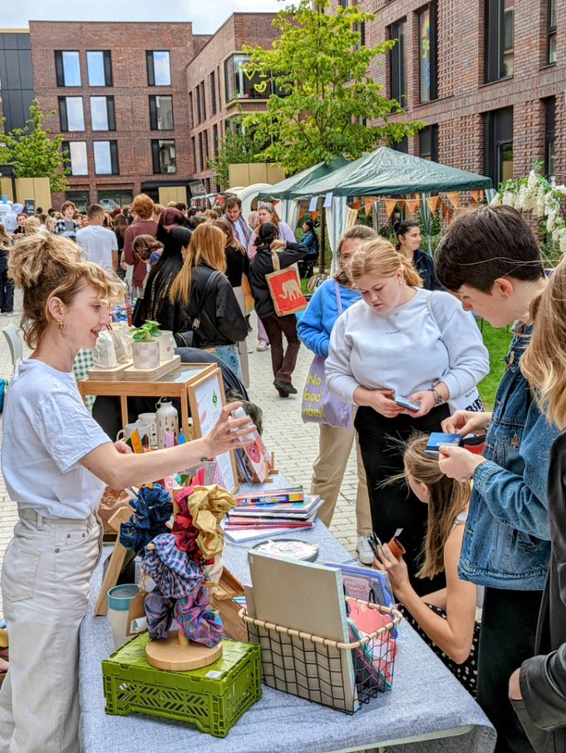
Accommodation
&
AUB Community
3 AUB Halls of Residence:
Campus Halls
Madeira Road
Home Park
@aubchampions
AUBStudentpad - private housing website
studentadvice@aub.ac.uk

Slide 109

Disability
& Mentoring
Disclosure on-line via the Applicant portal or E-vision
Disability disclosure added to student dashboard upon receipt of medical evidence
AUB process for agreeing reasonable adjustments to teaching / assessment
Dyslexia Screening – optional - many or most signs may be referred for full assessment
Mentoring available for specialist, specifically tailored 1:1 support needed through a disability
Student Support Manager: Ce Johnson
disability@aub.ac.uk

Slide 110


Counselling
BACP Accredited Counselling Team
In person and online appointments.
Non-judgmental service
Single therapeutic ‘person centred’ sessions
Staff Counsellor : staffcounsellor@aub.ac.uk
Confidential
counselling@aub.ac.uk

Slide 111
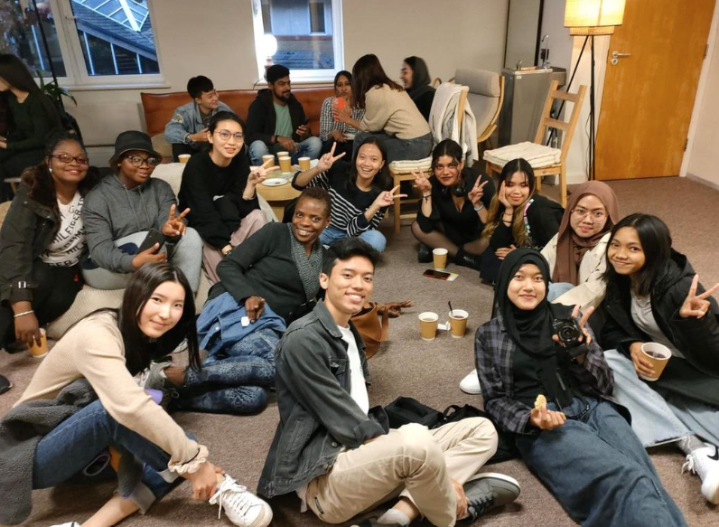
Faith & Reflection
Inclusive faith and reflection centre for those of all faith and of none.​
Open to all students and staff​
Prayer rooms, quiet room, kosher kitchen
Global Café ​
Located in Talbot House, BU Campus​
@buandaubfaith
faithandreflection@bournemouth.ac.uk
Rev. Ruth Wells, Chaplain

Slide 112
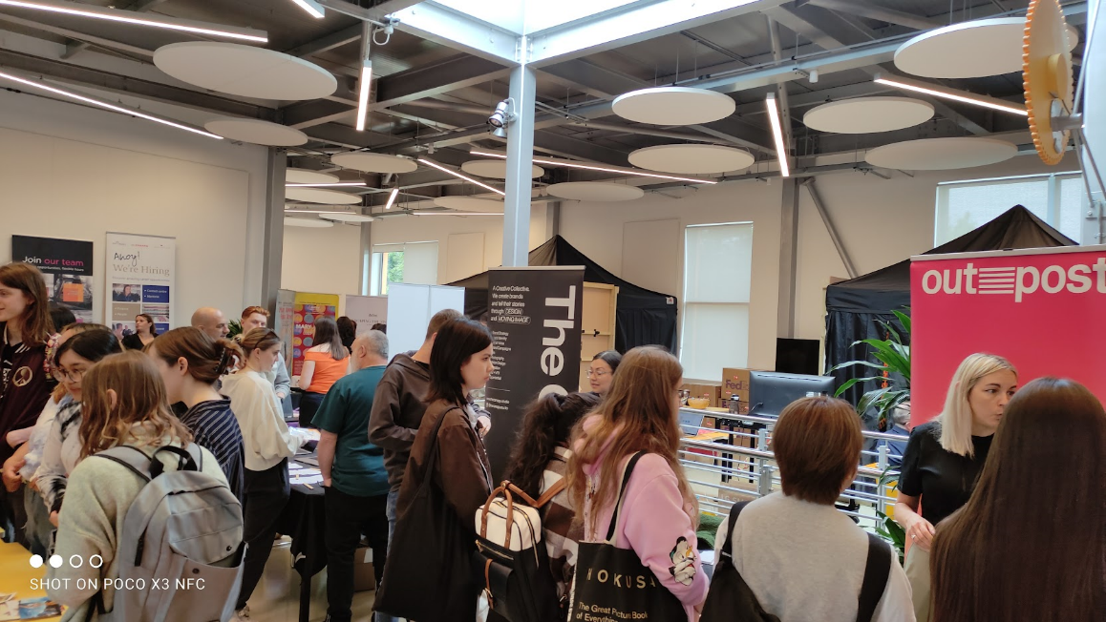
AUB Futures
1:1 support for students with variety of topics including CVs & Applications to Freelancing.
Students may also discuss their options if considering changing or leaving their course.
Close course collaboration – in course delivery
Industry events
AUB Futures Careers Hub​
Available up to 3years post graduation
@aubfutures
futures@aub.ac.uk
Employability Manager: Alison Zorraquin

Slide 113

Wellbeing
Why Wellbeing?
Wellbeing daily Drop-Ins – in person and online
The Retreat – Tolpuddle Annex 2, BU Campus (next to Talbot House)​
​
Mental health first aid training – staff and students​
Wellbeing Webinars​
​
Fitness to Study policy​
wellbeing@aub.ac.uk

Slide 114

Study Skills
& EAP
All you need to know!
1-1 tutorials – open to all students
In person and online appointments
Study skills open workshops
IFD English for international students
Sessions on your course to help students develop academic skills
Resources on Viewpoint / Canvas
studentadvice@aub.ac.uk
Director of Student Experience & Employability:
Heidi Cooper-Hind

Slide 115

Student Conduct
&
Complaints
Report & Support
Student Code of Conduct ​
Disciplinary Policy & Student Complaints Procedure​
Data protection and speaking to parents​
Safeguarding and Prevent – contact safeguarding@aub.ac.uk
PREVENT
complaint@aub.ac.uk
Senior Investigating Officer – Aimee Garner

Slide 116
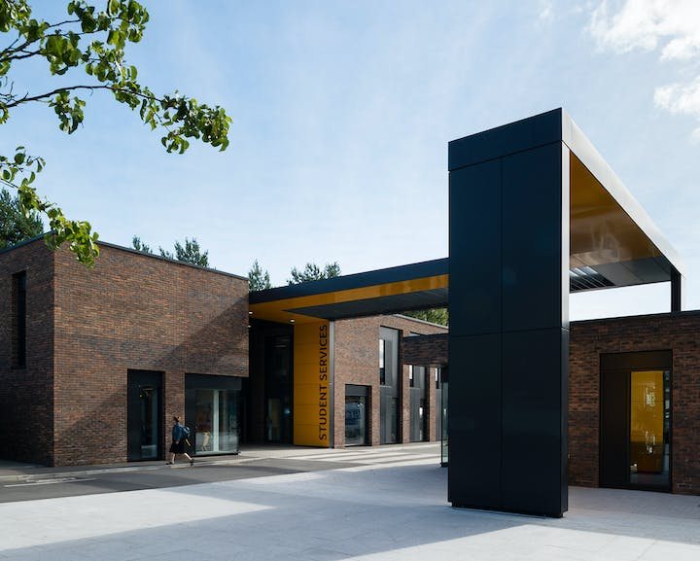
AUB Student Services
Contact:
studentadvice@aub.ac.uk
+44 1202 363780
or pop in and say hello!

Slide 117

New Starter Induction
Equality, Diversity & Inclusion (EDI)

Slide 118
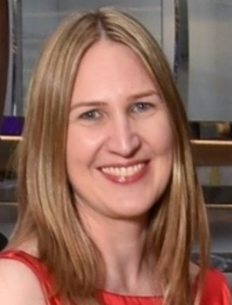
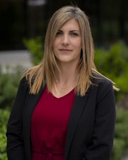
Meet the team
Sarah Addis –
HR EDI & Wellbeing Partner
Cathy John –
EDI Academic Advisor and Senior Lecturer
Abby Weekes –
Senior Officer, EDI

Slide 119
Equality
Diversity
Fair treatment and equal opportunity
Recognising and valuing difference
BELONGING
Belonging:
Sense of being accepted and valued for your unique contribution to a group; feeling comfortable to be your true self
Inclusion
Everyone has an opportunity to contribute and influence; an inclusive culture supports everyone to be their best

Slide 120
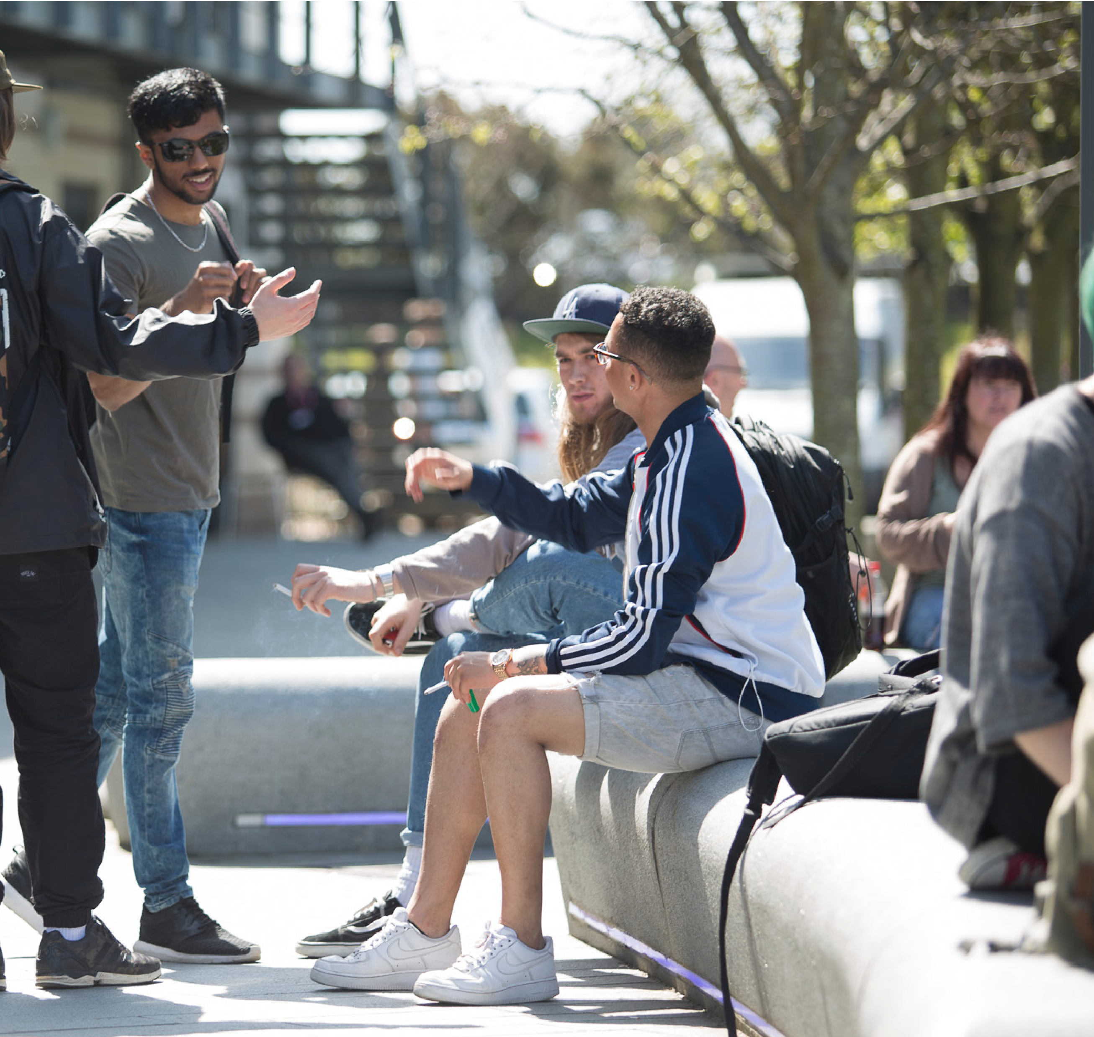
EDI Goals
Belonging
A community of advocates
Promoting equity
Open dialogue (voice)
External recognition and collaboration

Slide 121
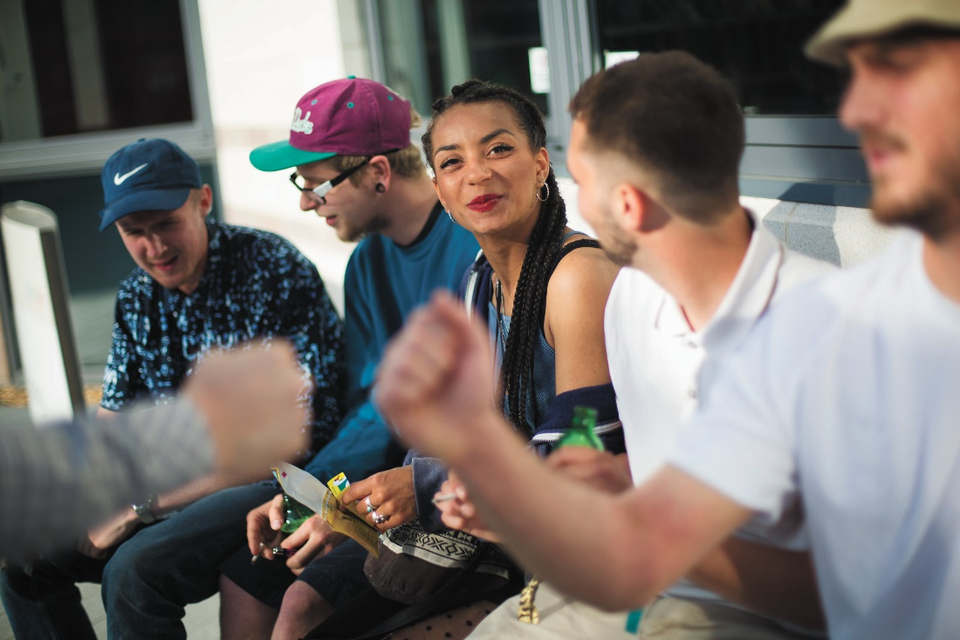
EDI plans and projects
Inclusive curriculum
Training and development
Staff groups and networks
Annual surveys
Race Equality Charter Pilot
Inclusive recruitment
Inclusive assessment
Raising awareness

Slide 122




EDI training and development
Trans Awareness
Conversational Integrity
Gender Identity
Confident Conversations
Neurodiversity
EDI thinking in teaching and learning
Allyship
Intersectionality
Anti-Racism
Gender equality
Parents and carers
Unconscious bias
EDI resources

Slide 123

How to get involved
Staff EDI Collaboration Group
LGBTQ+ Network
Join events on campus
Participate in webinars
Share your pronouns in meetings and email signatures
Share your name pronunciation in email signatures
Be an inclusion ally and role model inclusive behaviours

Slide 124
Contacts and resources
edi@aub.ac.uk
LGBTQ+ network: Corin Peacock – cpeacock@aub.ac.uk
EDI resources: Staff EDI Resources
EDI intranet pages: Intranet
EDI website info: EDI
EDI LinkedIn Learning collections

Slide 125

AUB Library
New starter induction

Slide 126
The basics
Your AUB ID card is your Library card
You need to fill in a short form to create your library account. You can do this online.
If you need to replace your ID card please let us know so that we can update your account.
To borrow you will need to create a Library PIN number. This is a short process and can be reset easily. We will send you instructions when you join.
Foundation, UG and PG students will be enrolled automatically and their details are updated using the central system (SITS / eVision)

Slide 127

Using the Library (for staff)
Borrow 25 items
2 week loans
Automated renewals unless someone else has asked for the item.
We send you an e-mail to say what you can keep and what needs to be returned.
Online account so you can keep on top of your loans.
Fined if you don't bring back an item reserved by someone else. £1 a day per item.

Slide 128
We are open 7 days a week
Monday to Friday 8.30am - 5pm Library staff available.
Self service with a Security guard. Monday to Friday 5pm – 9pm, Saturday and Sunday 9am – 4pm
You will need to bring your AUB ID card and know your Library PIN to be able to borrow items during evenings and weekends.

Slide 129

Collections
Print and online
Books
Journals (academic, research, professional and consumer)
Newspapers (online only)
DVDs, Blu-ray, Streaming media
Audio (Radio, plays, poetry readings, interviews, sounds, accents)
Materials library
Artist’s books and Zines
Online specialist databases
Notes:
Mention relevant databases depending on audience:
Arts Professional (News database useful for Events management and Creative writing), trends and forecasting
Box of Broadcasts (TV and Radio free to air TV for educational use, clips, more recent content higher resolution), theatre databases
LinkedIn Learning (IT (Creative and things like Excel) and career development / work practices)
Education source and Social science databases

Slide 130
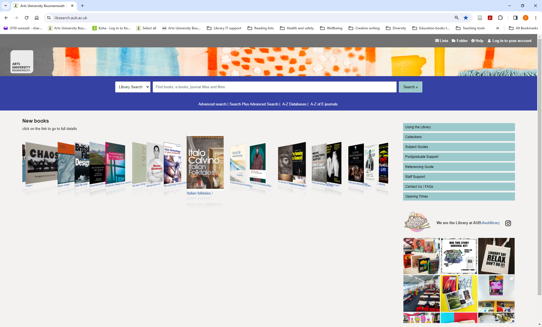
www.aub.ac.uk/library
Notes:
Website (Digital collections as big if not bigger than physical collections – website gateway to that content.
Talk through the menu a little (information about library how things work (using the library), short help videos, subject guides, staff support (research and for teaching practice)

Slide 131
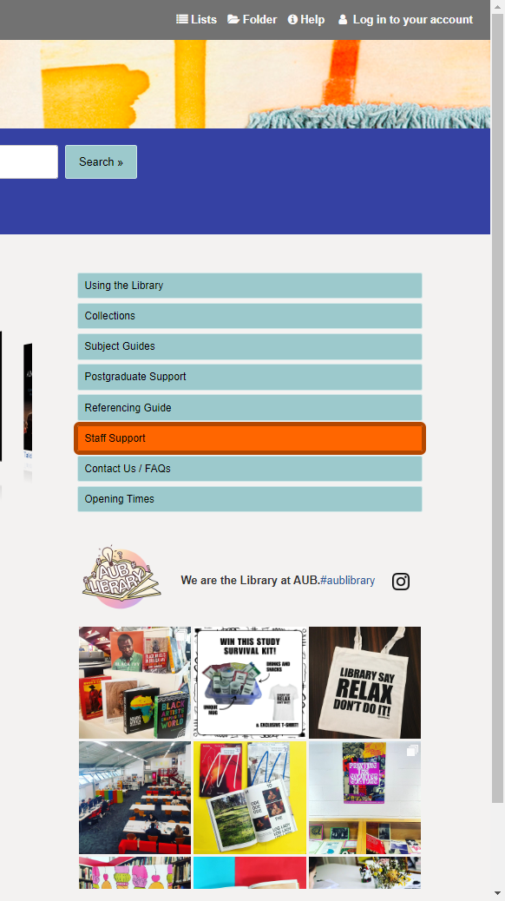
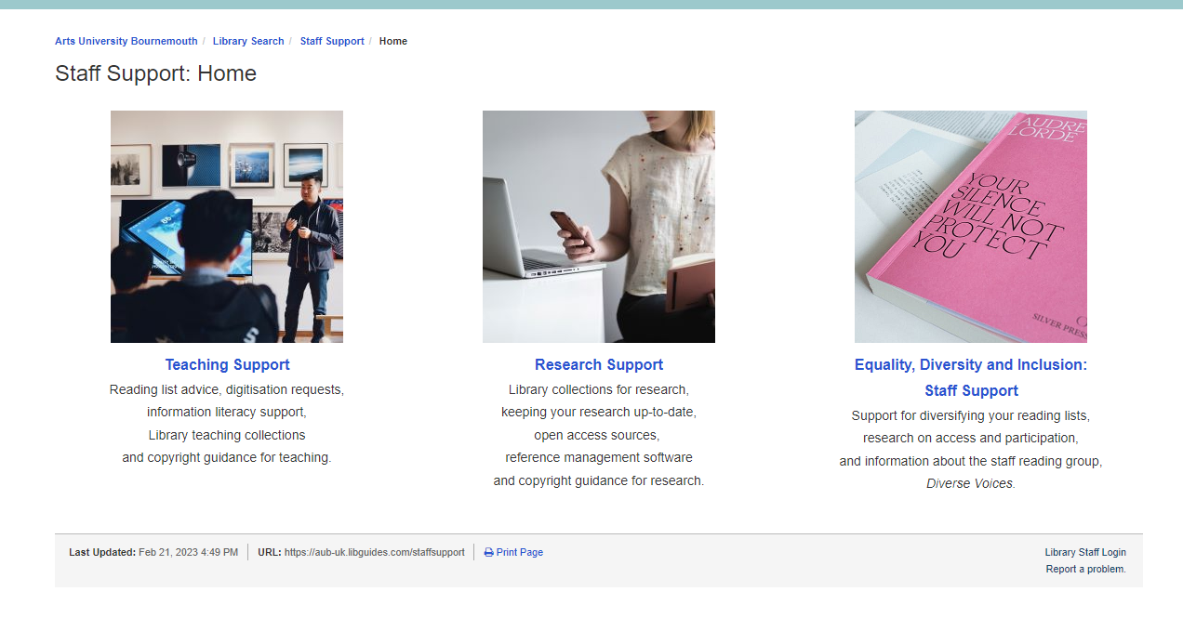
Staff support pages aub.ac.uk/library
Staff support pages aub.ac.uk/library

Slide 132
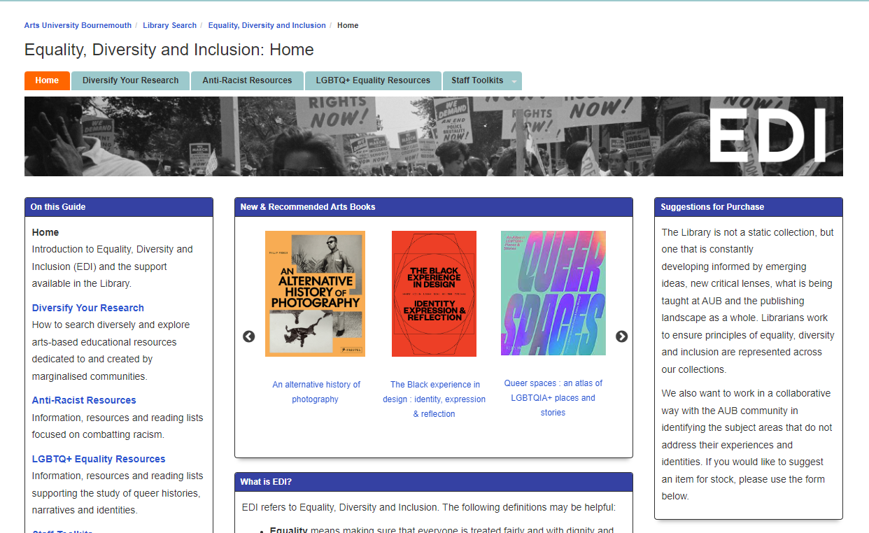
EDI pages
www.aub.ac.uk/library
Using the Library
Equality, diversity and inclusion
Clear definitions of terminology
Option to make recommendations or identify gaps in our resources
Diversify your research
Anti-racism resources
LGBTQ+ Equality resources
Staff toolkits:
Access and participation
Diversify reading lists
Staff reading group: Diverse voices

Slide 133






Subject Librarians
Academic staff – meet with your Subject Librarian for a fuller induction in areas to support your work.
Reading lists: purchasing and scanning resources
Range of resources available for your subject area and students
Special collections
How to use these effectively
Copyright and licensing
Information literacy for your students
Support for students and staff with additional needs
Support for your research

Slide 134
Information literacy
Ensuring that students can search for information effectively.
Introduction to resources available. Understanding qualities of different types of sources
Breaking down an information need and developing a strategy to help find relevant resources.
Critical evaluation
Referencing

Slide 135
How we can support you with professional practice / research
Print and online collections includes material to support staff. Subject pages for Academic staff for teaching and research
Inter Library loans / Purchase. We may not have it but we can often get it for you.
Inspiration and ideas for practice based research: materials samples, visual research, artist’s books and zines.
Sconul Access – membership of other libraries
Bournemouth University Library
1 to 1 with a Subject Librarian to look at relevant resources

Slide 136
More information
library@aub.ac.uk
aub.ac.uk/library
Instagram - aublibrary

Slide 137

Trade Unions

Slide 138


UNISON is one of the largest unions in the higher education sector, supporting 50,000 members working in universities.
We represent higher education members employed by universities directly, or who work for a contractor supplying services. These roles include:
administration and IT;
cleaning, catering and facilities maintenance;
technical and laboratory services;
security;
library and sports centre services; and
student union services.

Slide 139
UNISON is one of the largest unions in the higher education sector, supporting 50,000 members working in universities.
We represent higher education members employed by universities directly, or who work for a contractor supplying services. These roles include:
administration and IT;
cleaning, catering and facilities maintenance;
technical and laboratory services;
security;
library and sports centre services; and
student union services.

Slide 140
Annual salary​ | Monthly cost​
Up to £2,000​ | £1.30​
£2,001-£5,000​ | £3.50​
£5,001-£8,000​ | £5.30​
£8,001-£11,000​ | £6.60​
£11,001-£14,000​ | £7.85​
£14,001-£17,000​ | £9.70​
£17,001-£20,000​ | £11.50​
£20,001-£25,000​ | £14.00​
£25,001-£30,000​ | £17.25​
£30,001-£35,000​ | £20.30​
over £35,000​ | £22.50​

Slide 141
What do we do
We negotiate nationally and locally to protect pay, terms and conditions and to prevent members from being outsourced to private companies. UNISON representatives help to ensure a safe working environment.
UNISON campaigns for decent pay in universities – including a living wage for the lowest paid – as well as an eradication of the gender pay gap and to stop the use of zero hour contracts and the casualisation of work.
Our reps form the vital links between members and the union as a whole and are volunteers, trained by UNISON to support members at work.

Slide 142

More information
https://www.unison.org.uk/
Benefits of Joining Unison

Slide 143
Trade Unions
Madalina Voicu mvoicuaubunison@gmail.com Health and Safety rep – Design and Architecture
Hope Urbani hurbaniaubunison@gmail.com Central workshop
Richard Williams rwilliams.unison@gmail.com Fine Art
Preeti Sood psoodaubunison@gmail.com Print Room
or
Our branch office – office@unisonbhfe.org.uk

Slide 144
Thank you!

